Slide 1


End-to-end forecast of the Arctic sea ice initialized directly from observations
Julien Brajard, Léo Edel, Célia Roess, Cyril Palerme, Anton Korosov, Laurent Bertino
This work has been carried out as part of the Copernicus Marine Service IceCastNet project. Copernicus Marine Service is implemented by Mercator Ocean in the framework of a delegation agreement with the European Union.

Slide 2
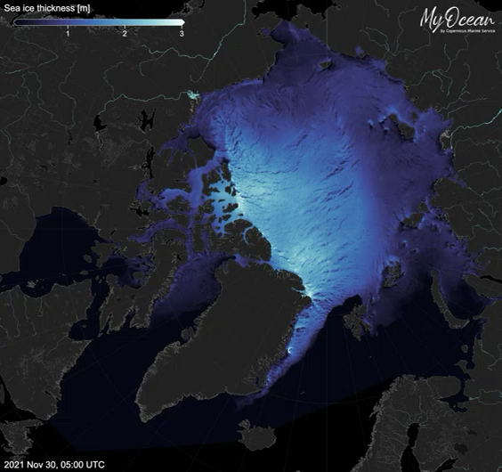
neXtSIM
Sea ice model marine. copernicus.eu

Slide 3
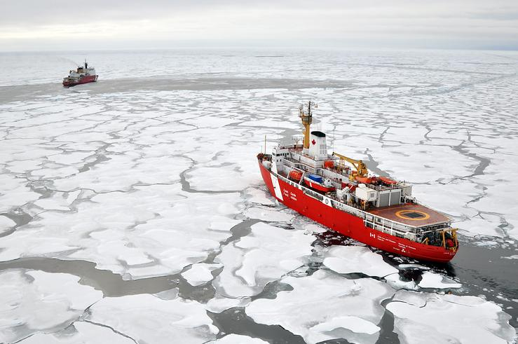
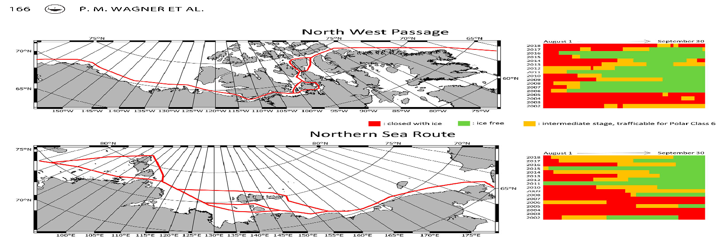
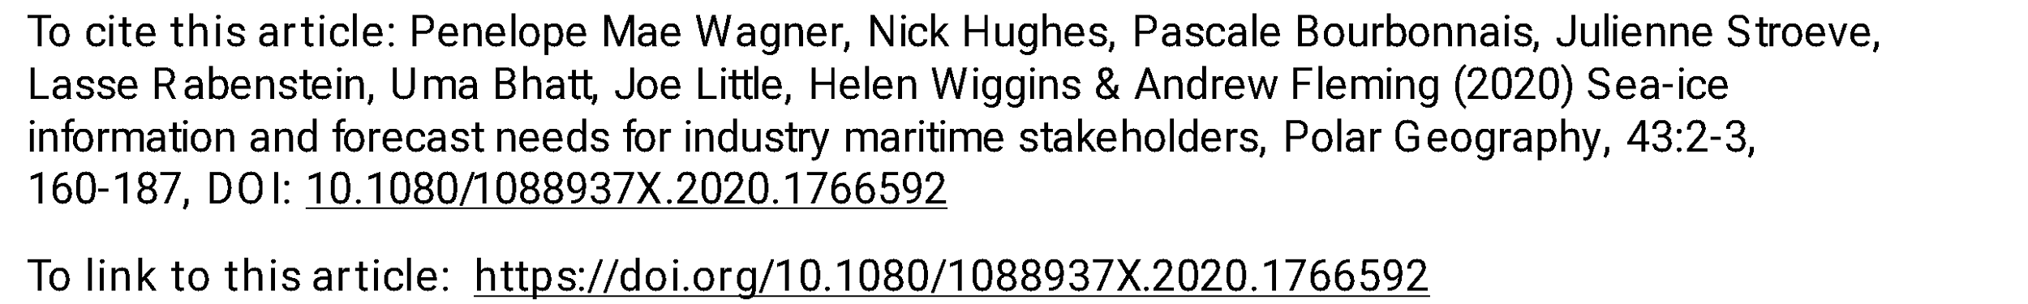
An increasingly busy Arctic Ocean
Navigation season has become longer than 20 years ago
But also more waves and treacherous seas
Users need to know how far they are from the sea ice edge
time

Slide 4
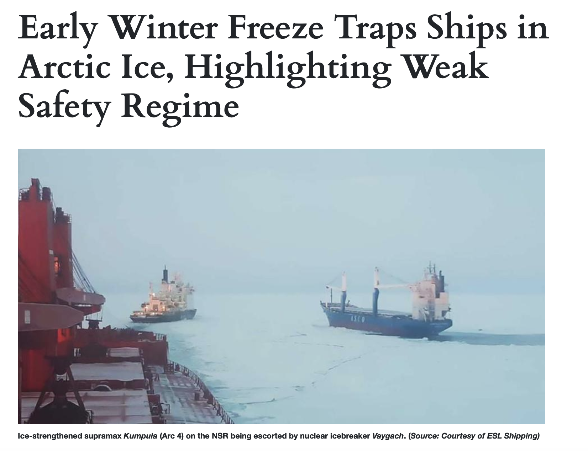
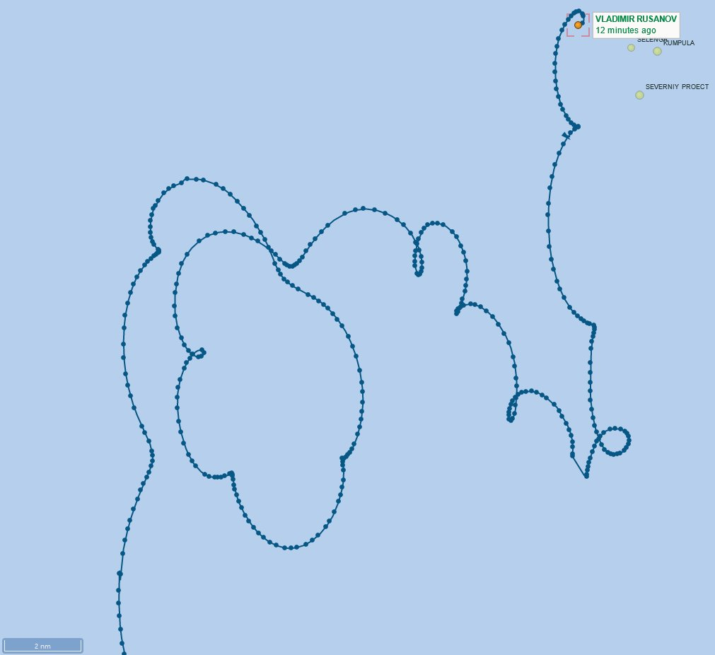
Too much anticipation …
24 ships trapped in the East Siberian Sea November 2021
They did not use any forecasts
Most expensive in situ sea ice data ever
Tweet from Aker Arctic

Slide 5
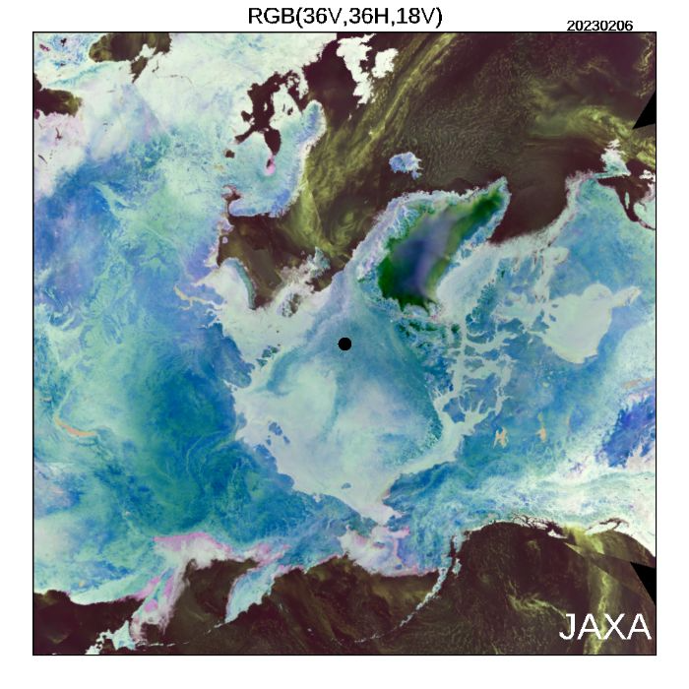
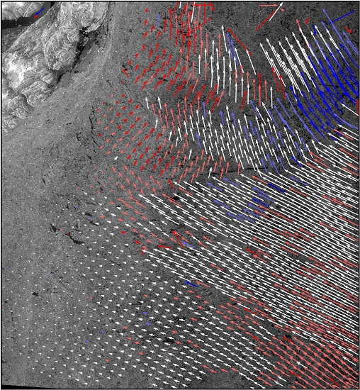
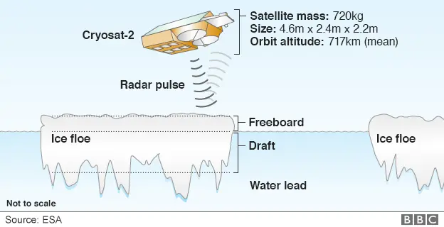
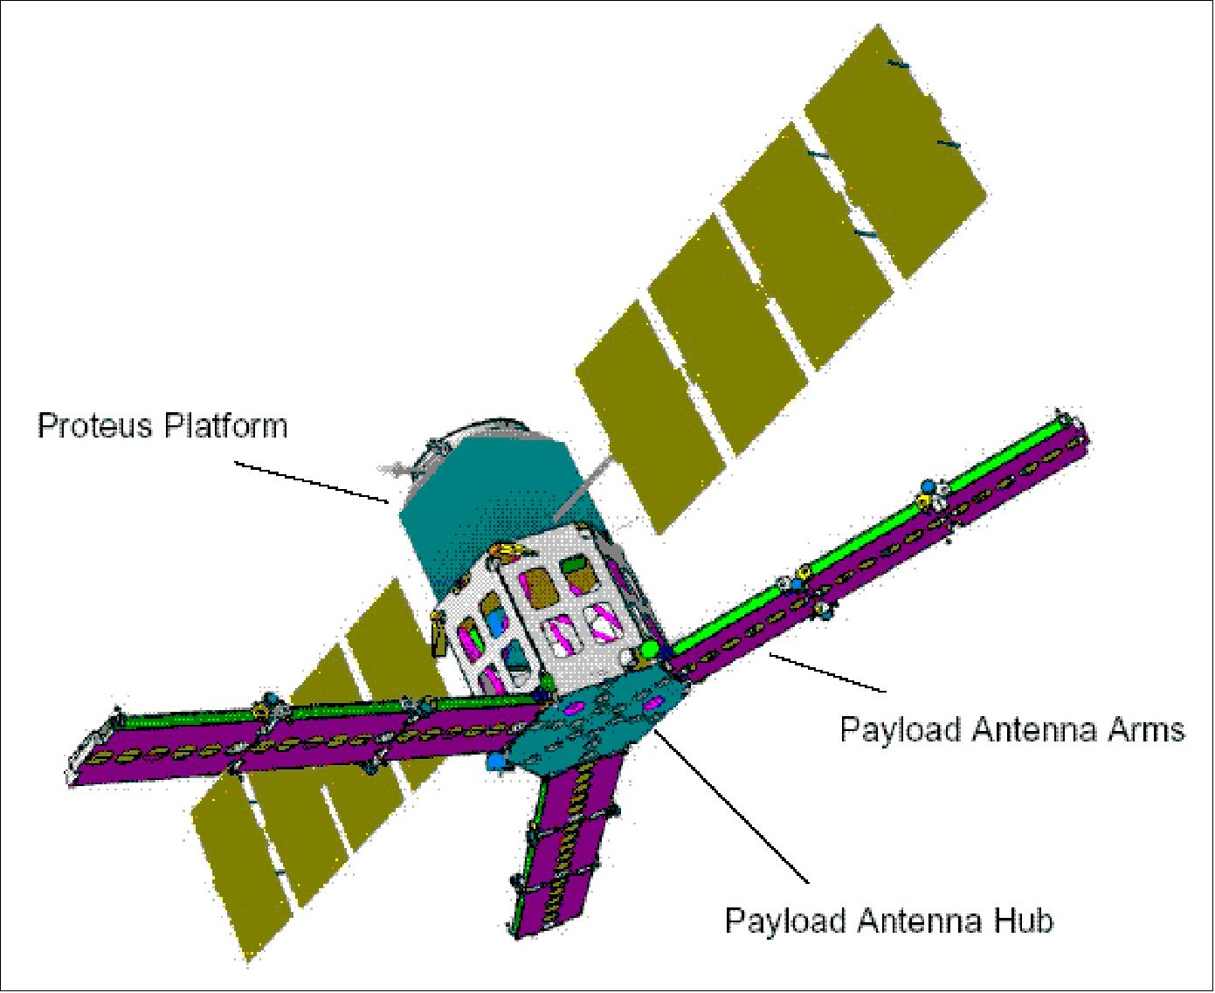
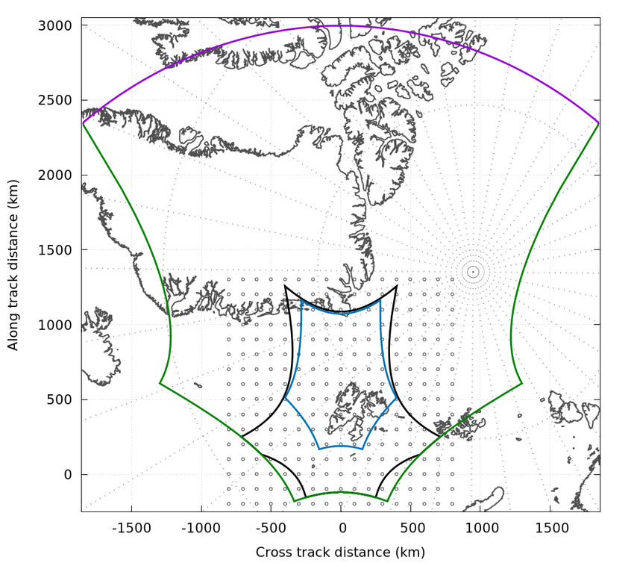
Satellite data for sea ice
Observations – d
Concentrations
Drift motions
Thickness
AMSR2
SMOS
Passive MicroWaves – 10 km
Scatterometers + Passive MW
Max. cross-covariance – 60 km
Altimeter + Passive MW
60 km

Slide 6

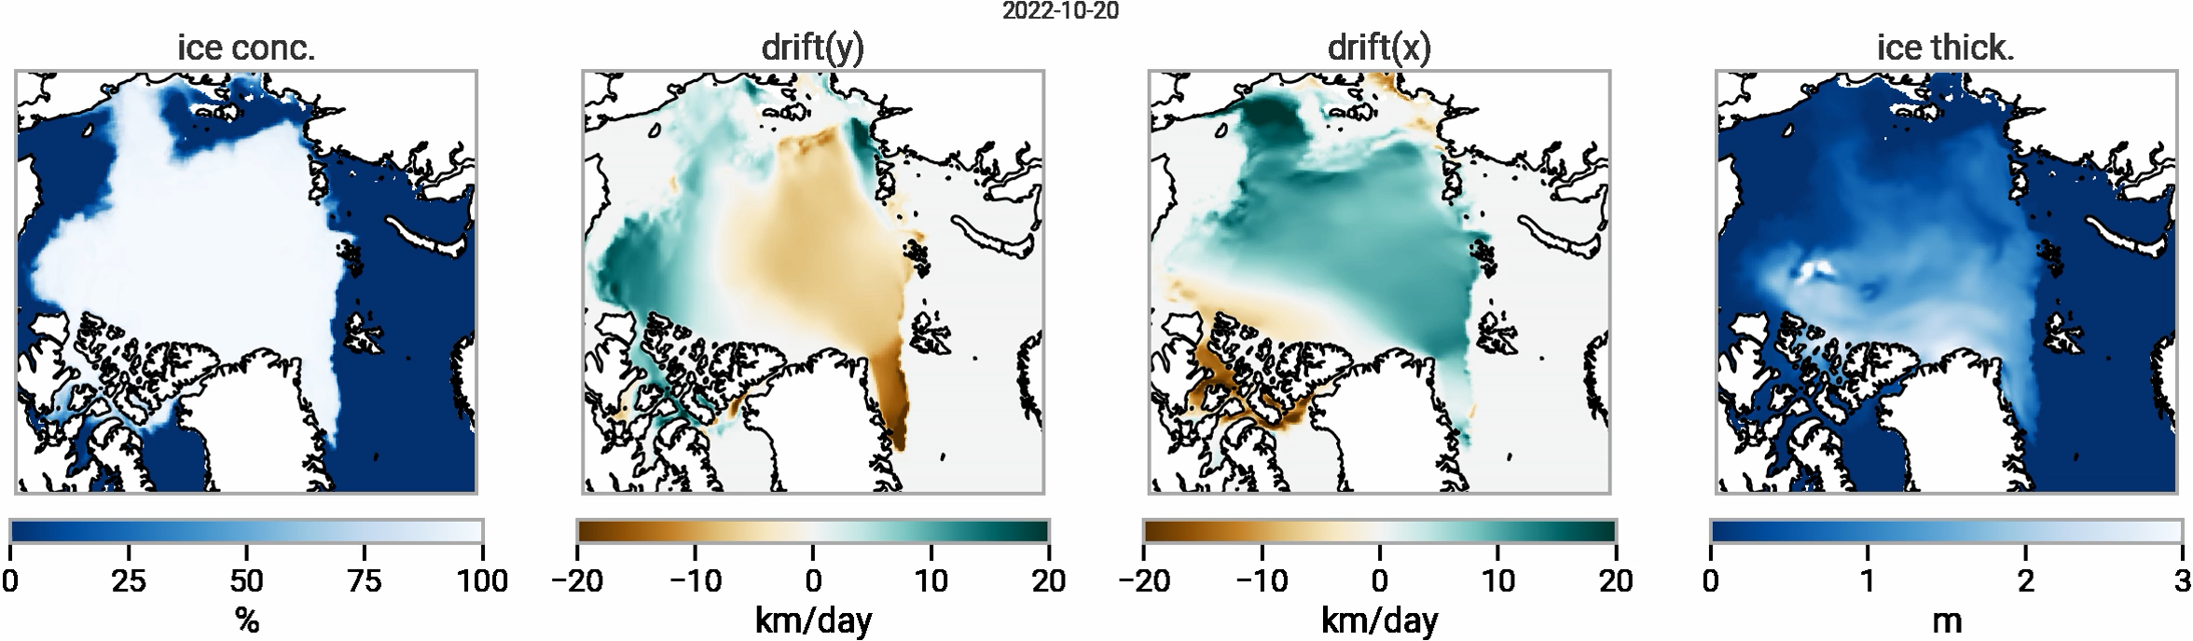
Current sea ice forecast
Modeling and DEnKF data assimilation system
Sea ice forecast are produced operationally by physical-based models.
Ex: the TOPAZ system (available on Copernicus marine) delivers every day forecast up to 10 days
Instrumental for navigation in the Arctic, search-and-rescue, oil spill contingency planning: ~5000 Monthly downloads…
Julien.Brajard@nersc.no

Slide 7
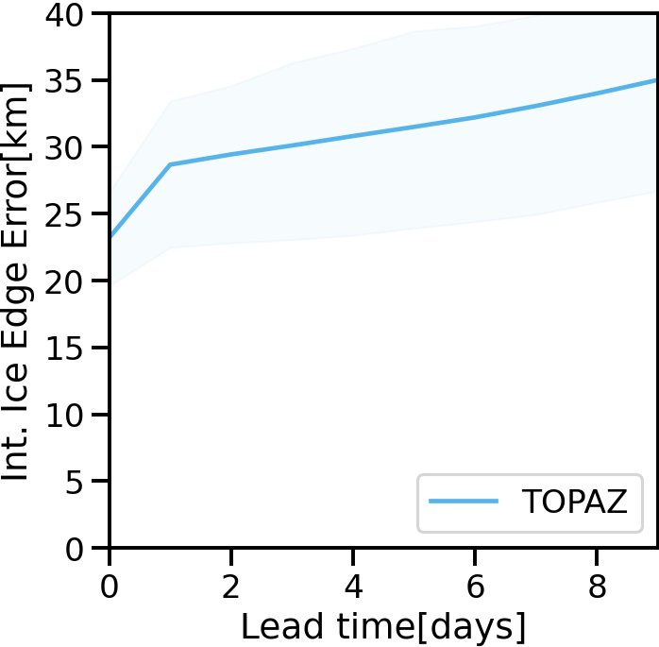
Limitations of current physical-based sea ice forecast
Biased forecast
Error in positioning the ice edge
Computational efficiency
Computation time:
12 h over 100 CPU (ocean + sea ice)
~1h30 CPUh for the sea ice only,
The rest for ocean variables
Comparison versus observations
(average 2022-2023)
Julien.Brajard@nersc.no

Slide 8

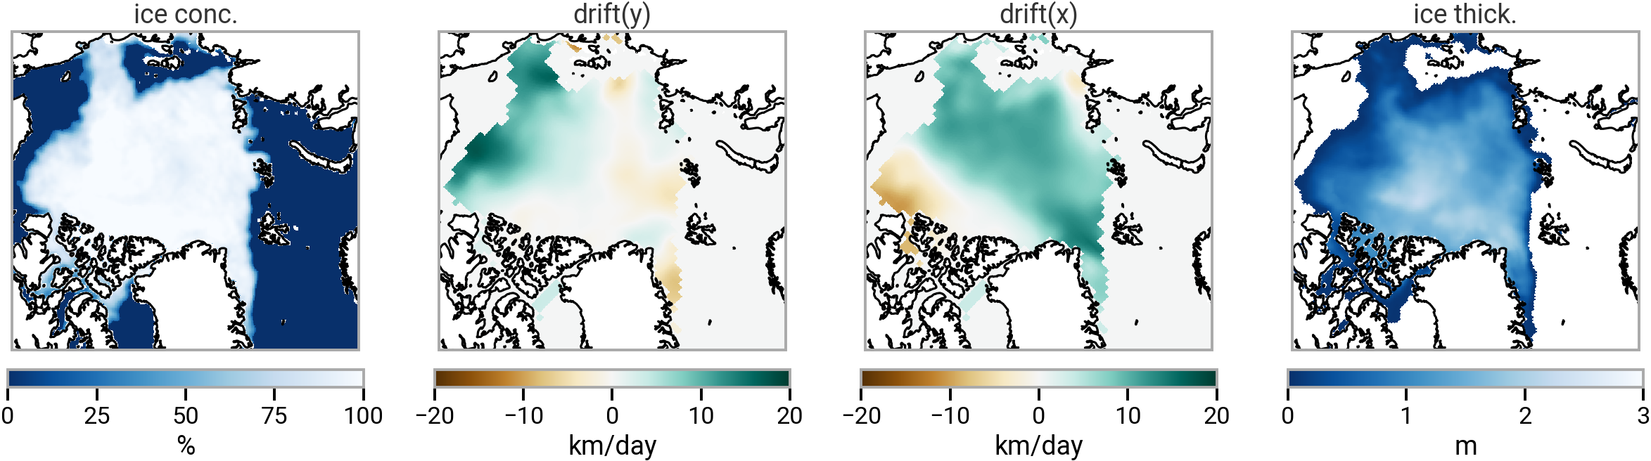
Explore the use of machine learning: IceCastNet
Biased forecast
Computational efficiency
~1h30 on multiple CPU
Unbiased forecast
Training based on satellite observations
Efficient Model
Graph Transformer
~10 sec on one GPU
From Passive Microwave satellites
From
Cryosat 2+SMOS in winter
TOPAZ Reanalysis in summer
Example from October 20, 2022
Julien.Brajard@nersc.no

Slide 9
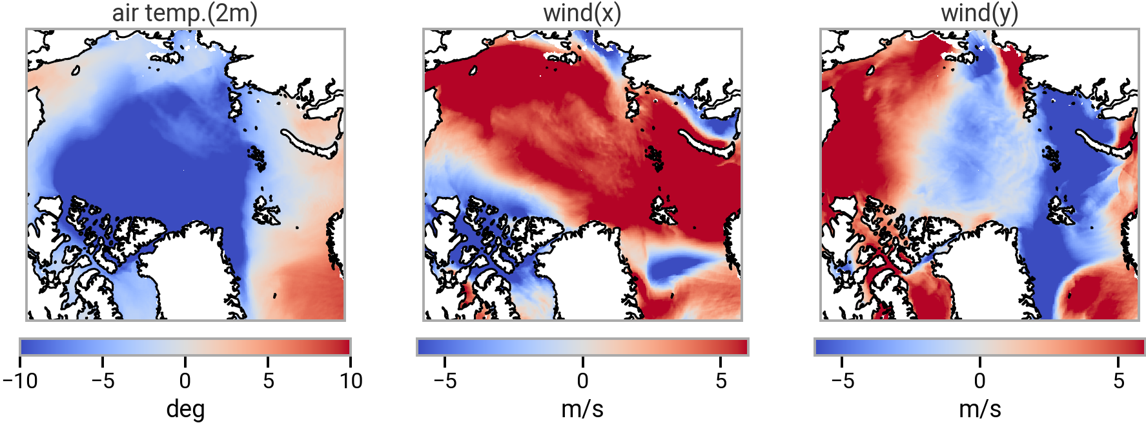
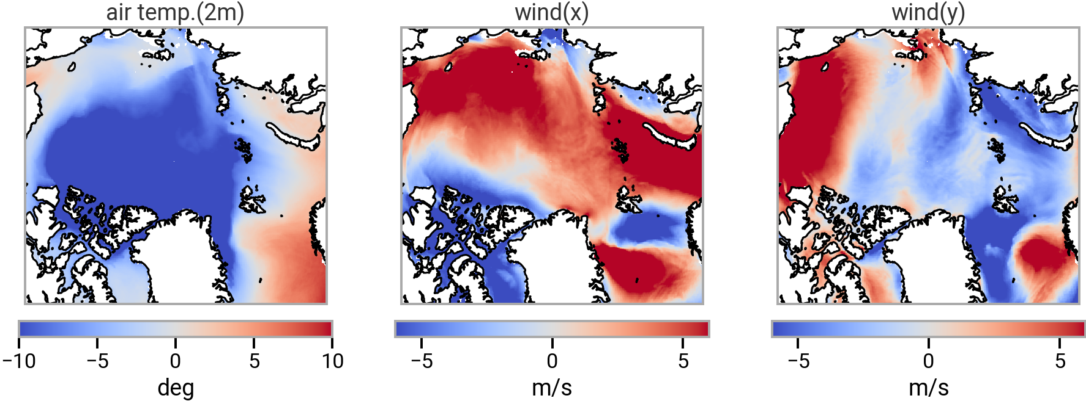
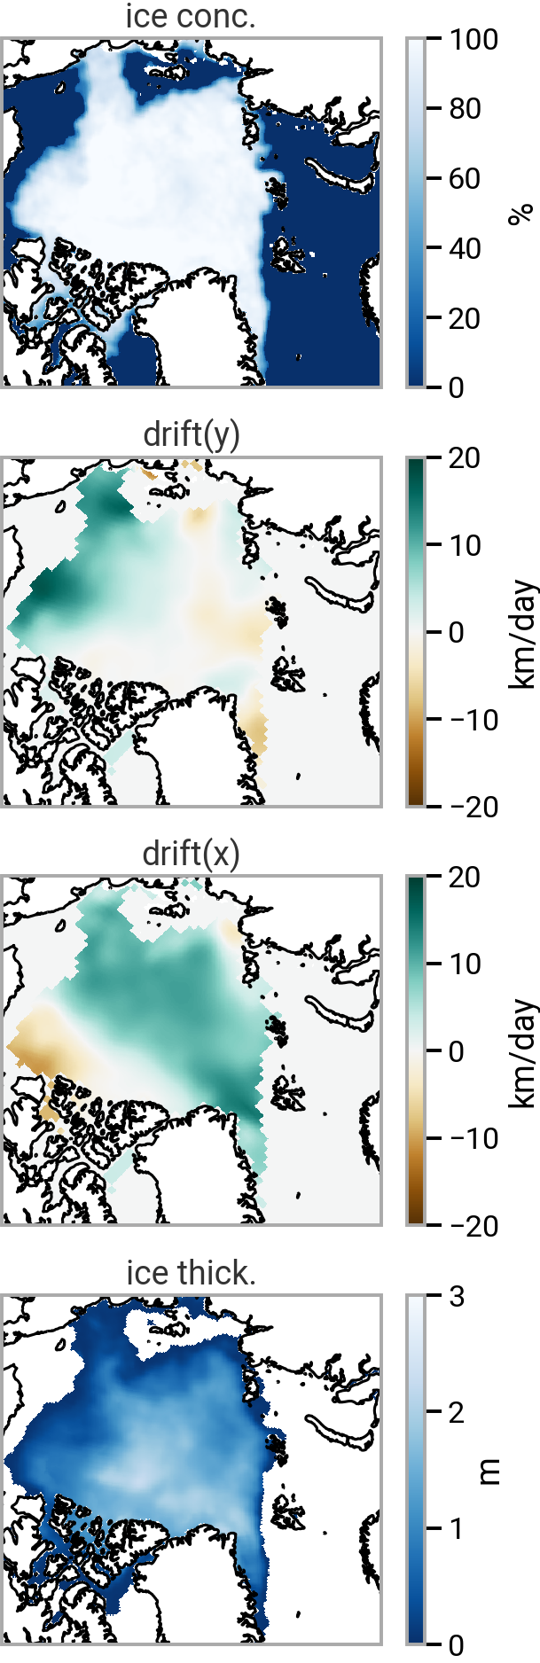
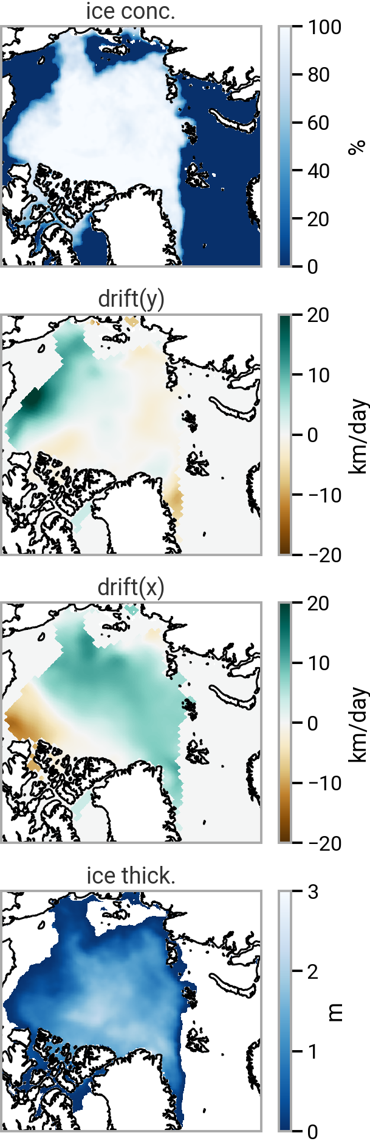
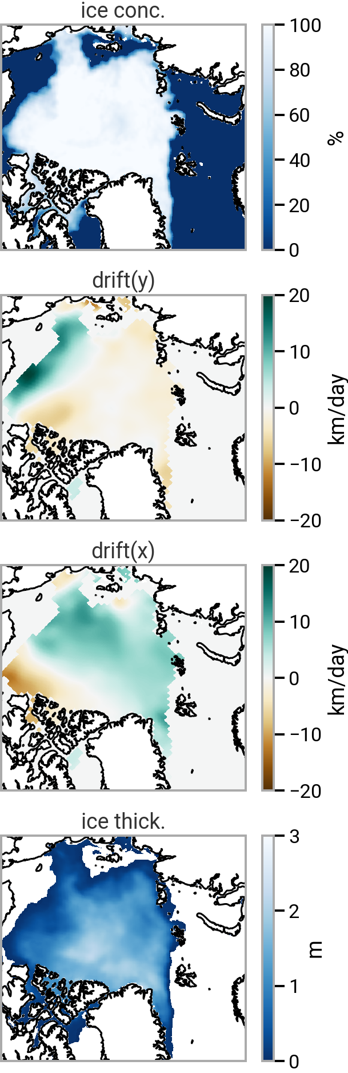

Scheme of the method
forcing
Training: 2018-2022
Evaluation: 2022-2023
Size of the model:
~87.5 millions parameters
Framework used:
state
Graph Neural Network
Graph Neural Network
Time = 0
Time = 1 day
Time = 2 days
Julien.Brajard@nersc.no

Slide 10
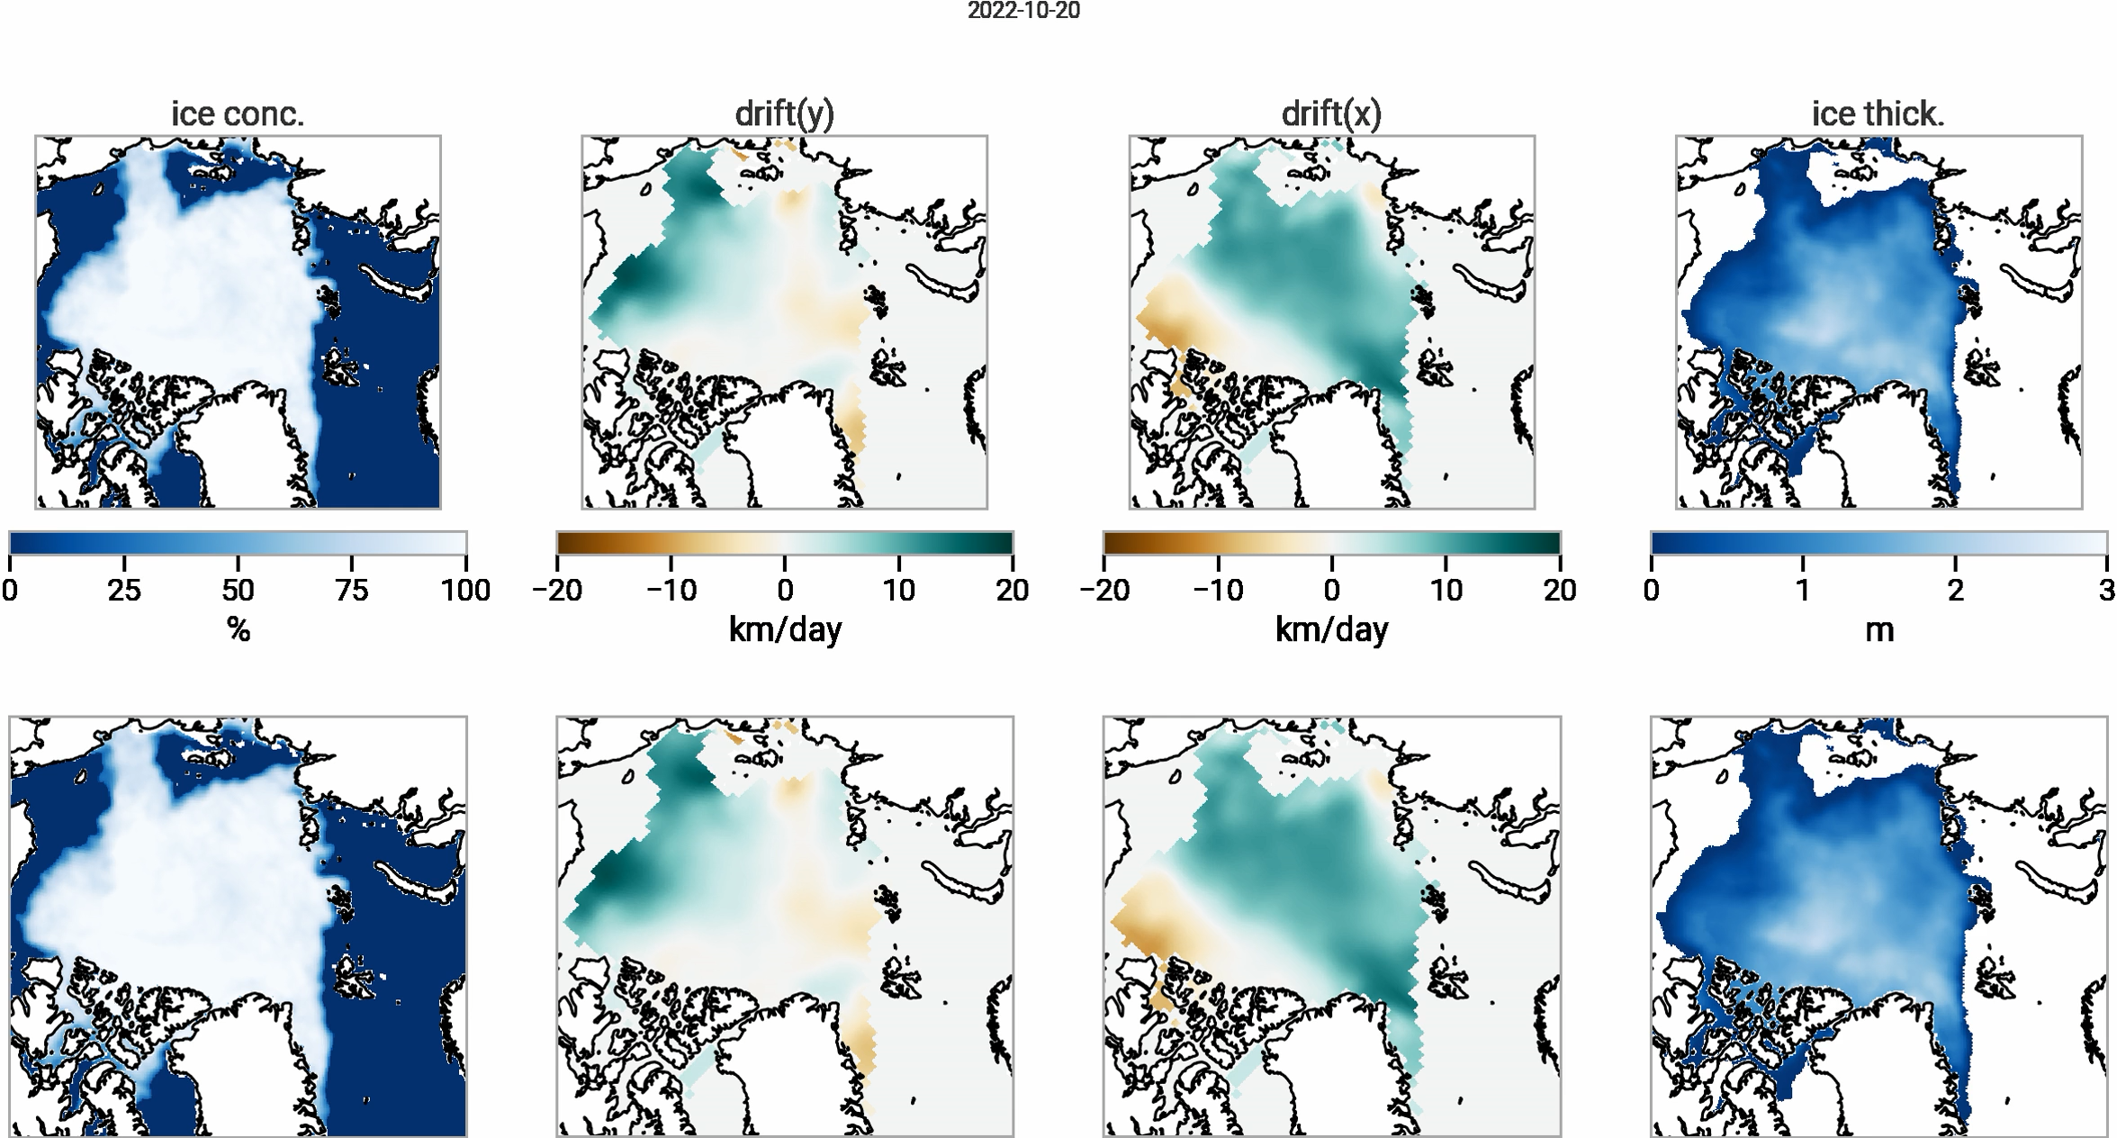
One example of result
IceCastNet forecast
Observations
Julien.Brajard@nersc.no

Slide 11
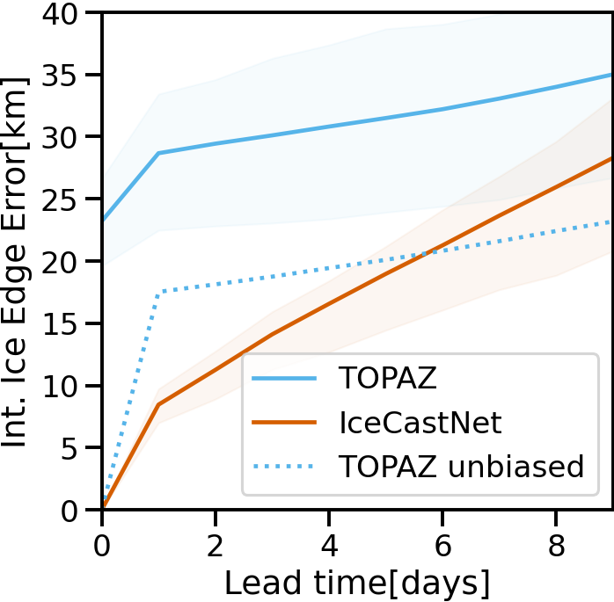
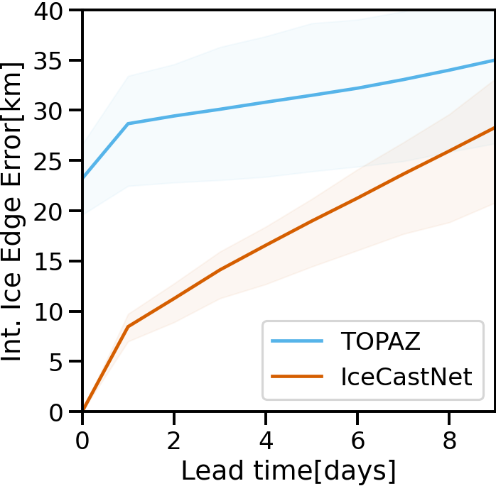
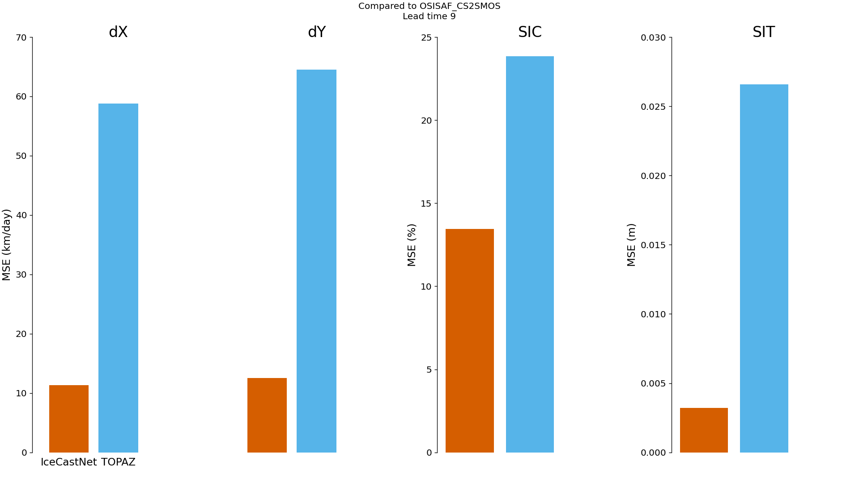
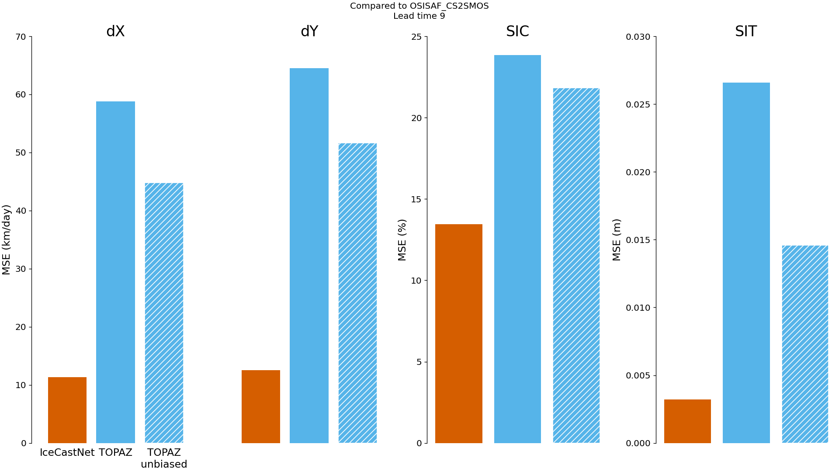
Validation with the same observational product (average over 2022-2023)
Error in positioning the ice edge
Error at Lead time: 9 days
Drift(y)
Drift(x)
Ice conc.
Ice thick.
Mean square Error
IceCastNet
TOPAZ
Julien.Brajard@nersc.no

Slide 12
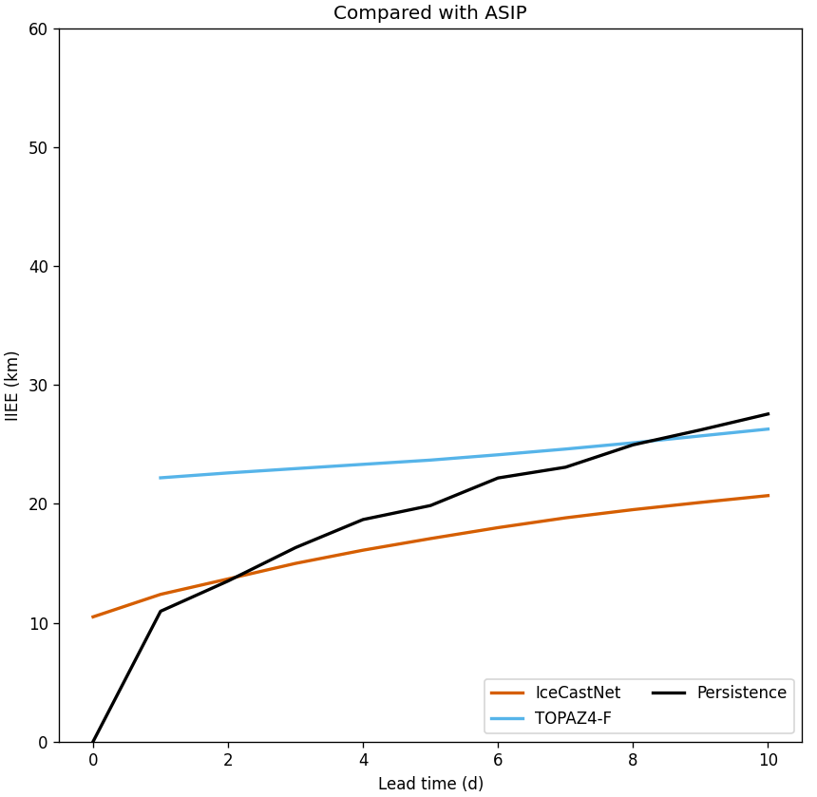
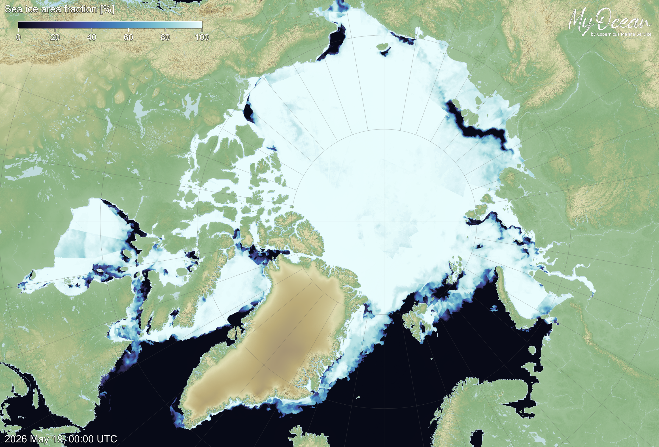
Validation using an independent products (ASIP)
Different satellites - no ground truth
ASIP (SAR)

Slide 13
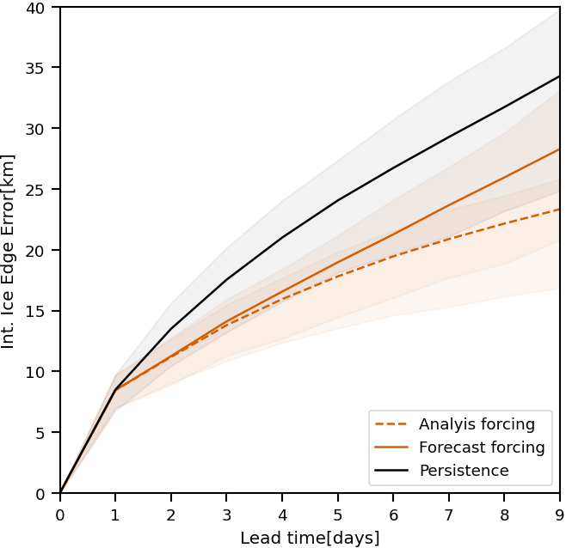
Sensitivity to the forcings
We reduce the improvement by ~50% if atmospheric forcings are forecast (less accurate) instead of analysis (more accurate)

Slide 14
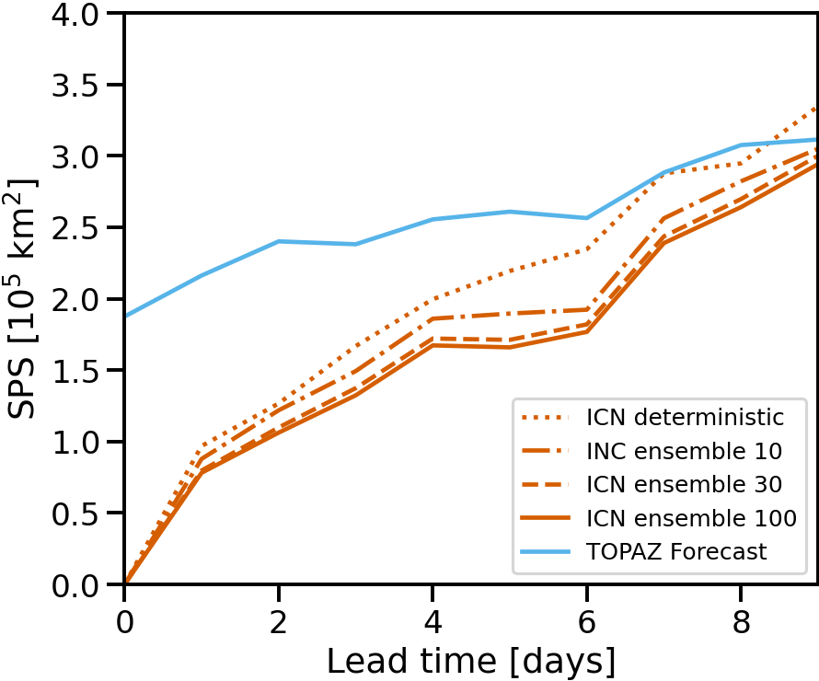
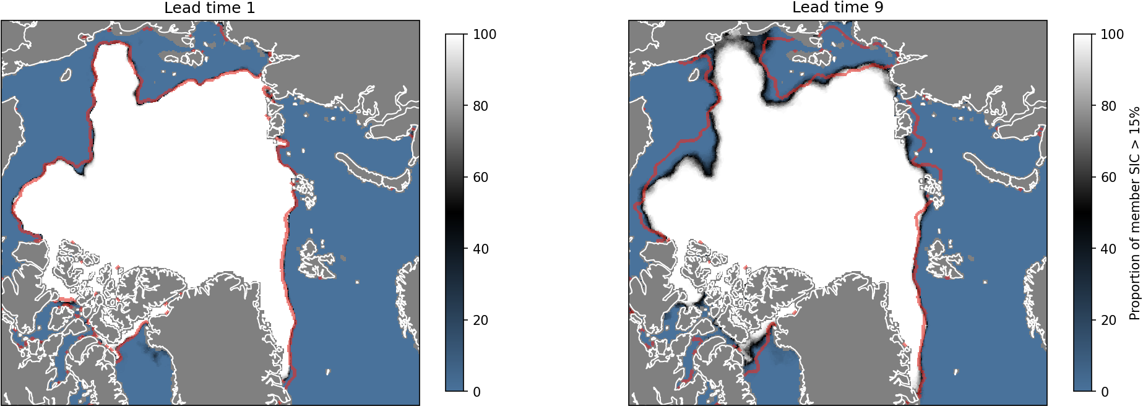
Ensemble forecast à la TOPAZ
Produce 100 forecasts:
Perturb atmosphere (randomly as in TOPAZ)
Take a few minutes on 1 GPU
SPS: Spatial Probability Score
(lower is better)

Slide 15
Higher resolution – learning from a model?
Next step
Train a diffusion model
Apply to the numerical model
Apply to the satellite data

Slide 16
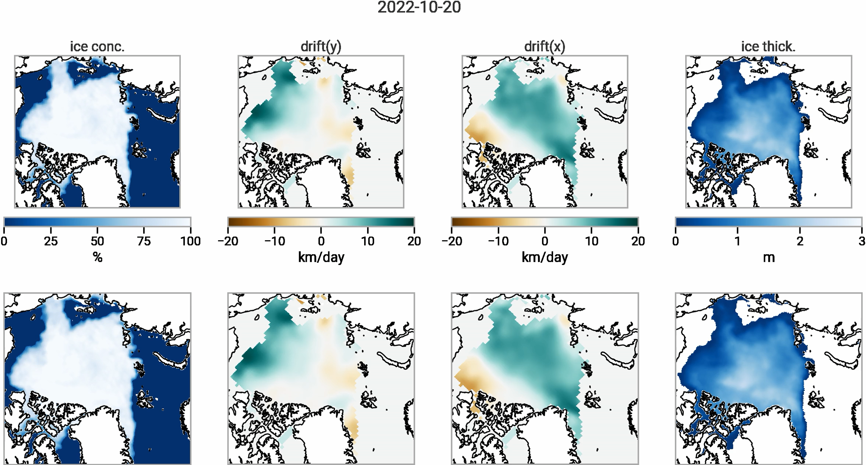
Conclusion
IceCastNet is a data-driven model simulating sea ice concentration, thickness and drift
IceCastNet is trained (almost) exclusively from observational dataset and is forced by atmospheric forecast
Over a lead time of 10 days, IceCastNet is faster (10 sec Vs 1h30) and less biased than the the operational physics-based model (compared with observations)
IceCastNet runs at the same resolution as the observations (e.g. ~100km for thickness)
Check preprint in https://egusphere.copernicus.org/preprints/2026/egusphere-2026-2318/
IceCastNet is stable over long runs
IceCastNet forecast
Observations
TODO: stochastic, super-resolution, run operationally
Julien.Brajard@nersc.no

Slide 17
Push the limits?
Run over 3 months, forced by meteorological analysis.
Running time (on 1 GPU): 1m15s
IceCastNet forecast
Observations
Julien.Brajard@nersc.no

Slide 18
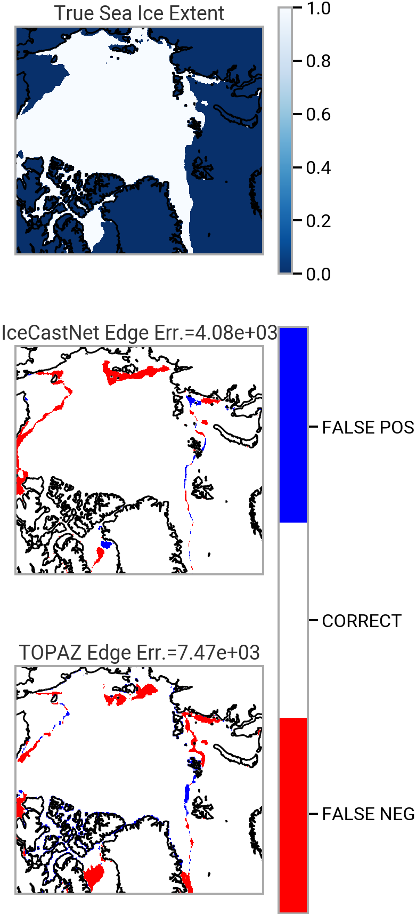
Validation with observational product (average over 2022-2023)
Error in positioning the ice edge
Example of October 20th 2022
Lead time: 9 days
(sea ice conc. > 15%)
Lead time: 9 days
Drift(y)
Drift(x)
Ice conc.
Ice thick.
Mean square Error
Julien.Brajard@nersc.no

