Slide 1





Creating Good Ensembles for
High-Resolution Data Assimilation
Max Frei (TU Delft + Whiffle) Stephan de Roode (TU Delft) Femke Vossepoel (TU Delft) Harm Jonker (Whiffle)
& contributions from Steven Knoop (KNMI)

Slide 2
Outline
Introduction to the numerical model and observations
Data Assimilation Method – LETKF
Study Motivation – Objectives – Approach
A case-study
Results + Conclusion

Slide 3
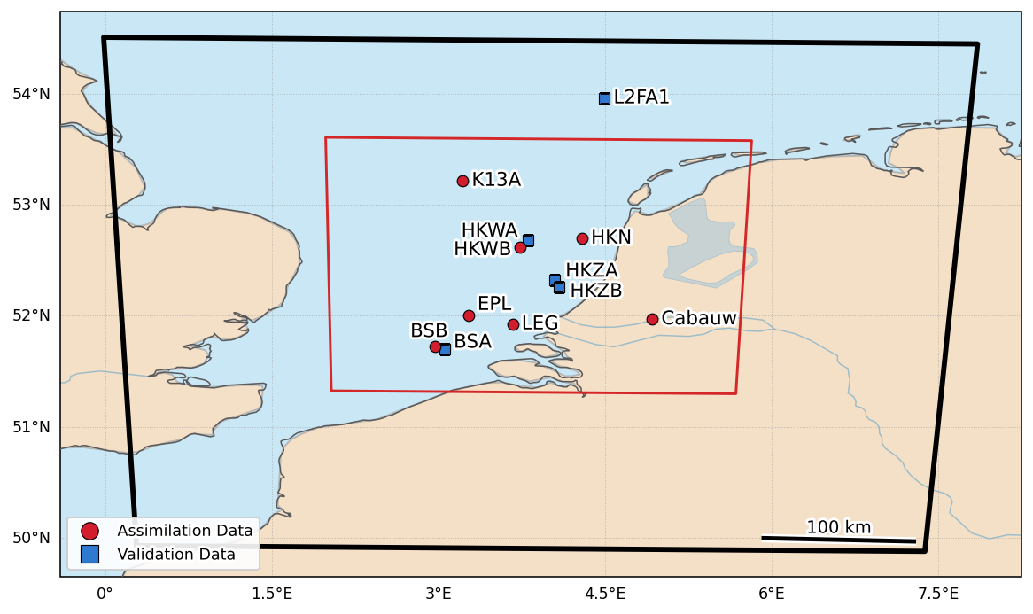
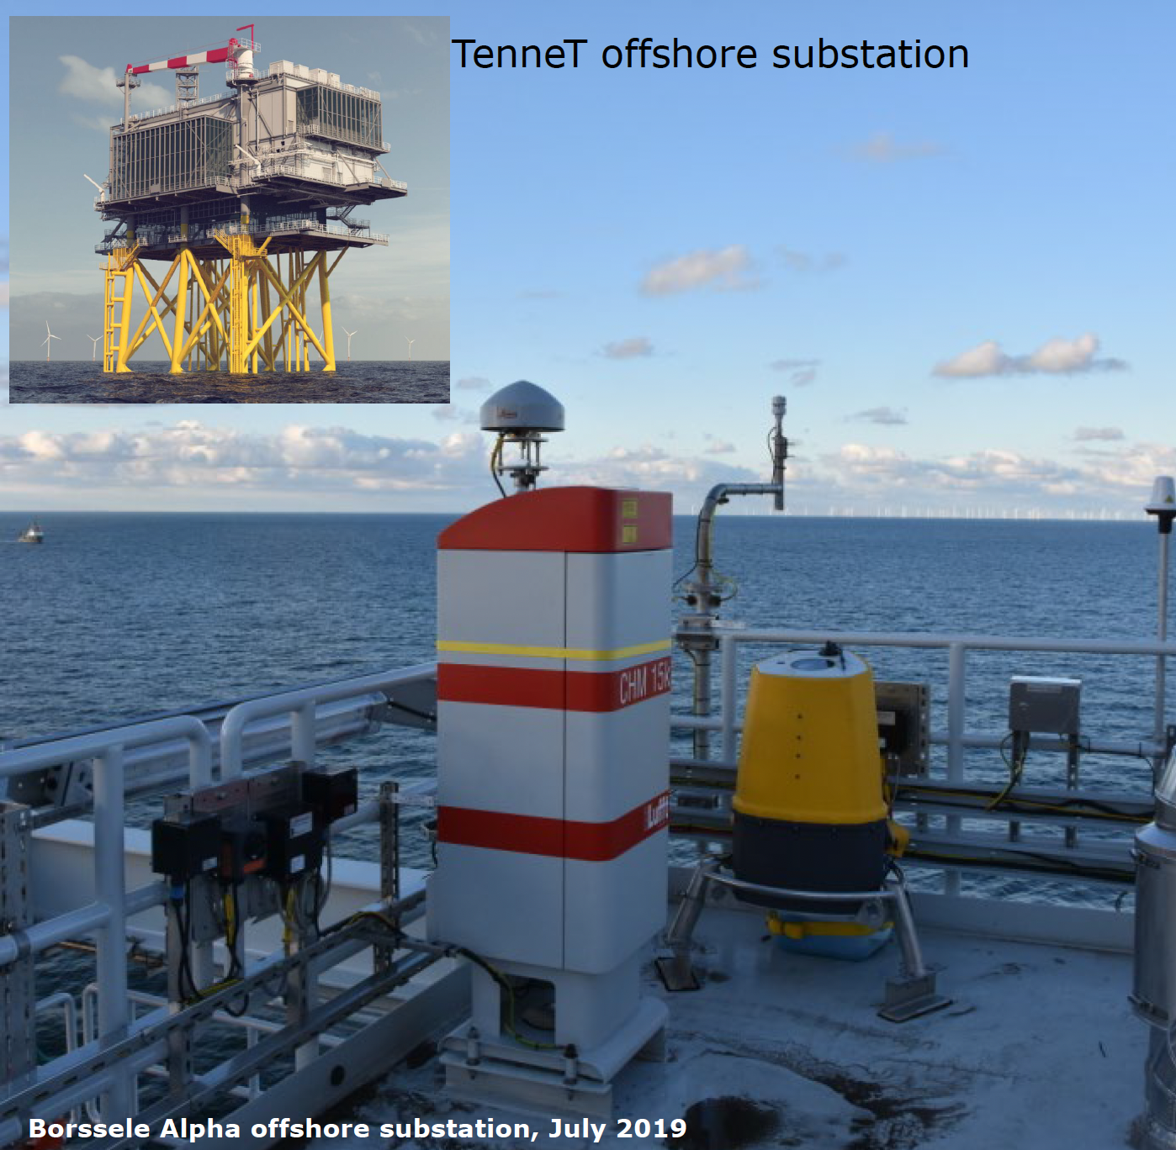
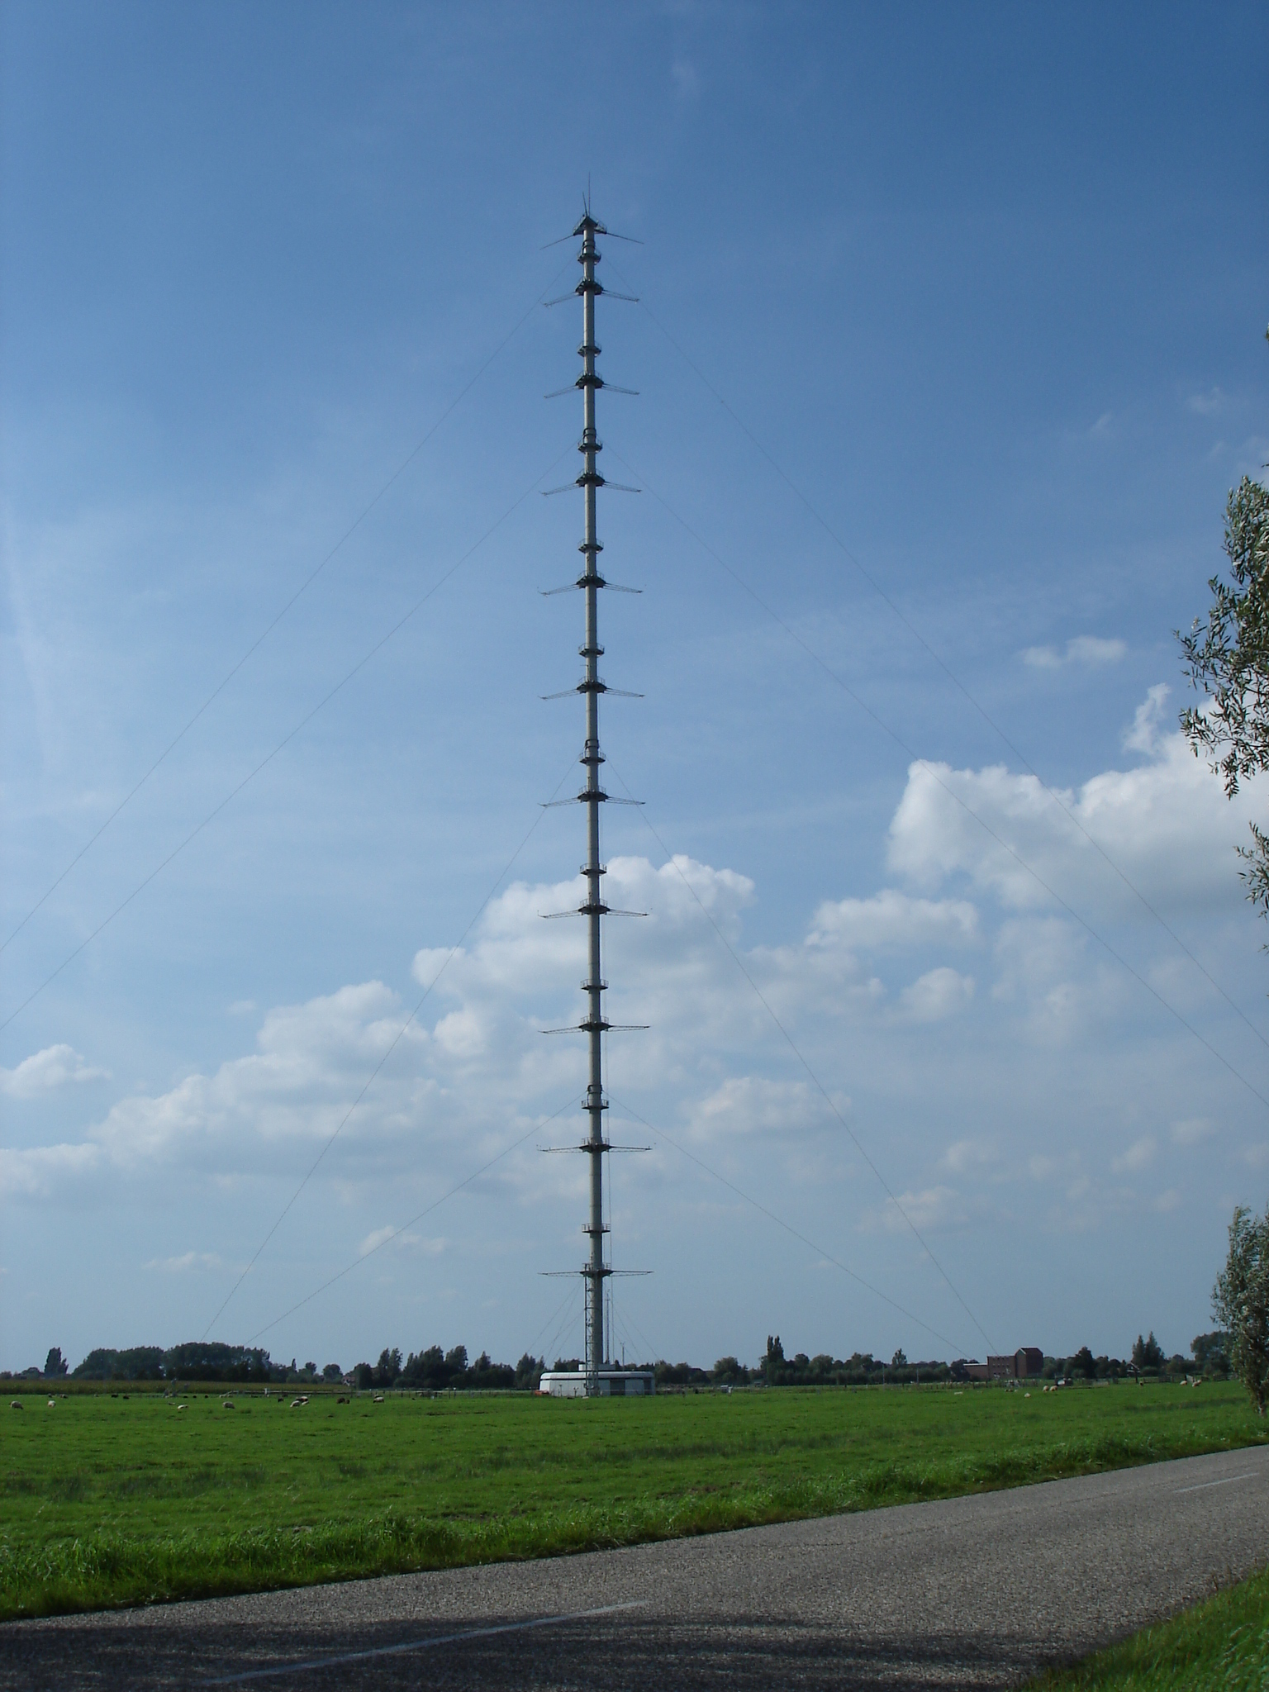

Limited-area Model
High-resolution Model by
  $Δx: 2km$
  Outer domain (512 x 512km)
  Inner domain (256 x 256km) → Data Assimilation
Boundary Conditions derived from a global model!
Split of Assimilation and Validation Observations
Observations
Wind-profile observations:
  10 North-Sea LiDARs
  Cabauw MetMast
Observations:
  Wind Speed & Direction
  Observation are 10min-averaged
  Observation Error: 0.5 m/s
Courtesy: Steven Knoop, KNMI

Slide 4





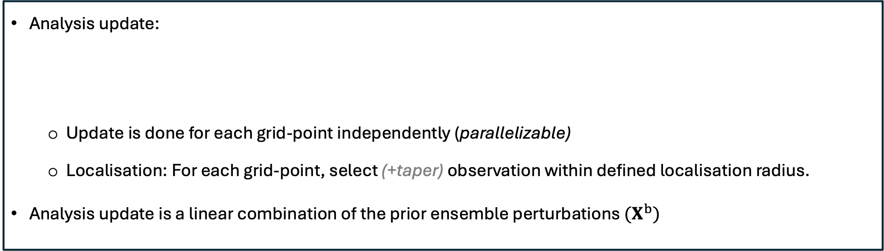

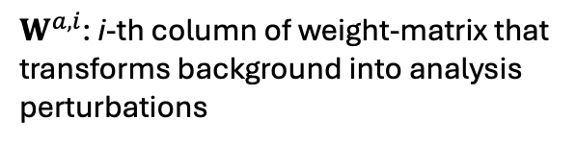

LETKF – A deterministic square root EnKF
(Hunt et al. 2007)
(Schraff et al. 2016)
Analysis update:
  Update is done for each grid-point independently (parallelizable)
  Localisation: For each grid-point, select (+taper) observation within defined localisation radius.
Analysis update is a linear combination of the prior ensemble perturbations ${(X}^{b})$
$\overline{w^{a}}$: Analysis mean weights
$W^{a,i}$: i-th column of weight-matrix that
transforms background into analysis
perturbations
$$x^{a,i}=\overline{x^{b}}+X^{b}(\overline{w^{a}}+W^{a,i})$$
State Vector $x$:
u- and v- wind components
4D-formulation:
  At analysis time, use ALL local observation that lie within DA-window.

Slide 5
Study Objectives
To use Ensemble DA methods, we have to create an initial ensemble
After initialisation, the EnKF undergoes a spin-up (burn-in) phase, during which:
  the ensemble mean approaches the true atmospheric state
  ensemble perturbations adapt to the “errors of the day”
The ensemble generation strategy, determines the length and quality of this spin-up phase
(Kalnay and Yang 2010)
(Zupanski et al 2006)
→ Research question:
What is a successful ensemble generation method for limited-area data assimilation?
Study Approach
Implement 5 “traditional” ensemble generation methods.
Compare them based on many identically set-up case-studies

Slide 6
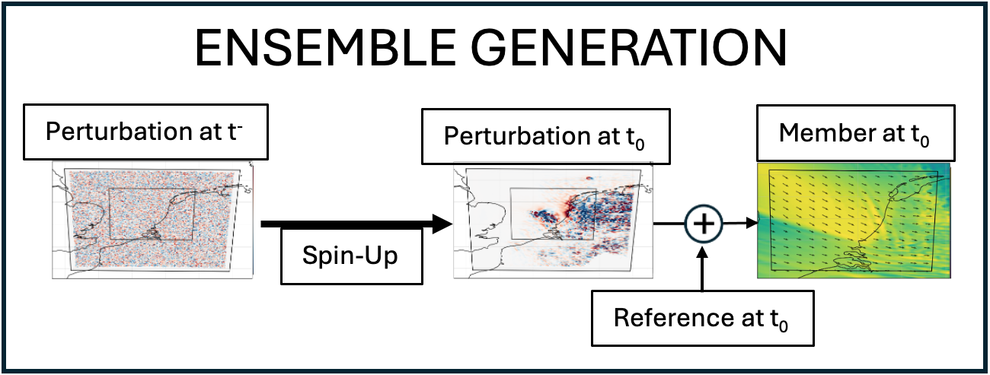
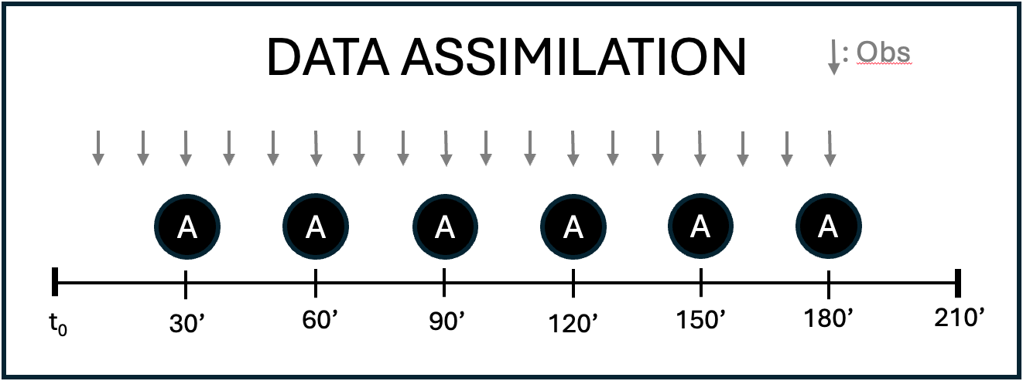
Case-study Design
Ensemble Size | 20
Localisation Radius | 50 km
Multiplicative Inflation | 1.1
RTPP (⍺) | 0.75
Ensemble Generation
  Create perturbation field
  Spin-Up perturbation field using the numerical weather model
Data Assimilation
  Sequential DA with 6 windows a 30min each
  Use all observations within window (4D-LETKF)
2

Slide 7
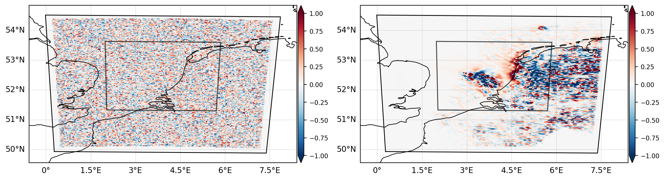
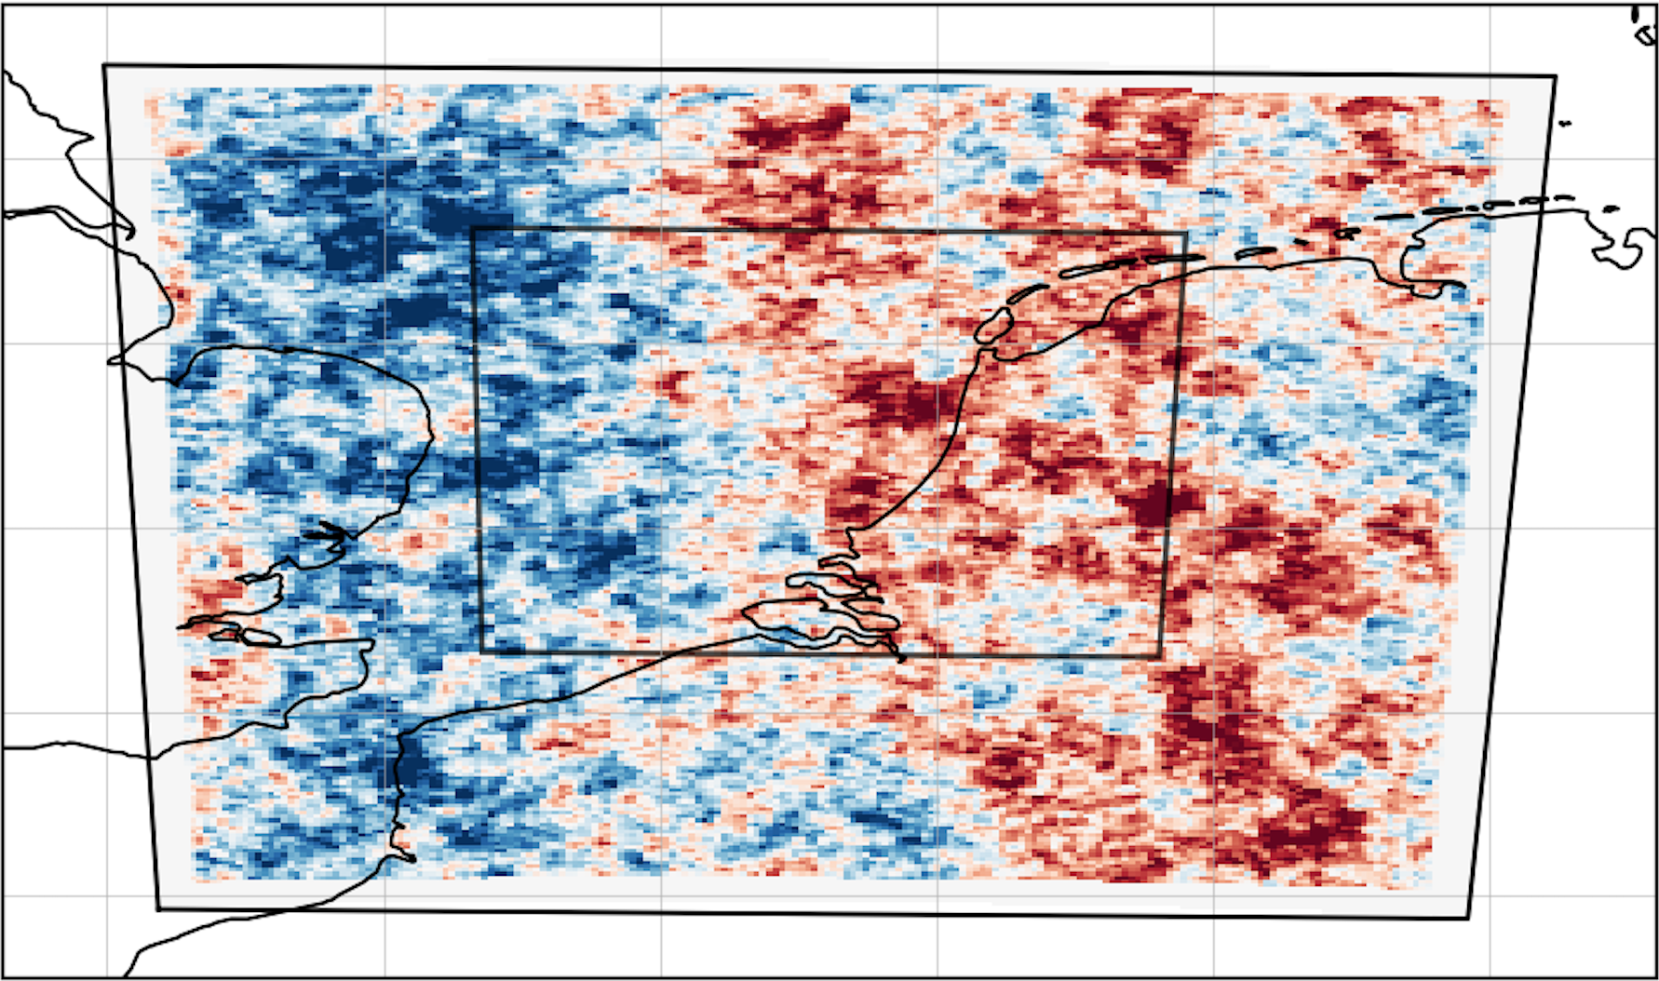
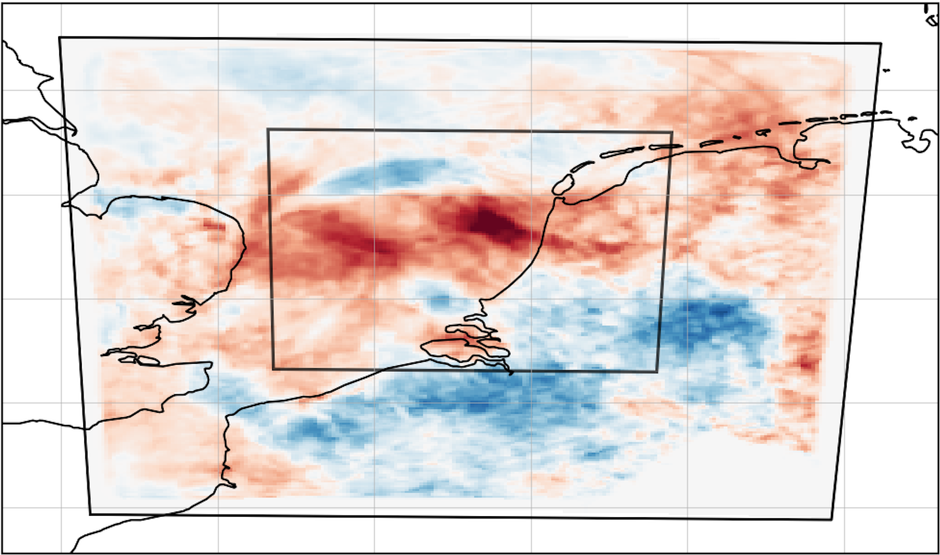
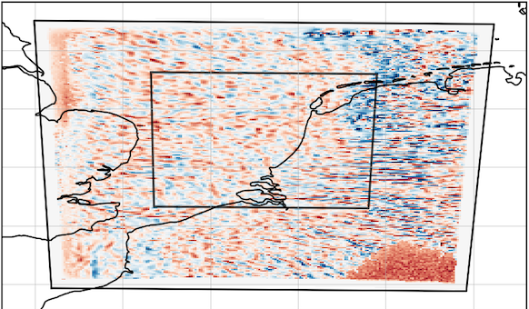
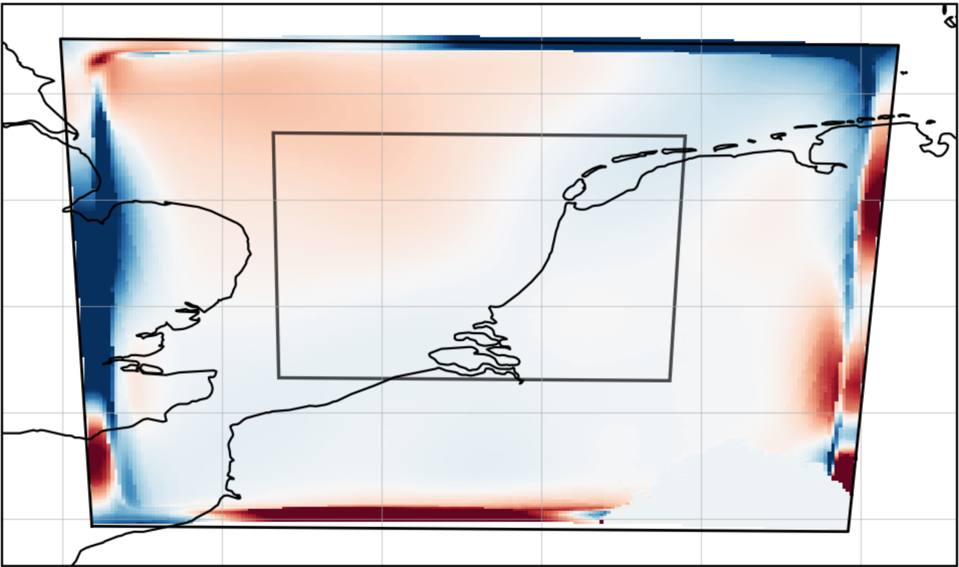
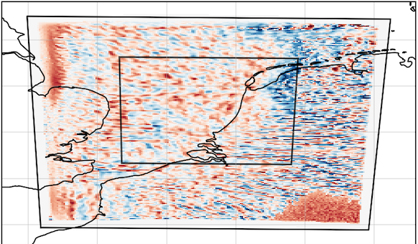
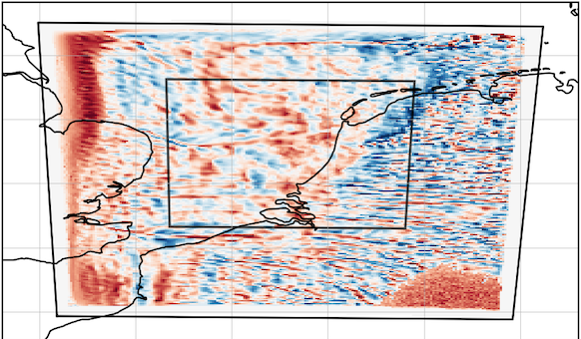
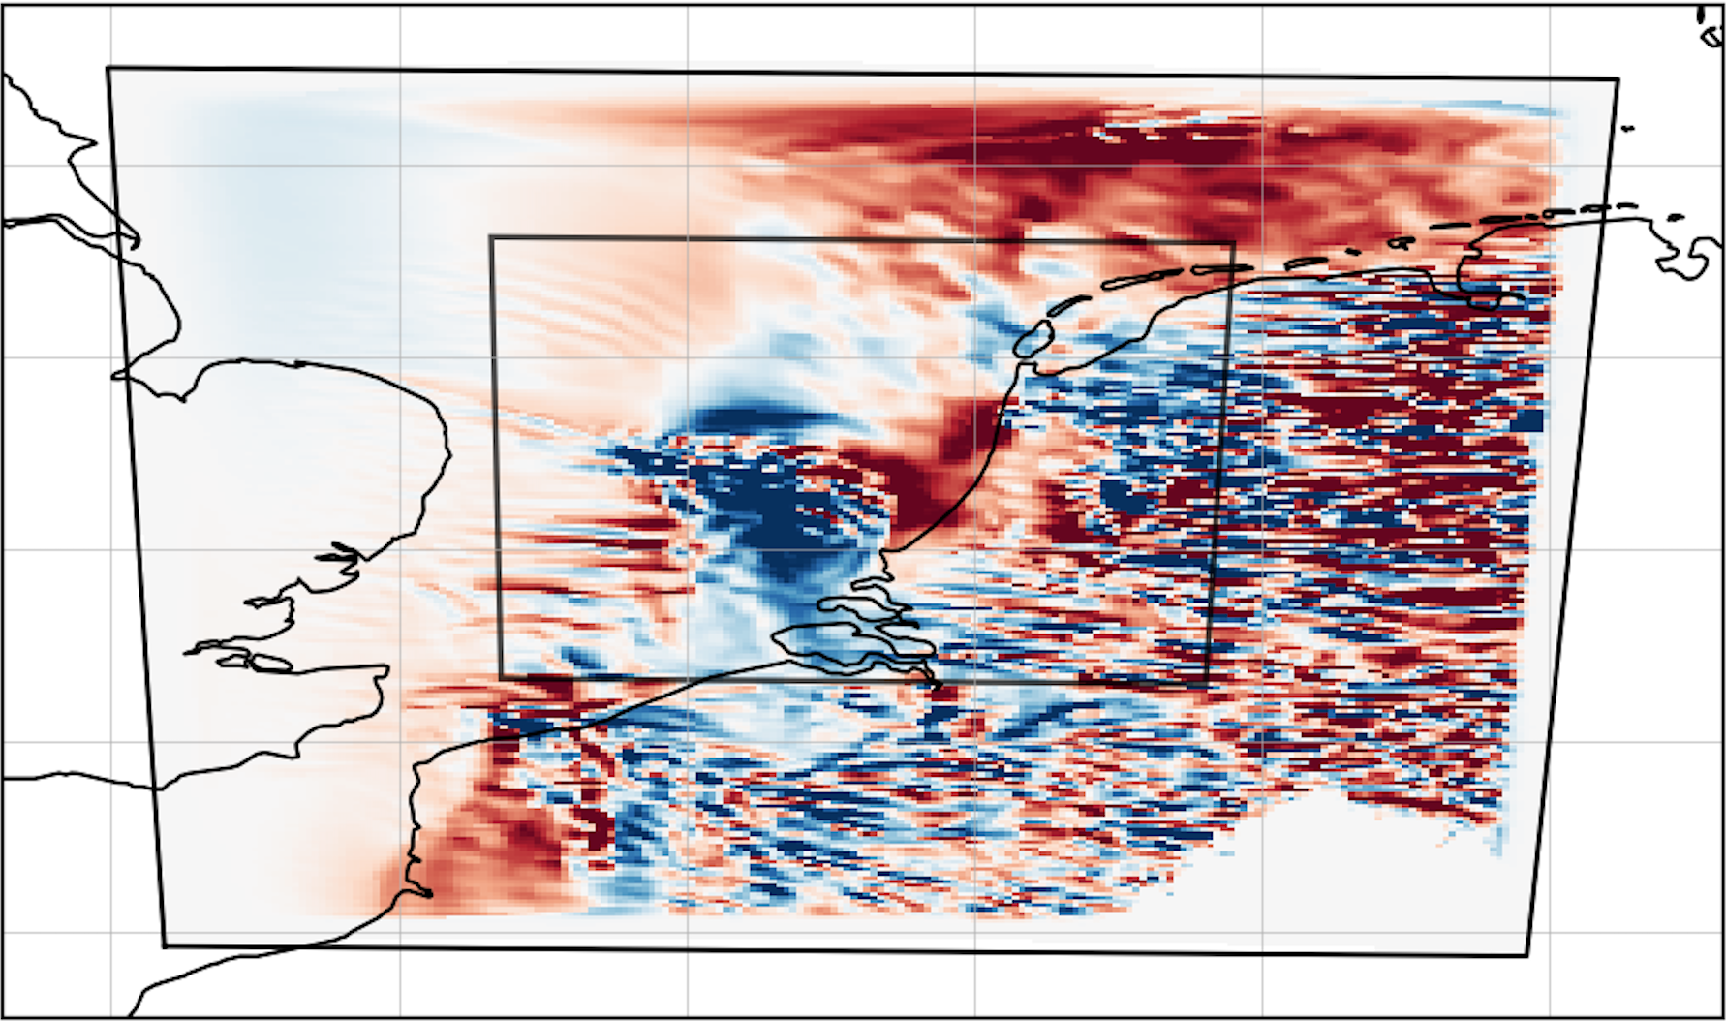
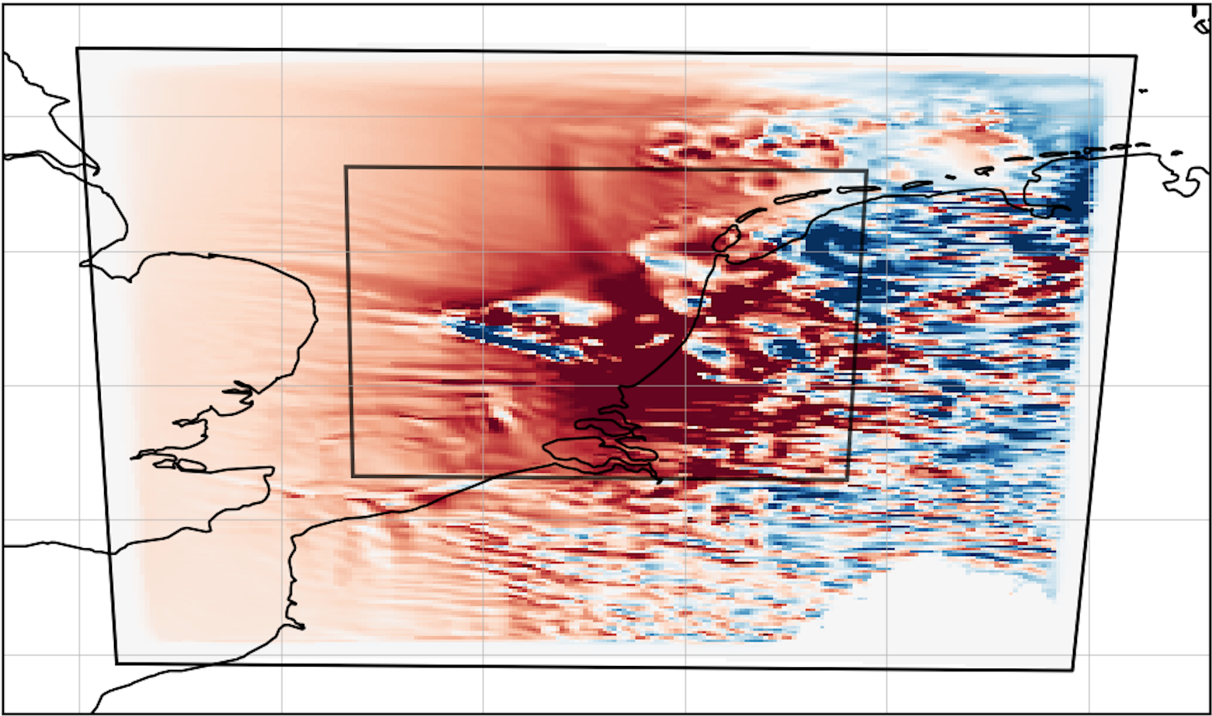
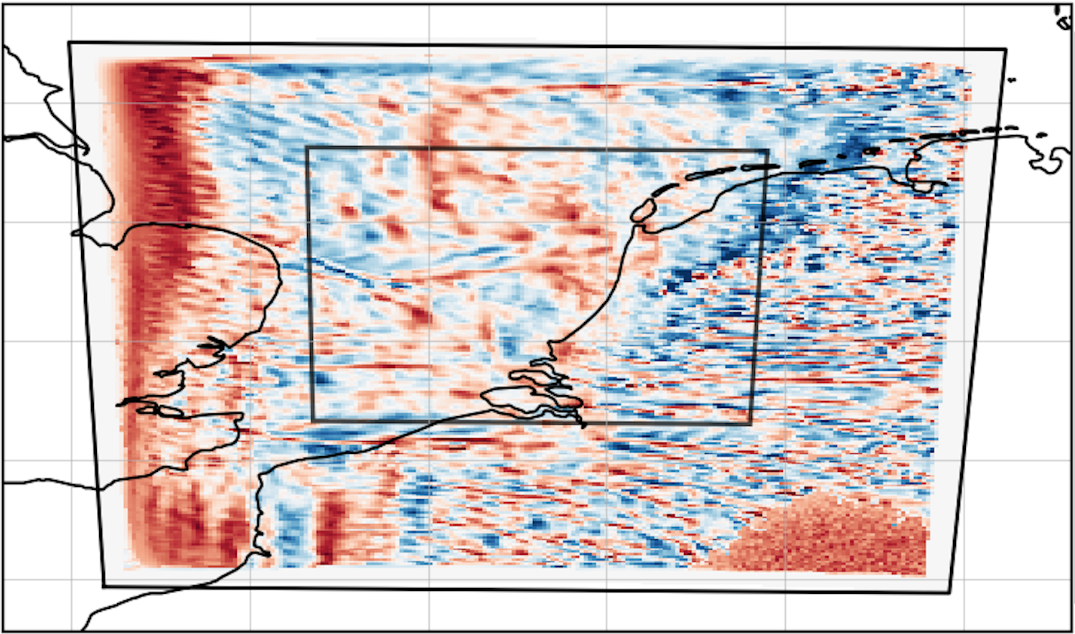
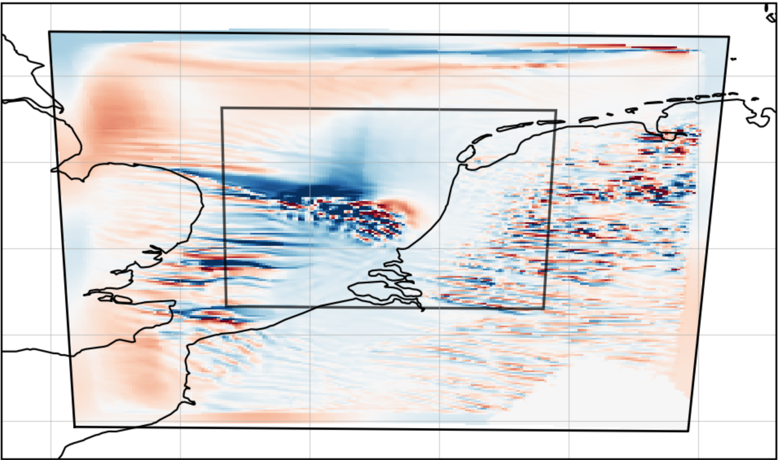
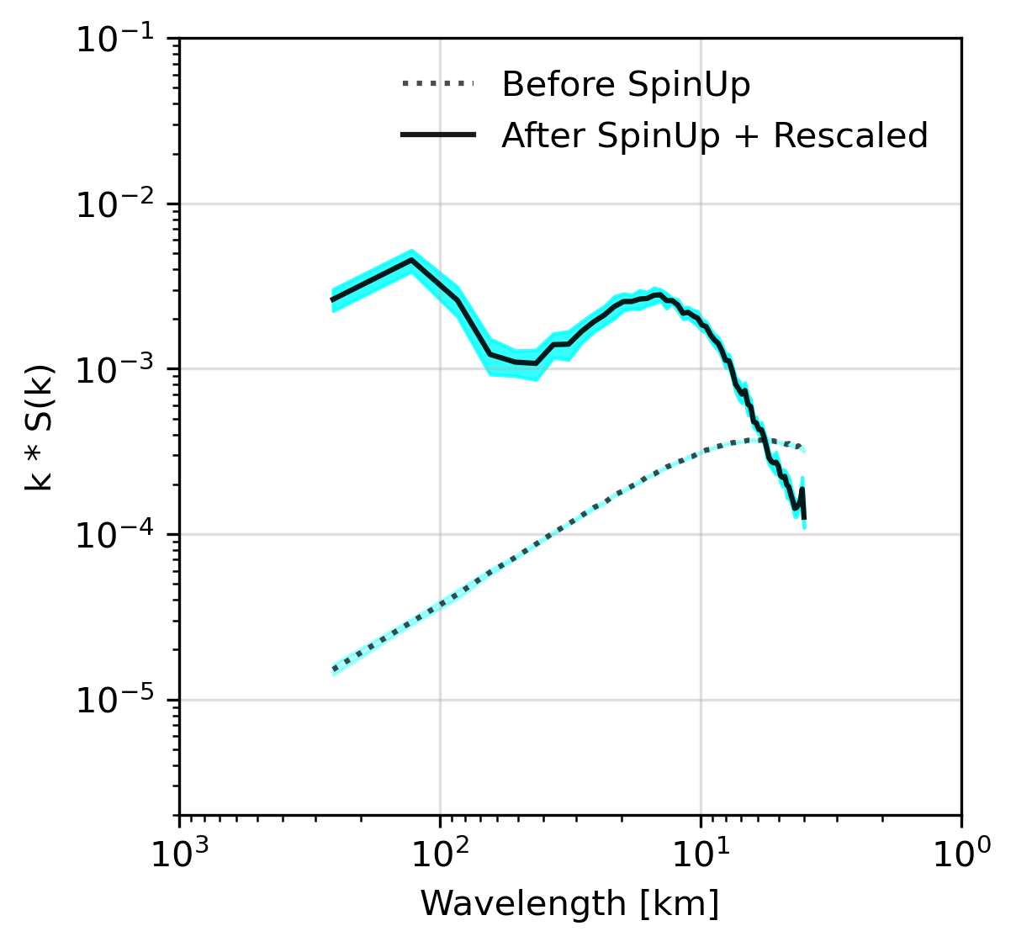
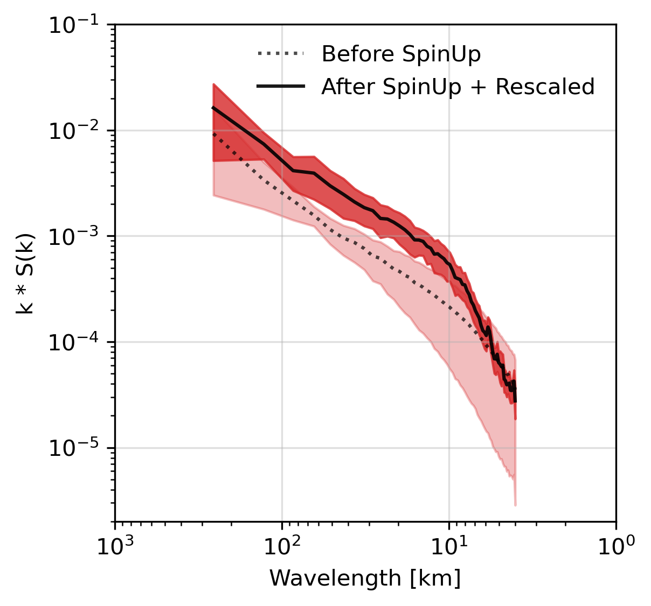
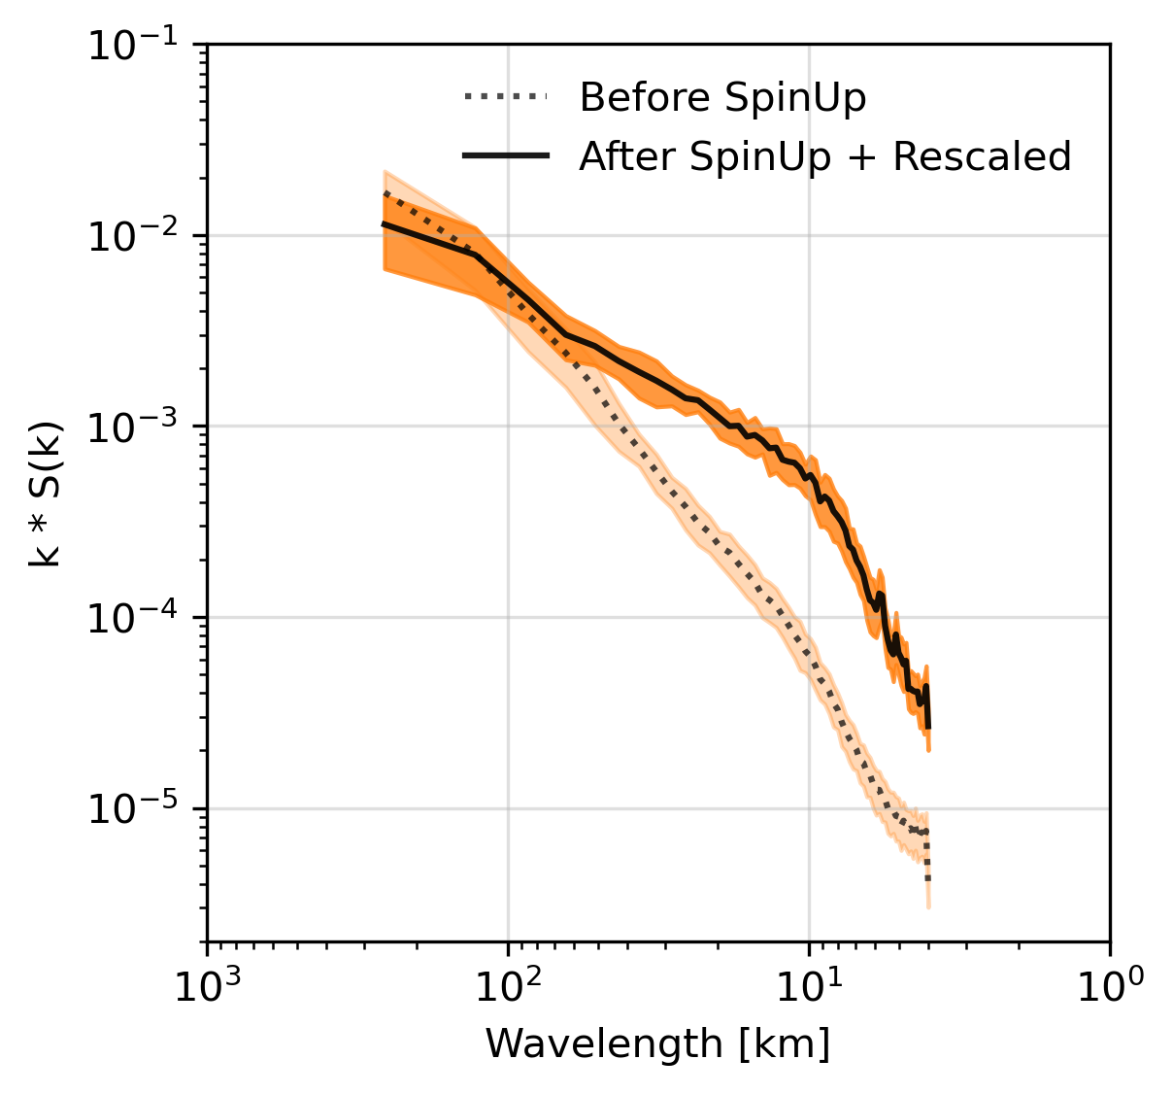
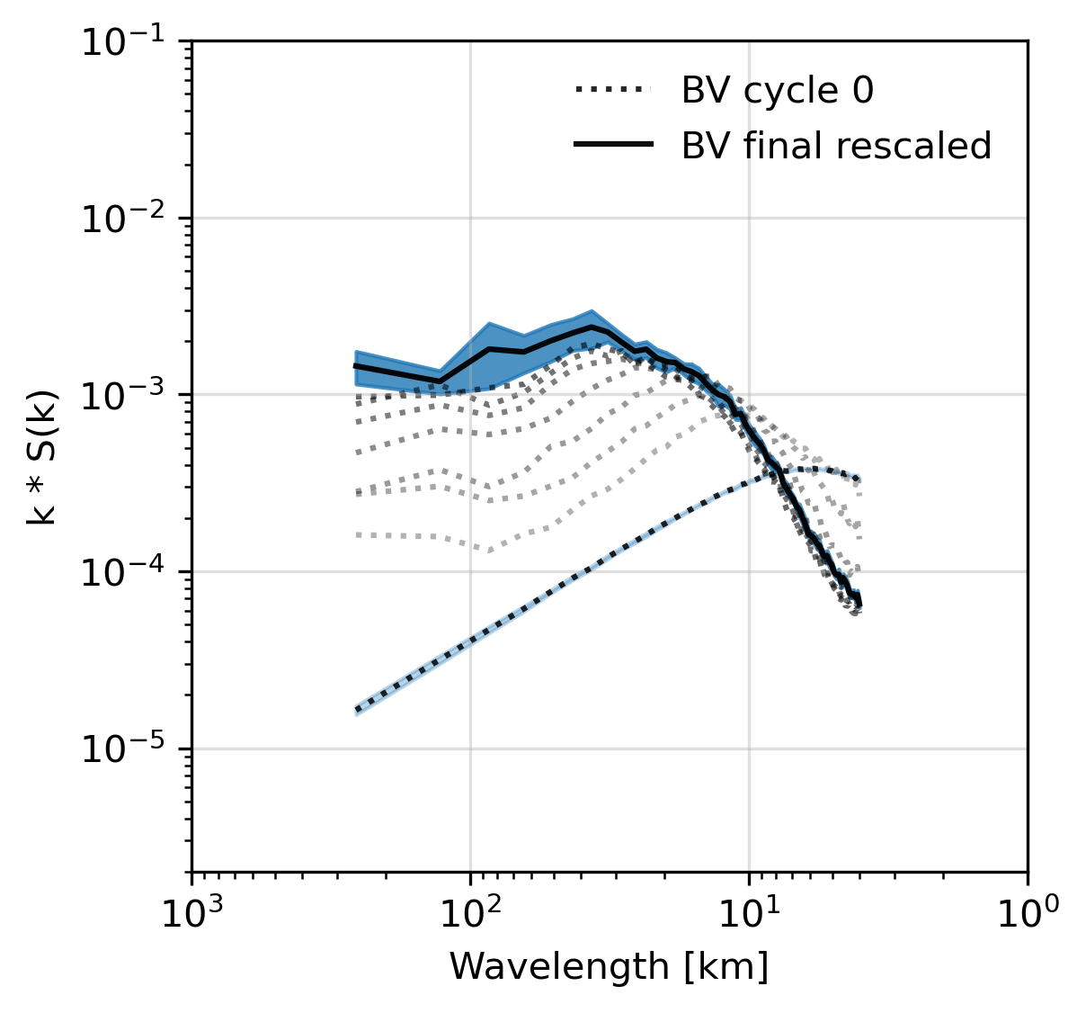
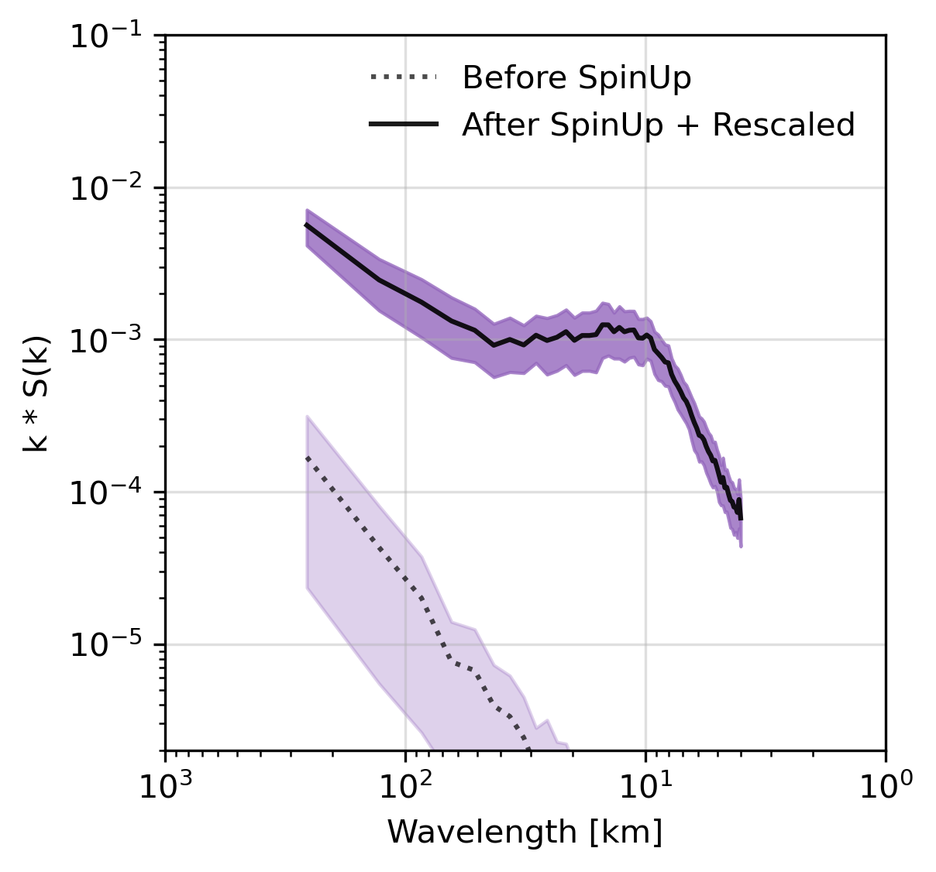
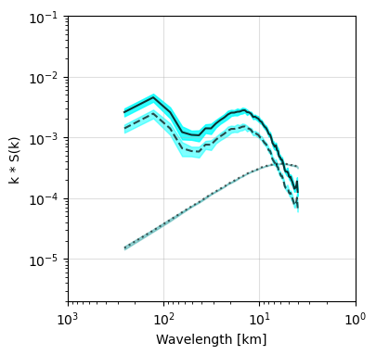
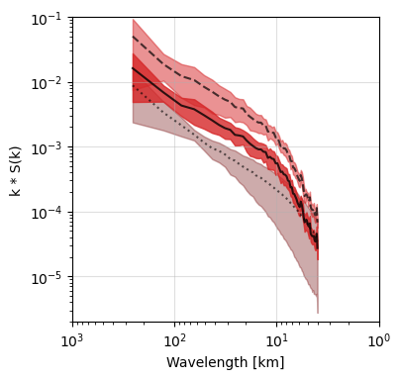
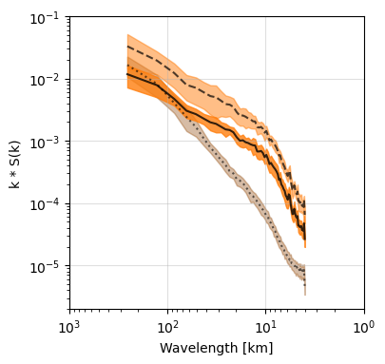
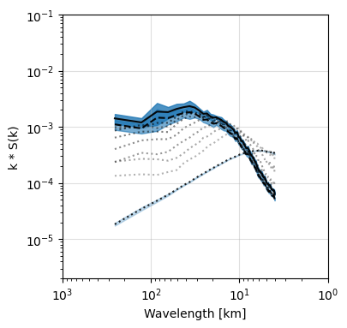
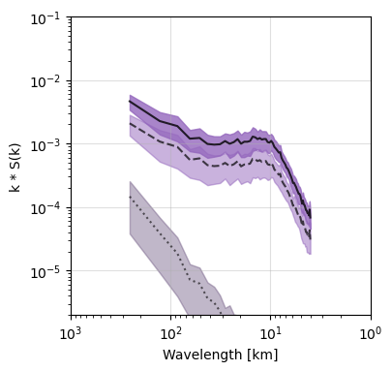
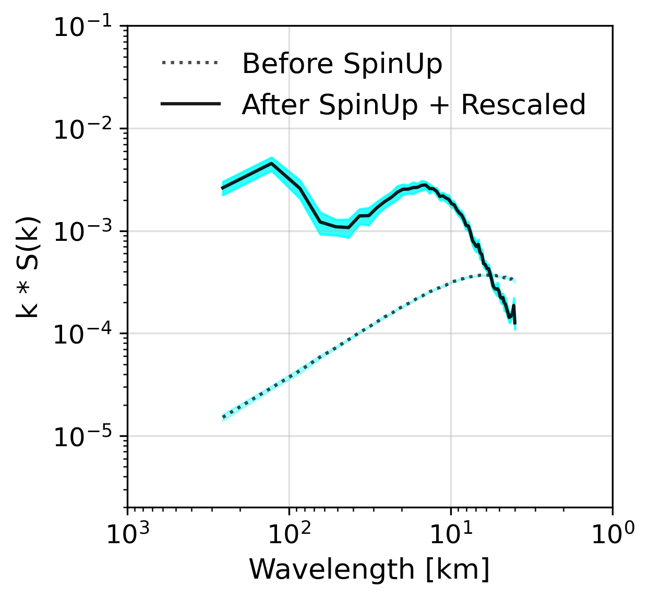
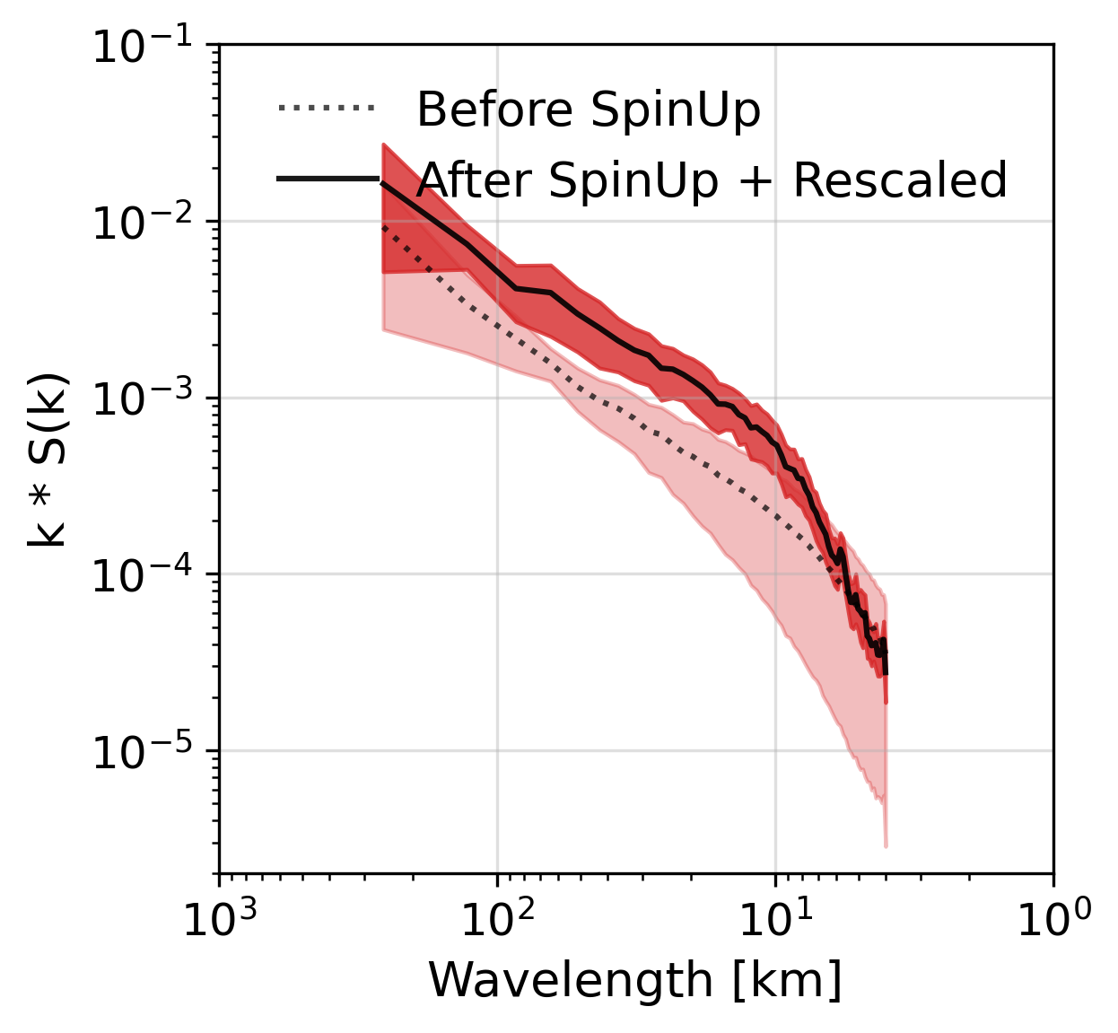
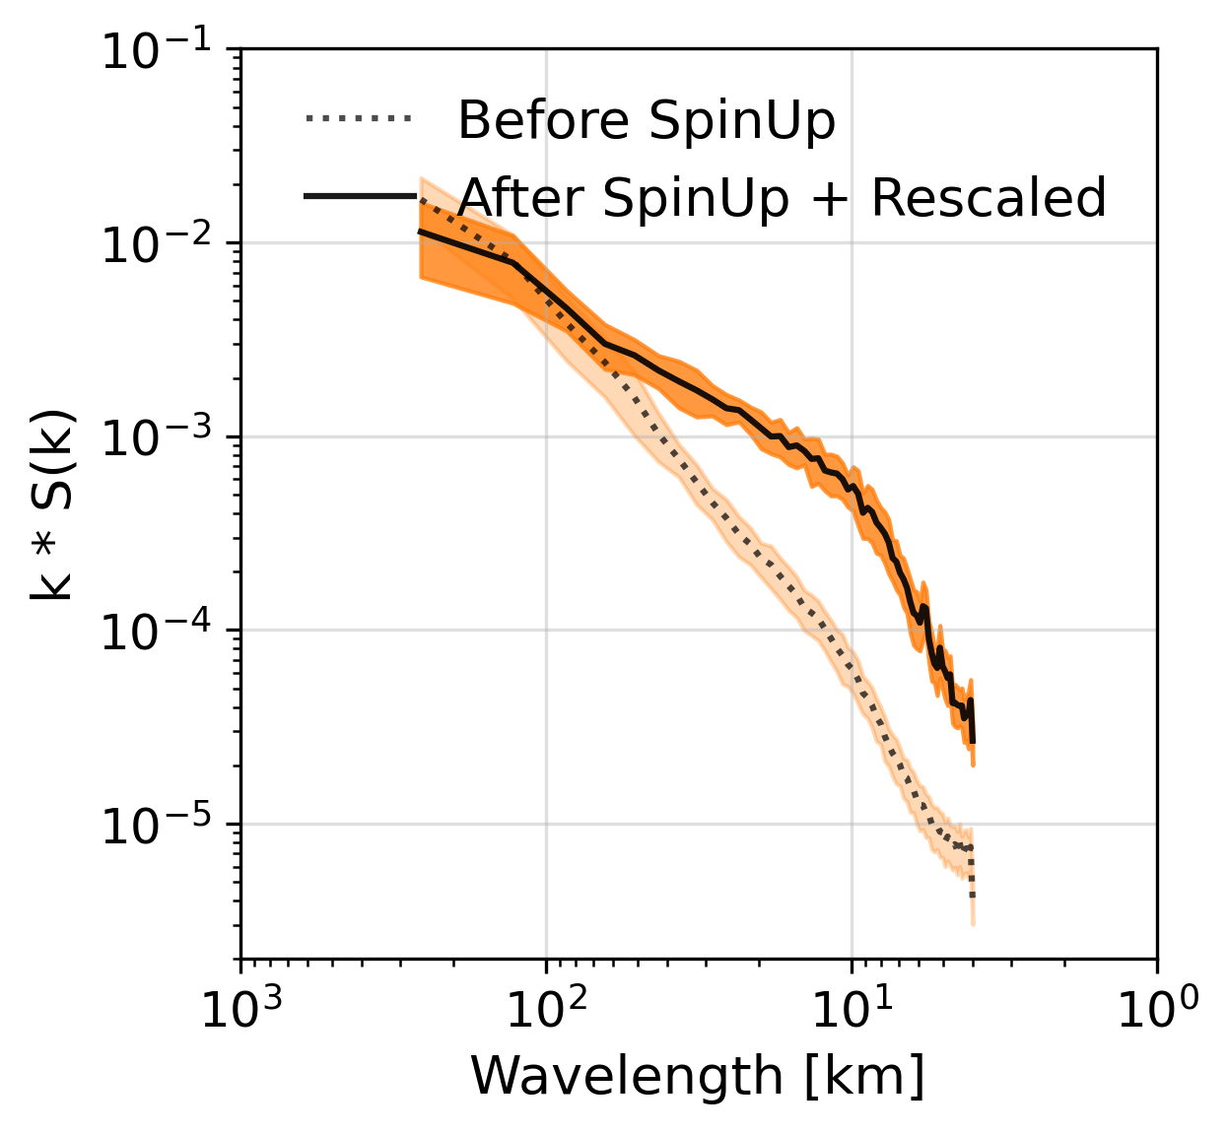
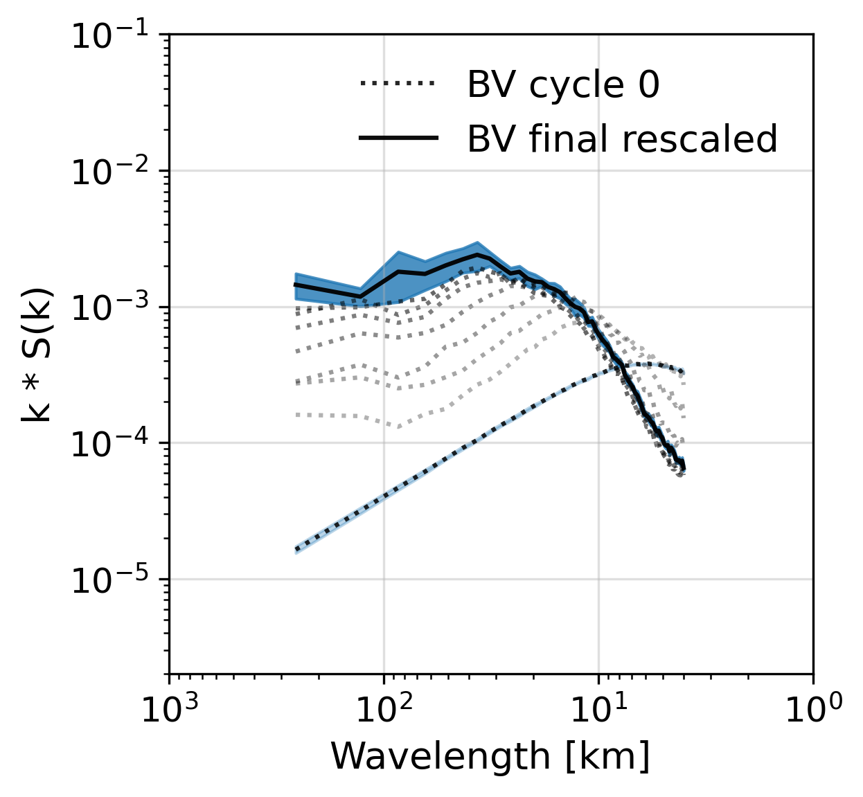
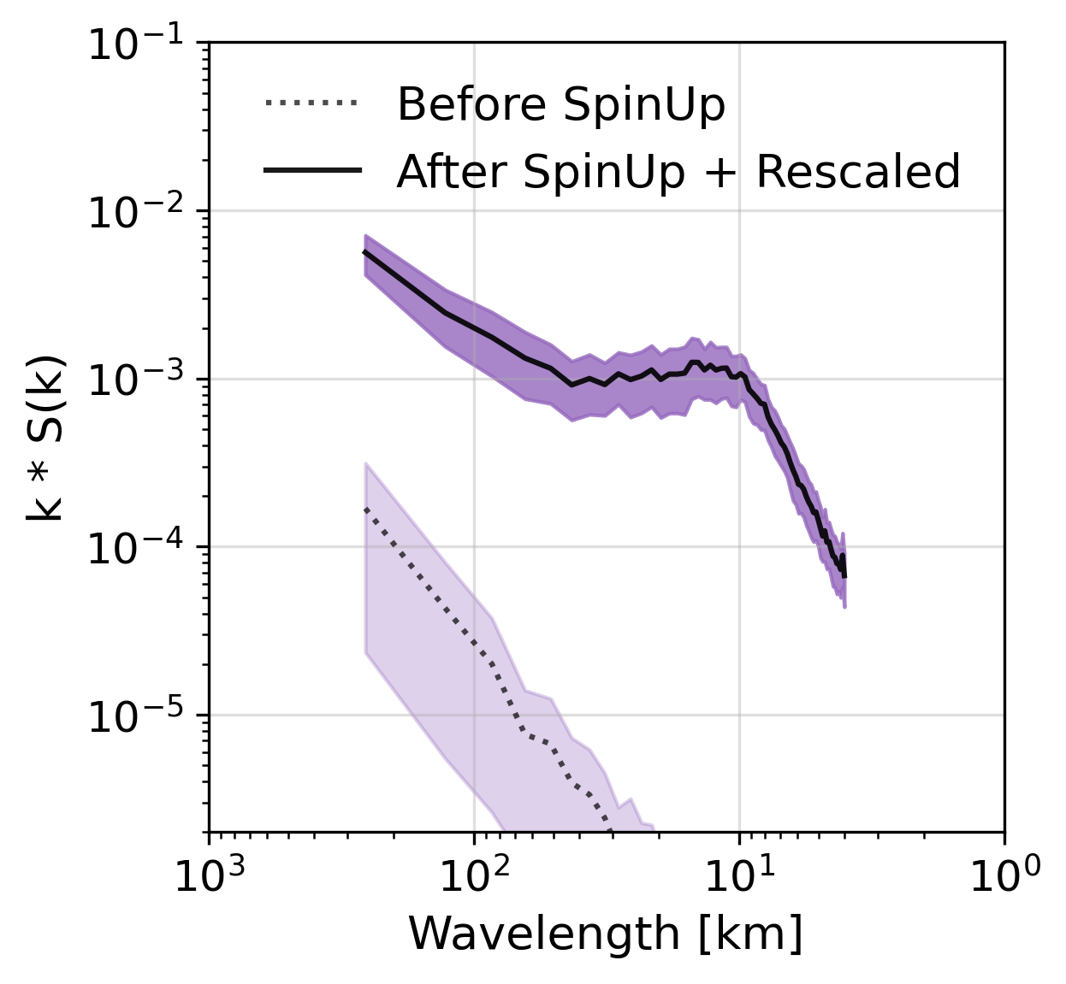
The 5 Contestants
Parrish & Derber (1992)
Kalnay & Toth (1997)
Hersbach et al. (2020)
White Noise | Red Noise | NMC method | Breeding Vector | ERA5 Ensemble
Random Noise | Random Noise | Climatological Model Error | Flow-dependent Noise | Downscaled Global Ensemble
Initial
Perturbs
4h Spin-Up
Ensemble
Perturbs

Slide 8
A CASE-STUDY

Slide 9
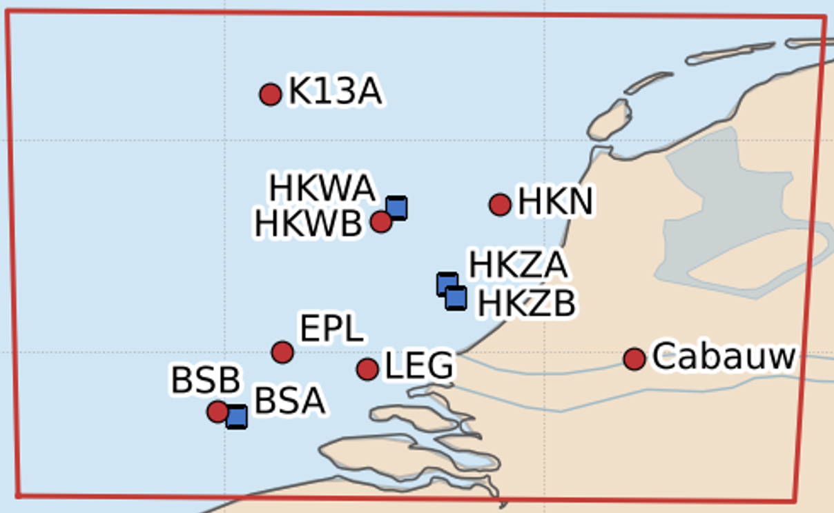
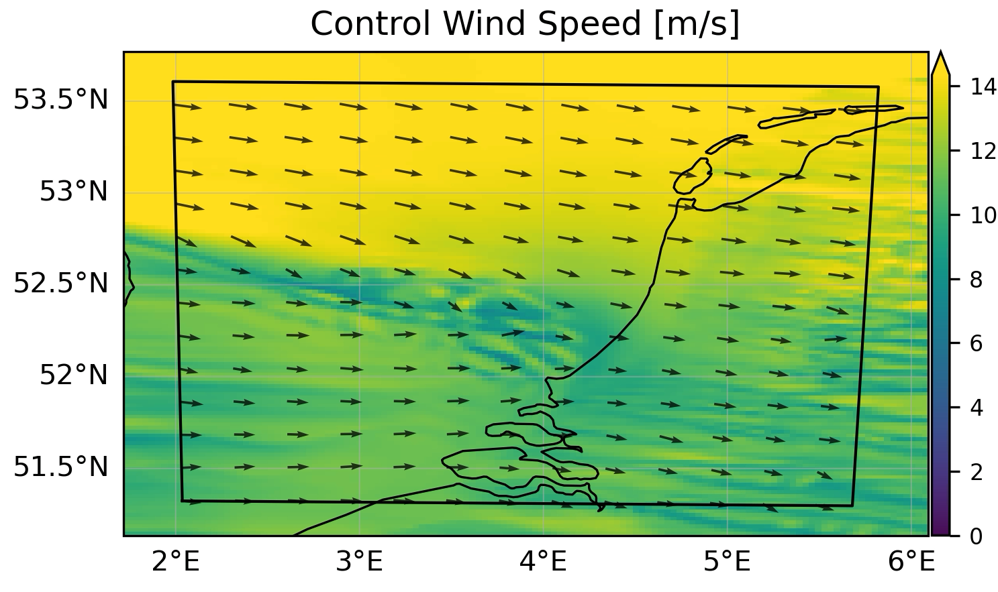
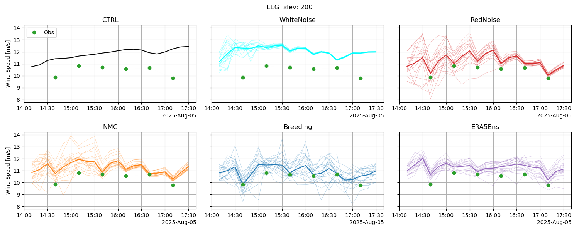
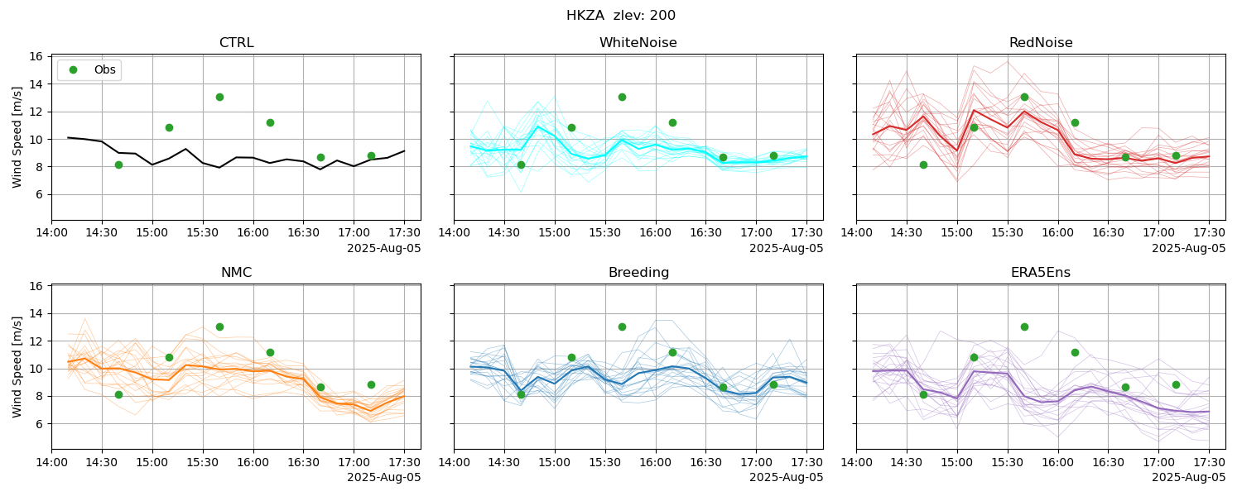
A Case-Study
Assimilation works for most methods, also fit to validation observations is improved!
WhiteNoise shows signs of ensemble collapse

Slide 10
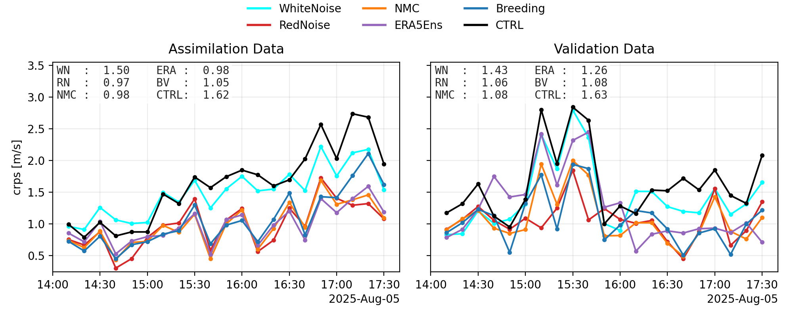
Skill aggregated over all stations
WhiteNoise is not much better than control forecast
RedNoise, NMC and breeding perform well on the assimilation & validation observations
ERA5 performs well on assimilation observations but worse on validation

Slide 11
Intermezzo – Evaluating Ensemble forecasts

Slide 12
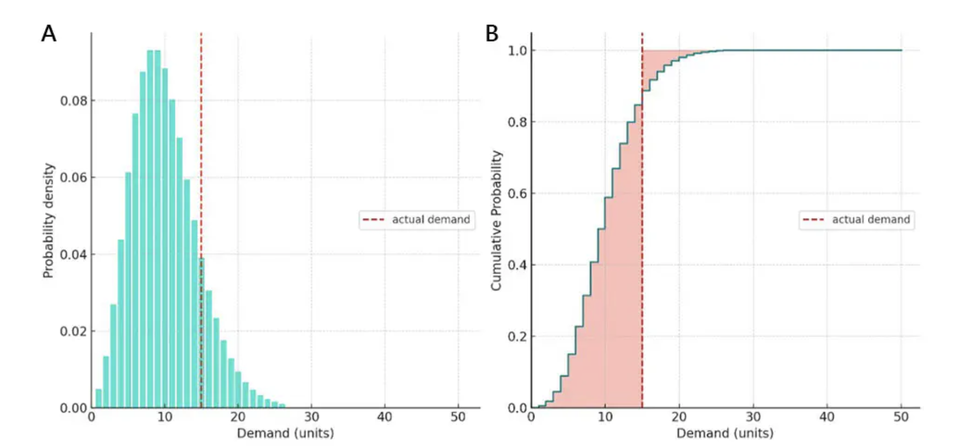
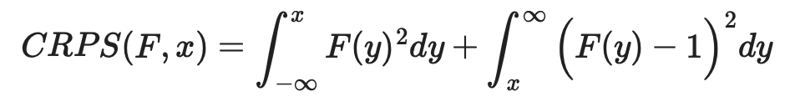


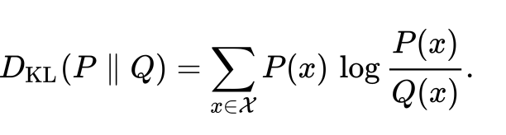
CRPS – Continuous Ranked Probability Score
CRPS is the squared distance between the forecast CDF and the observation delta-function
Proper scoring rule: Perfect score when the forecast distribution equals the true posterior distribution.
→ Asseses posterior posterior distirbution rather than how close ensemble mean is to truth (RMSE!)
CRPS becomes the Mean Absolute Error for a single-member
Forecasted Value (e.g. Temperature)
Notes:
Crps:

Slide 13
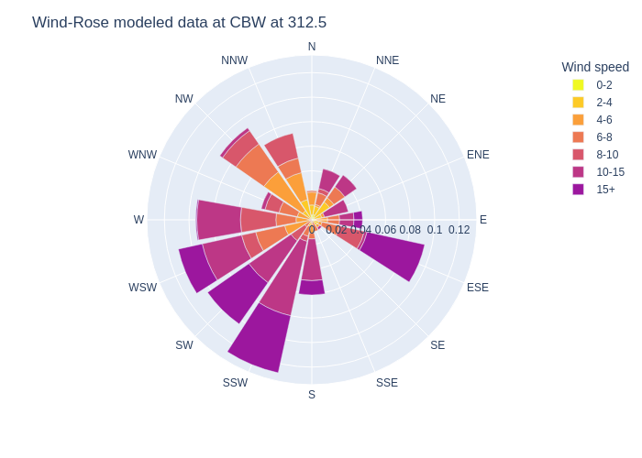
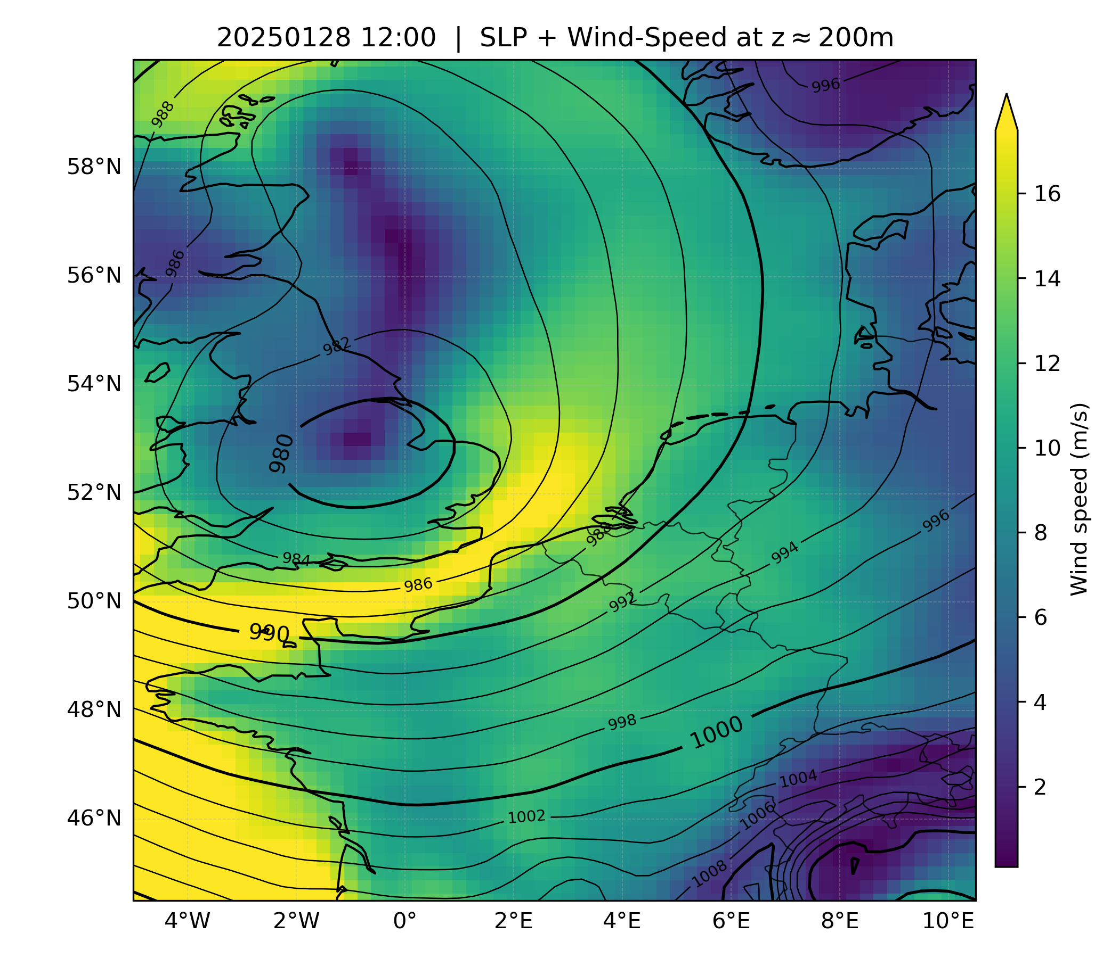
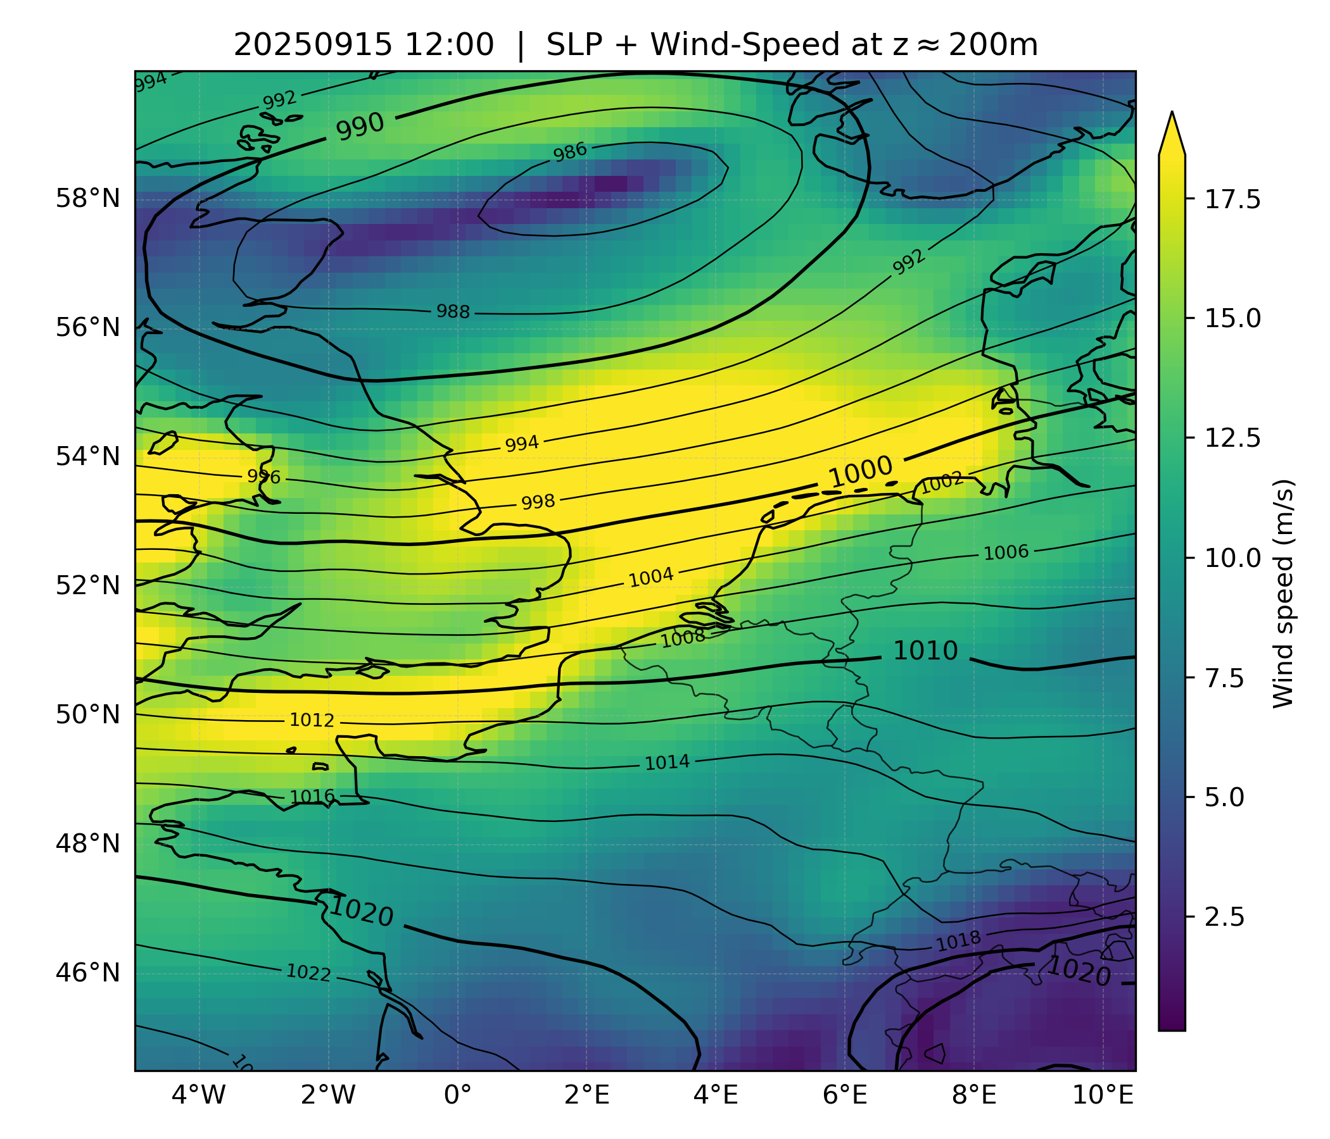
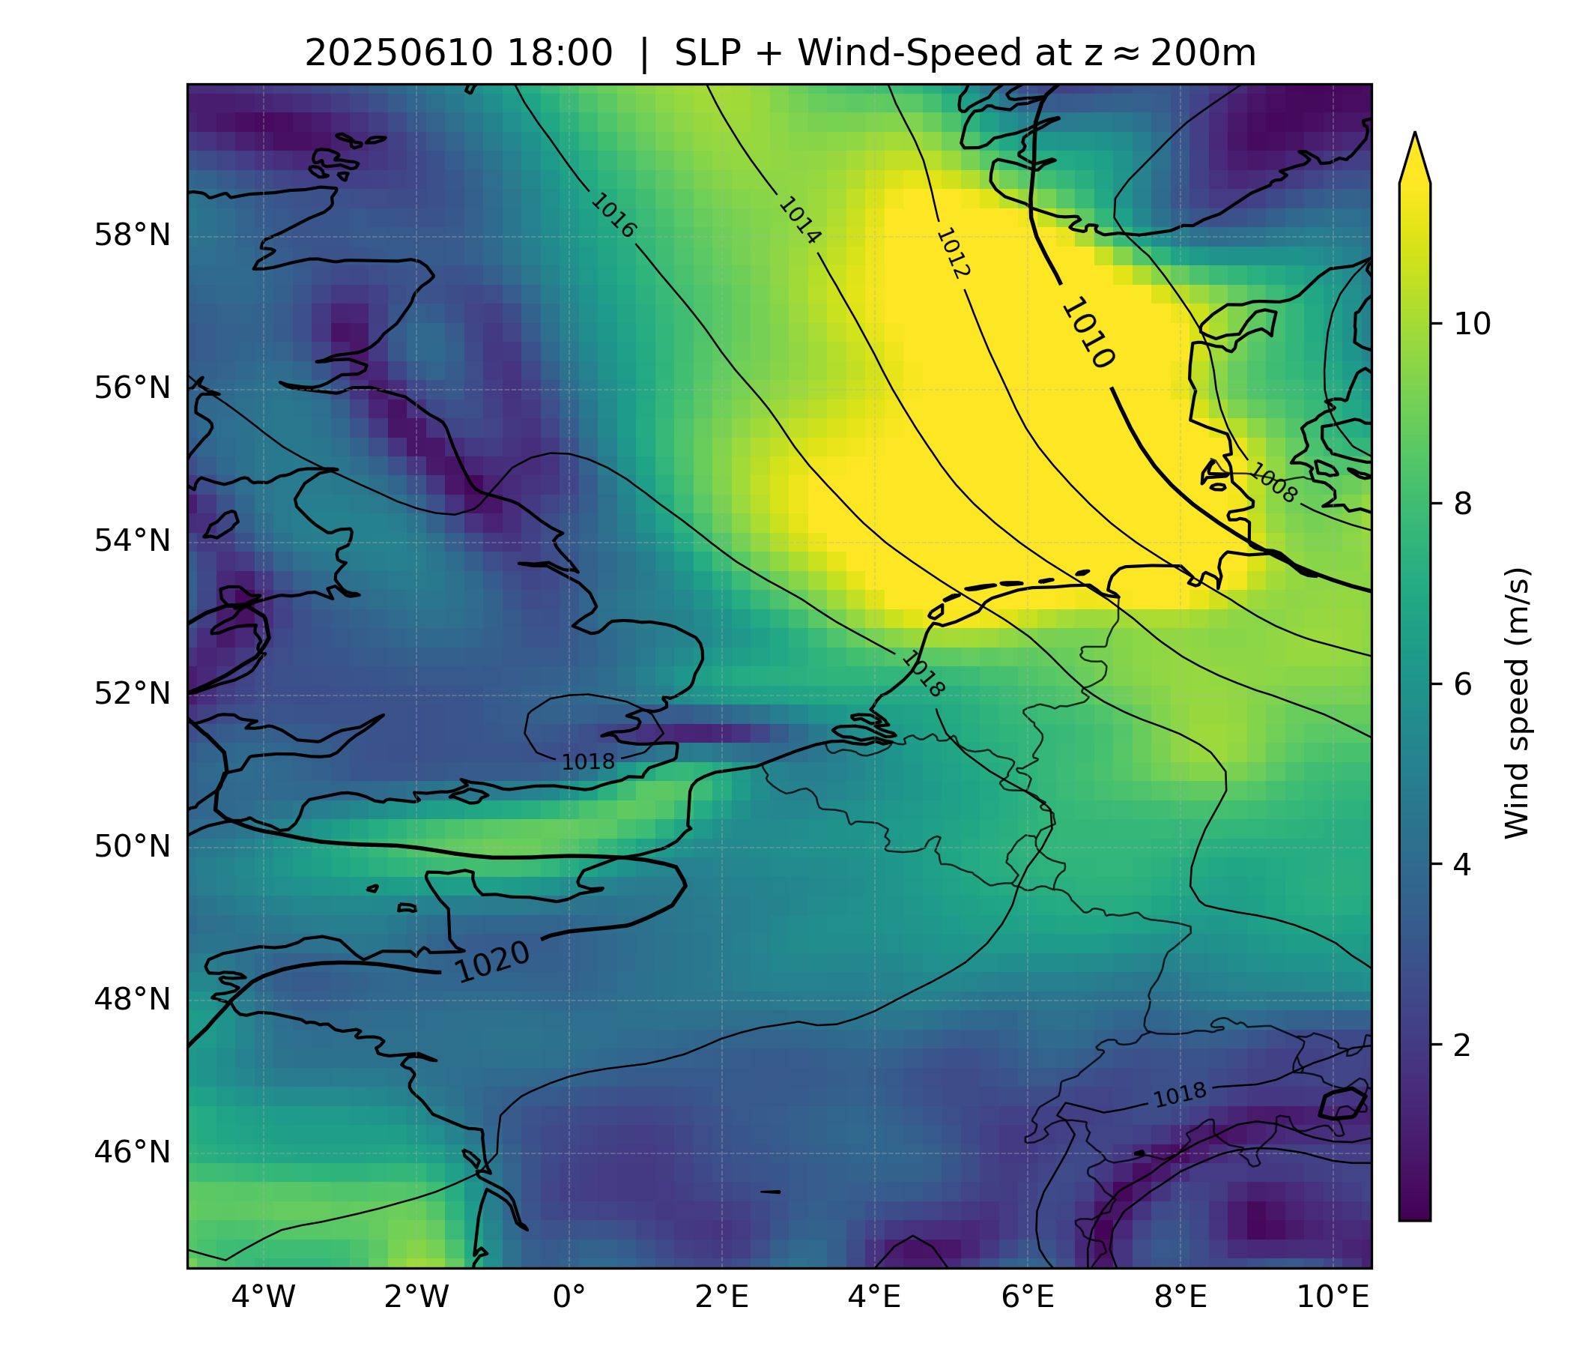
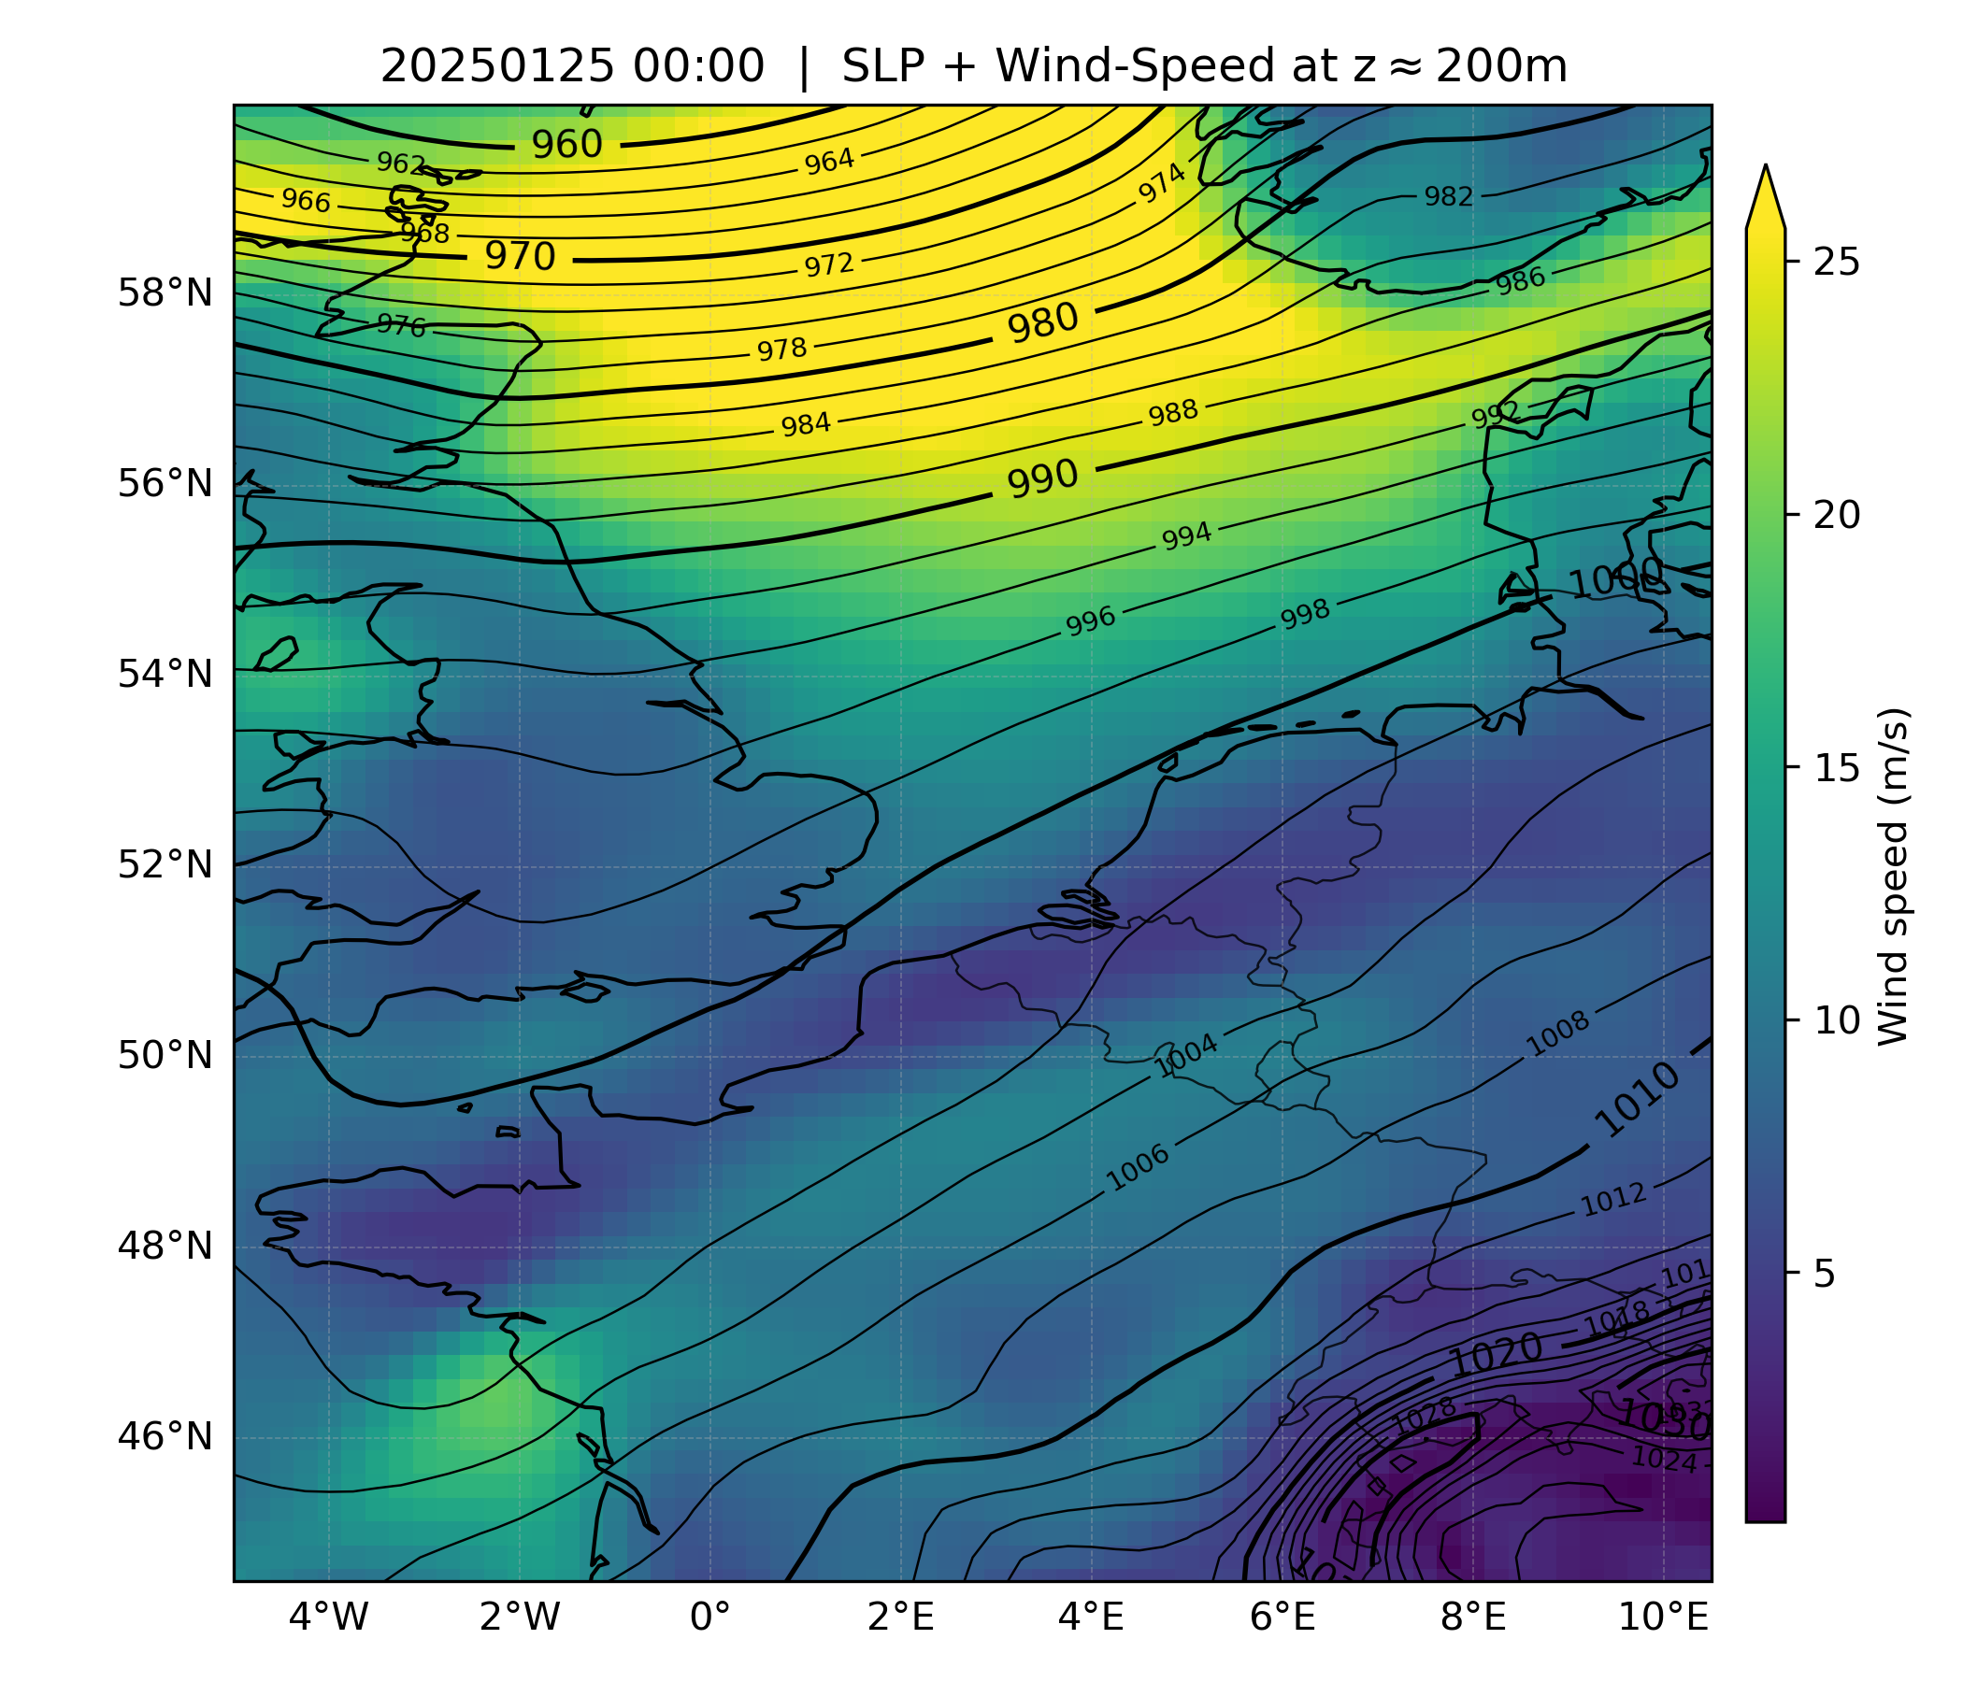
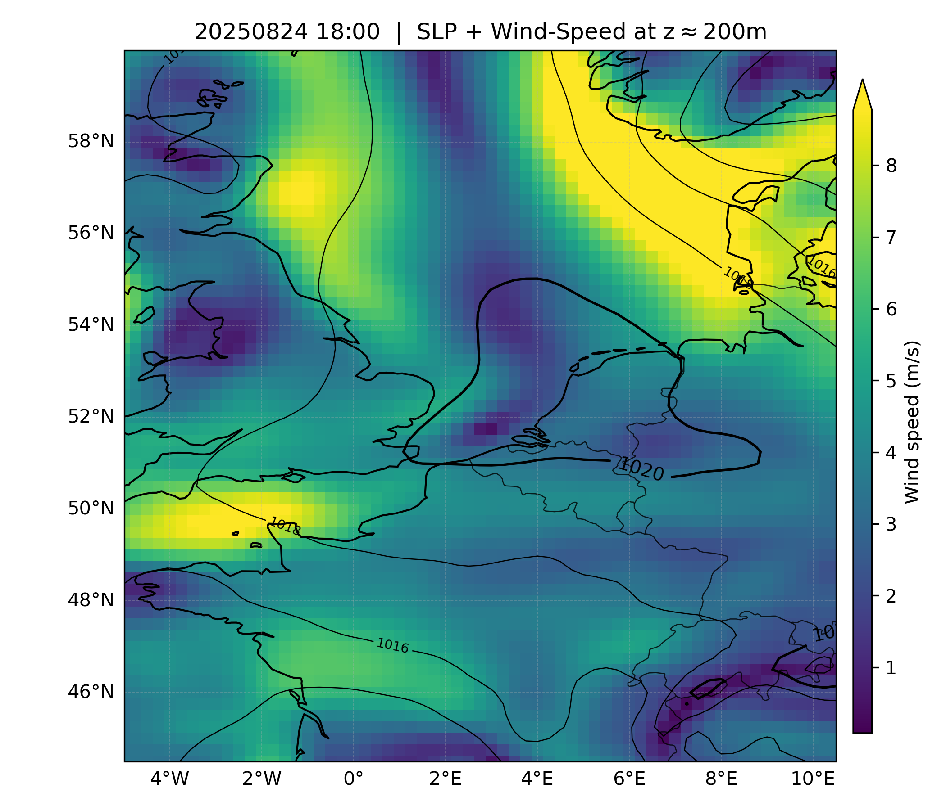
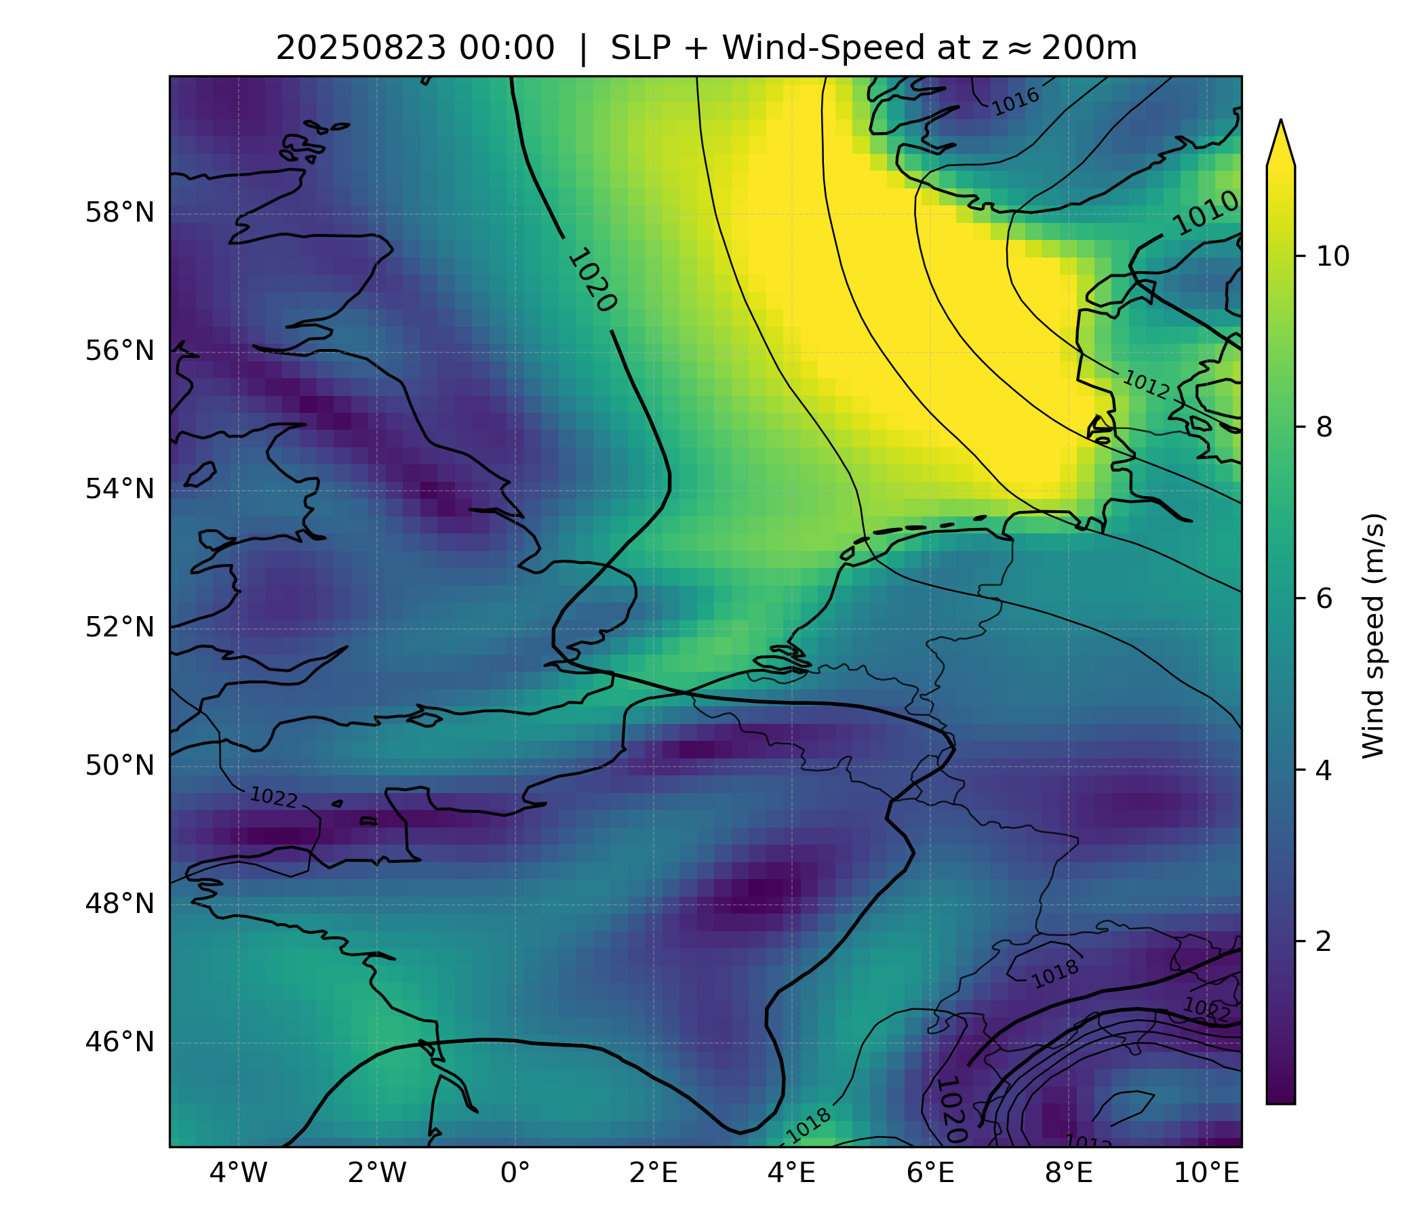
Multi-Case Statistics
60 cases (5 every month)

Slide 14
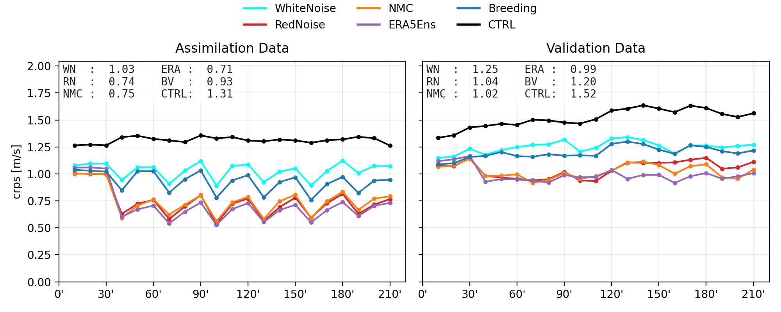
Skill aggregated over all cases

Slide 15
Who won?

Slide 16

Ranking of ensemble generation methods
For each time-step rank the methods according to their skill (CRPS)
Compute frequency of final rank of method
ERA, NMC and RedNoise are equally often either first or second place

Slide 17

Ranking of ensemble generation methods
Difficulty of case: Average skill over all methods divided by skill of control
(x-axis)
Left-side: Performance for all cases:
ERA5 is the winner
Right-side: Performance for difficult cases only
Breeding performs best for difficults cases
White Noise is also good, because it does not do much
NMC, RedNoise and ERA are comparable
Skill of method

Slide 18
Conclusion
ERA5, NMC, RedNoise perform comparably well. ERA5 looks best, but has some unfair advantages
Large spatial scales in initial perturbations are beneficial for data assimilation.
Pragmatic conclusion: RedNoise (spatially correlated noise) is good enough!
Potential Follow-ups
Breeding performs well when other methods tend to struggle (why?)
Can we get even better performance by combining methods
(e.g. blending Breeding + RedNoise)?
What is the added value of Lateral Boundary perturbations?

Slide 19
ADDITIONAL STUFF

Slide 20

Forecast Bias in Wake of Turbines
Bias (Ensemble Mean - Observation) .VS. Measured Wind-Speed
For waked and not-waked Observations
Waked-Biases show positive trend! → Unaccounted Model / Observation Error

