Slide 1


Ensemble-based Data Assimilation with AI Weather/Climate Models
Lili Lei
School of Atmospheric Sciences, Nanjing University
Acknowledgements to Haohao Sun, Huifeng Huang, Liang Ning, Zhengyu Liu, and Zhe-Min Tan

Slide 2
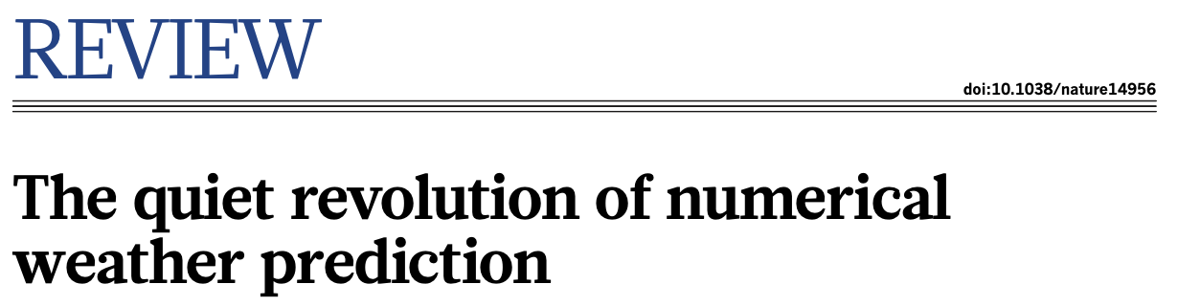
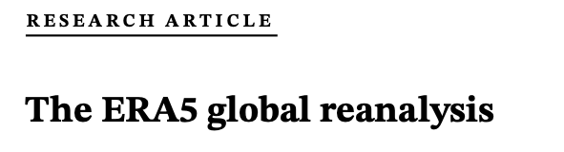

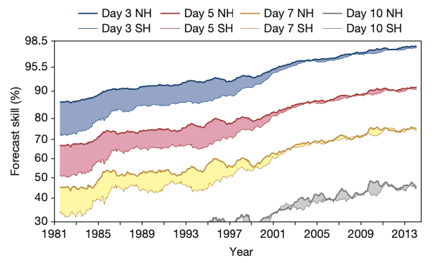
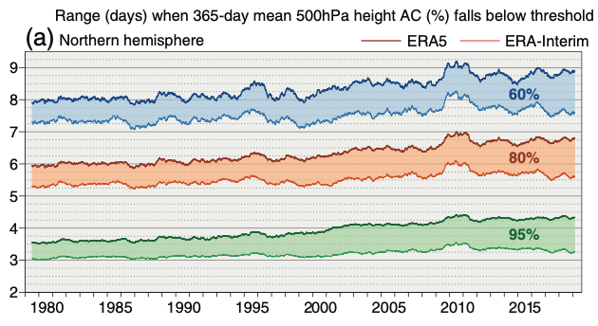
Numerical Weather Prediction
Atmospheric Reanalysis
Bauer et al. 2015
Hersbach et al. 2020

Slide 3
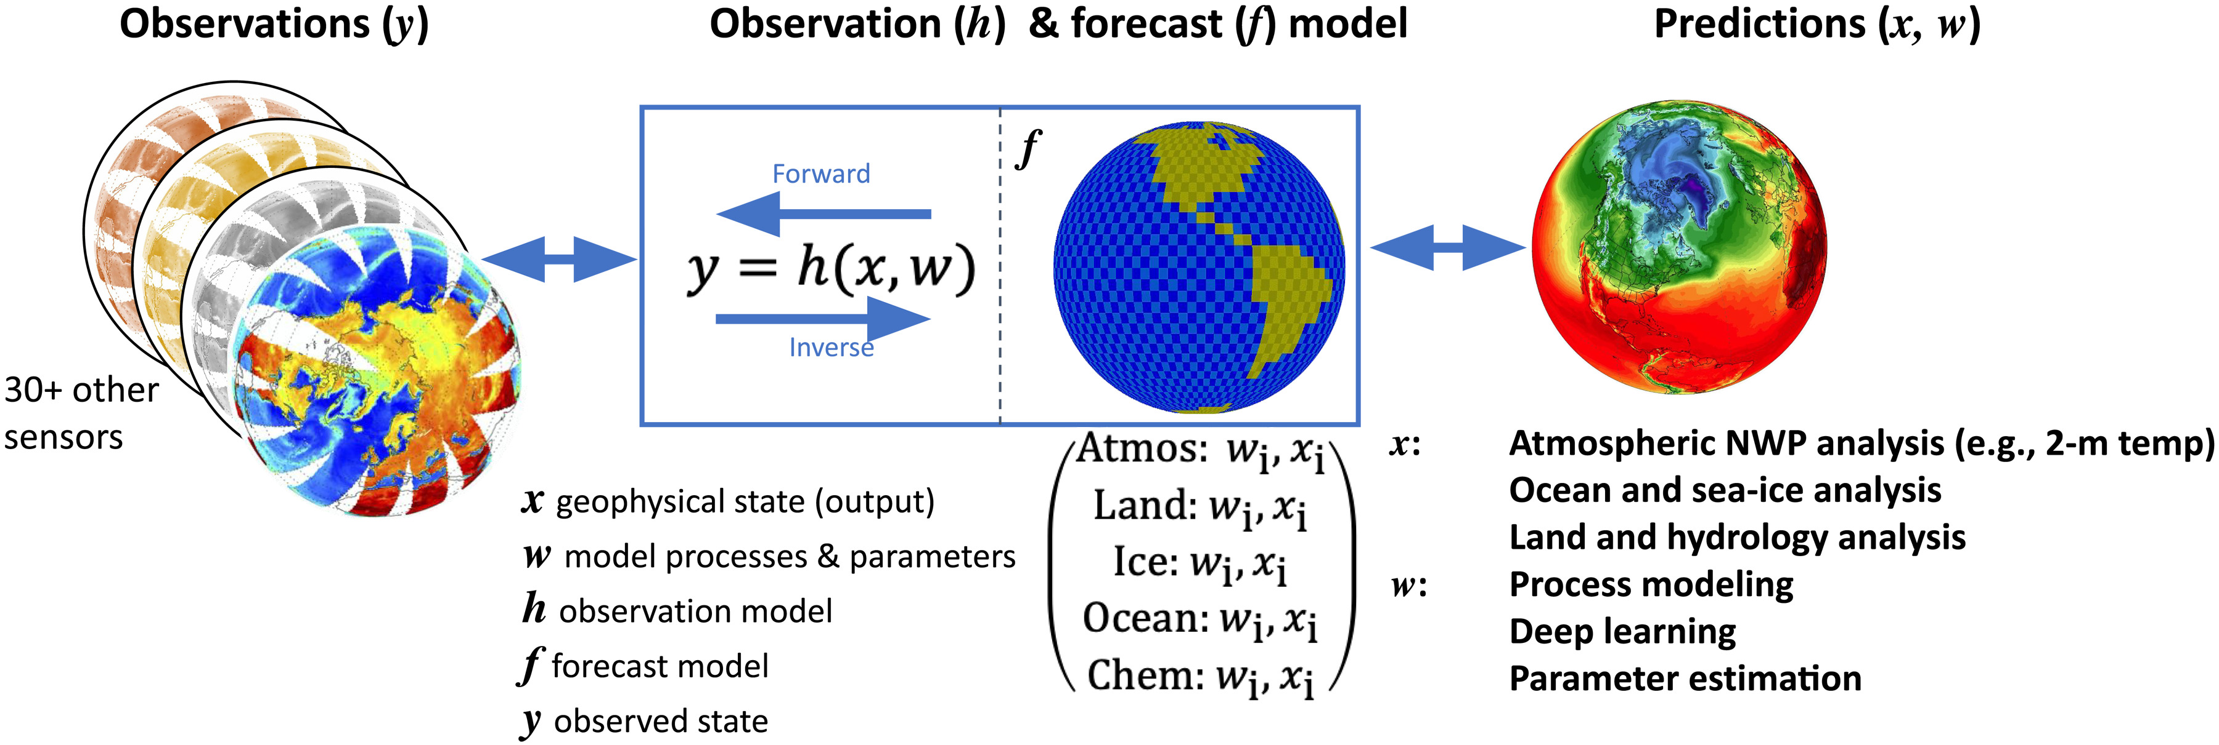
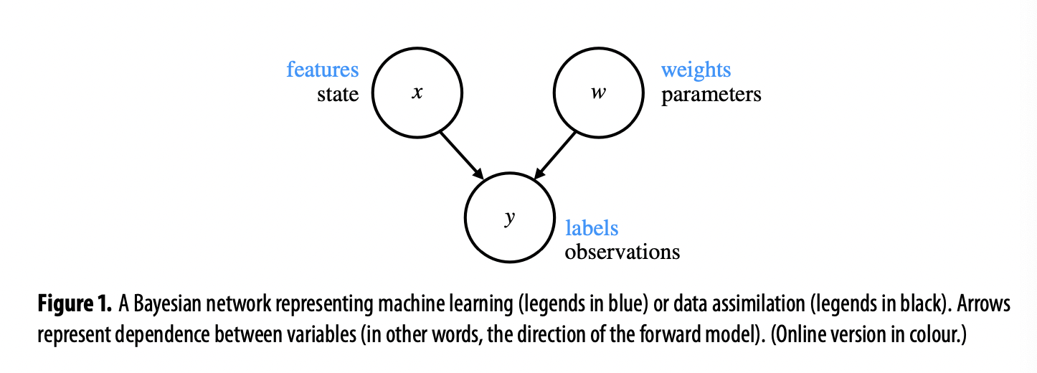
Data assimilation combines observations with numerical models to estimate evolving Earth system states for forecasting and monitoring
Gettelman et al. (2022)
Machine learning enables surrogate modeling, pattern recognition and Bayesian inference
Geer (2021)

Slide 4
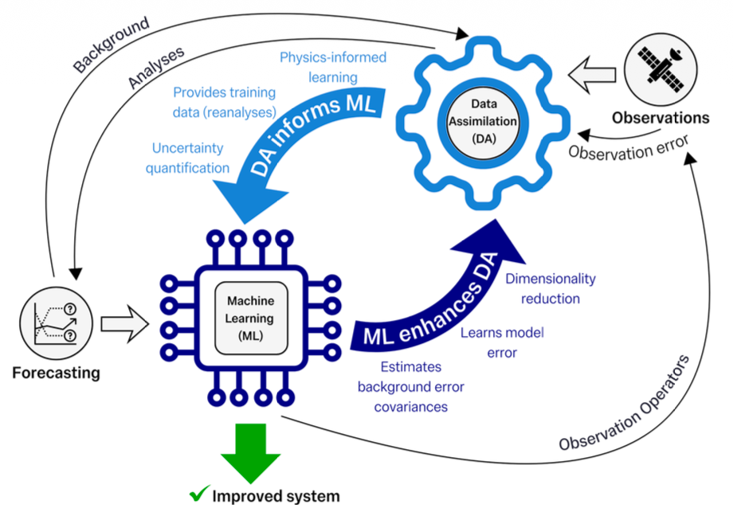
The convergence of machine learning and data assimilation in Earth system science
ML accelerates DA, while DA provides uncertainty quantification and physical constraints
Hybrid DA-ML systems are promising, yet challenges persist in generalization, consistency and reproducibility
These approaches are increasingly integrated, shaping next-generation prediction systems and observing networks
Arcucci et al. 2026 npj | artificial intelligence

Slide 5
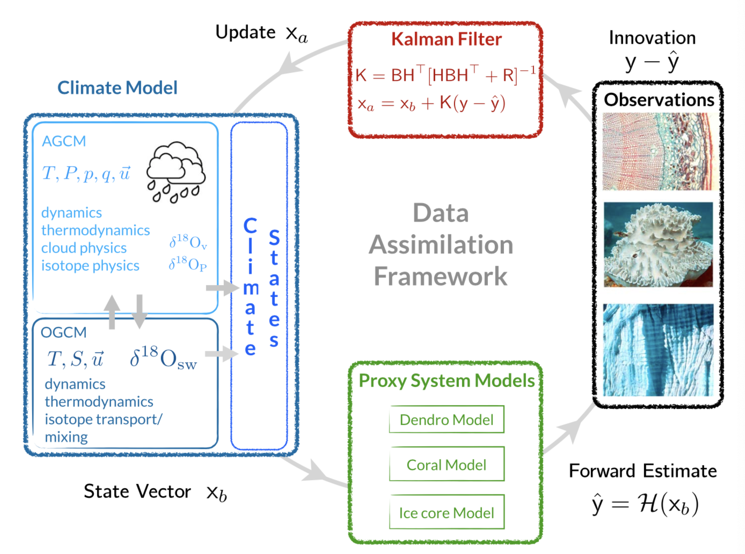
Weather DA
Paleoclimate DA
Dense observations
Advanced numerical weather models – accurate priors
Initial condition memories
Sparse proxy information
Earth system models – impractical for cycling DA
Less sensitive to initial conditions
Hakim et al. (2016)

Slide 6
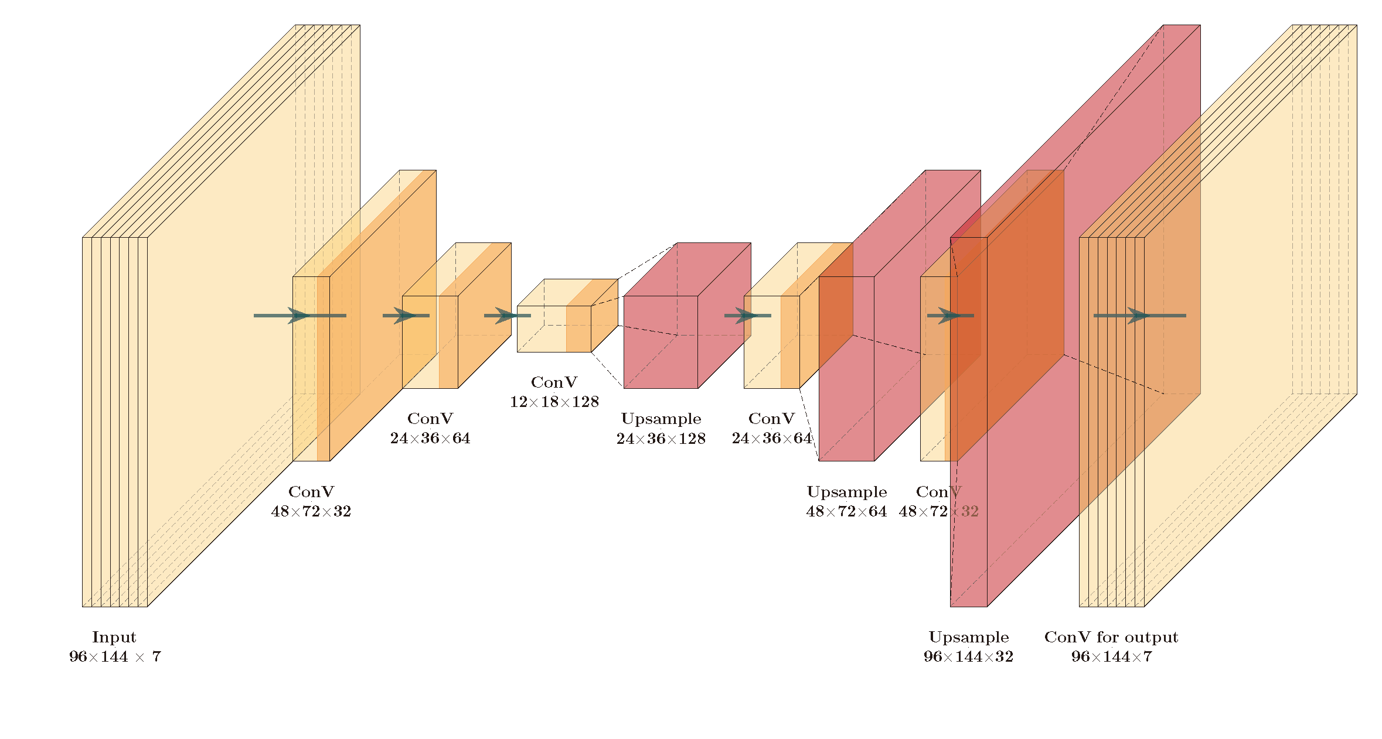
Weather DA
Paleoclimate DA
Dense observations
Advanced numerical weather models – accurate priors
Initial condition memories
Sparse proxy information
Earth system models – impractical for cycling DA
Less sensitive to initial conditions
AI weather/ climate models
Hakim et al. (2016)

Slide 7
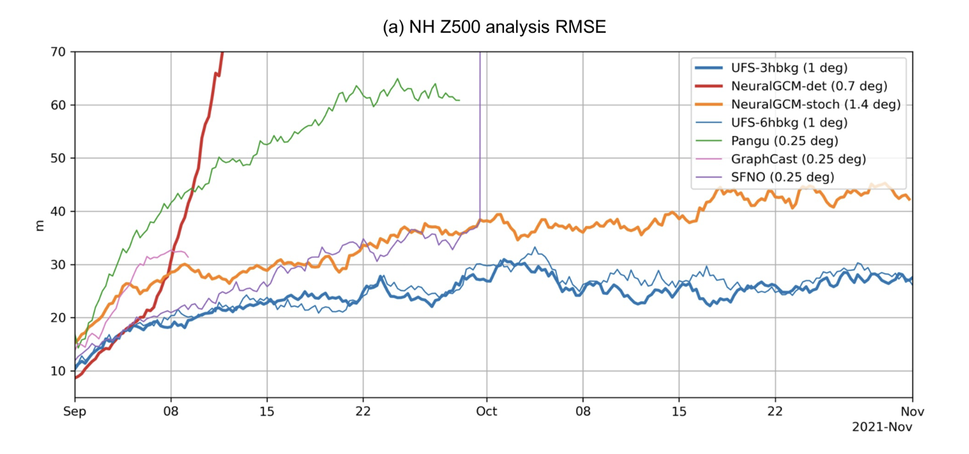
Ensemble-based DA with AI models
Slivinski et al. (2025)
Cycling DA with AI weather models to assimilate surface pressure observations faces filter divergence, possibly due to the accumulation of small-scale noises

Slide 8
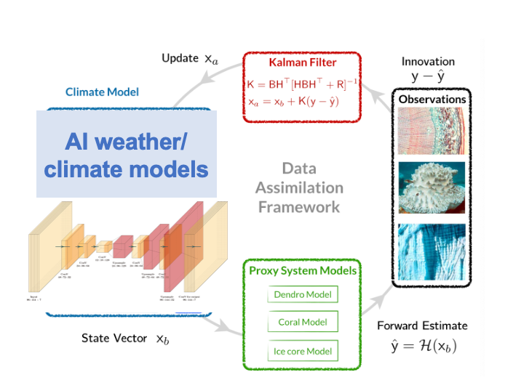
Ensemble-based DA with AI models
Ensemble-based DA with AI weather models
Online paleoclimate DA with DL-based surrogate models

Slide 9
Ensemble-based DA with AI models
Ensemble-based DA with AI weather models
Online paleoclimate DA with DL-based surrogate models

Slide 10
Ensemble-based DA with AI models
FengWu (Chen et al. 2025) and Pangu-Weather (Bi et al. 2023)
Radiosonde observations from NCEP GDAS
EAKF (Anderson 2001) from DART (Anderson et al. 2009)
80 ensemble members
GC covariance localization (0.2 radian / 600 hPa)
Inflation includes RTPS (1.0) and additive inflation (0.2)
Huang et al. (2026 GRL)

Slide 11
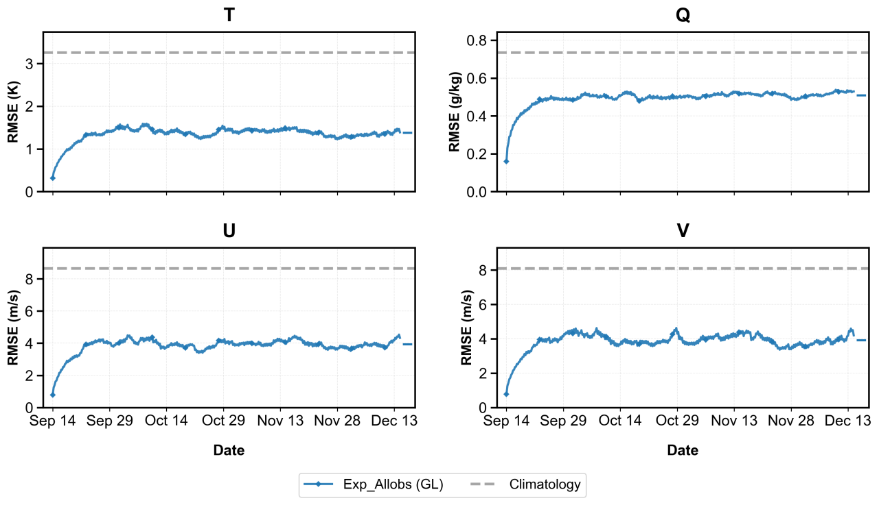
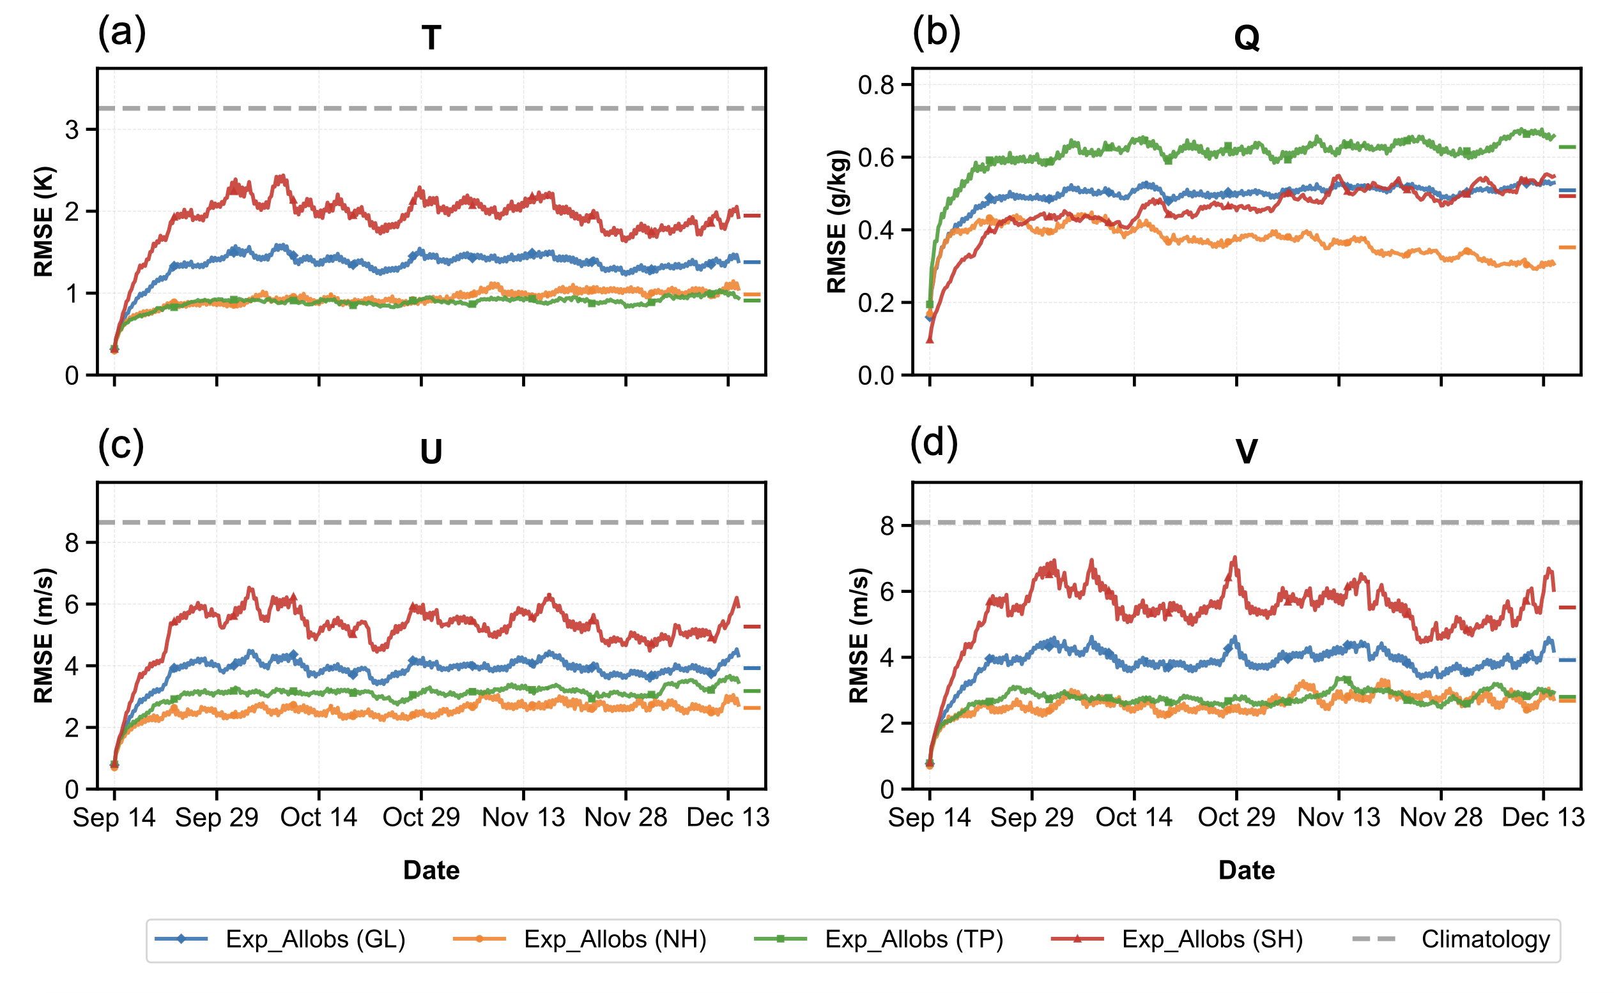
Ensemble-based DA with AI models
A successful cycling DA using FengWu with assimilating only sounding observations is achieved, with saturated errors much smaller than climatology
The converged RMS error reductions over GL are approximately 58% (T), 31% (Q), 55% (U), and 52% (V), respectively

Slide 12
Ensemble-based DA with AI models
Due to the sparsity of observations over SH, RMS errors of T, U and V averaged over NH / TP are smaller than those over SH
Comparatively, the largest RMS errors of Q over TP indicate the intrinsic uncertainty of tropical moisture processes and limited practical predictability

Slide 13
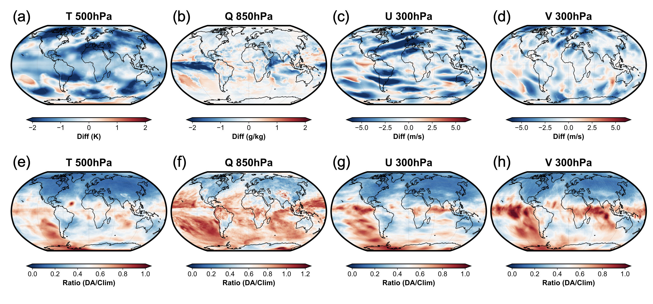
Ensemble-based DA with AI models
Abs. bias diff.
RMS error ratio
Consistent results are obtained from the spatial distribution of absolute bias differences and RMS error ratios compared to the climatology

Slide 14
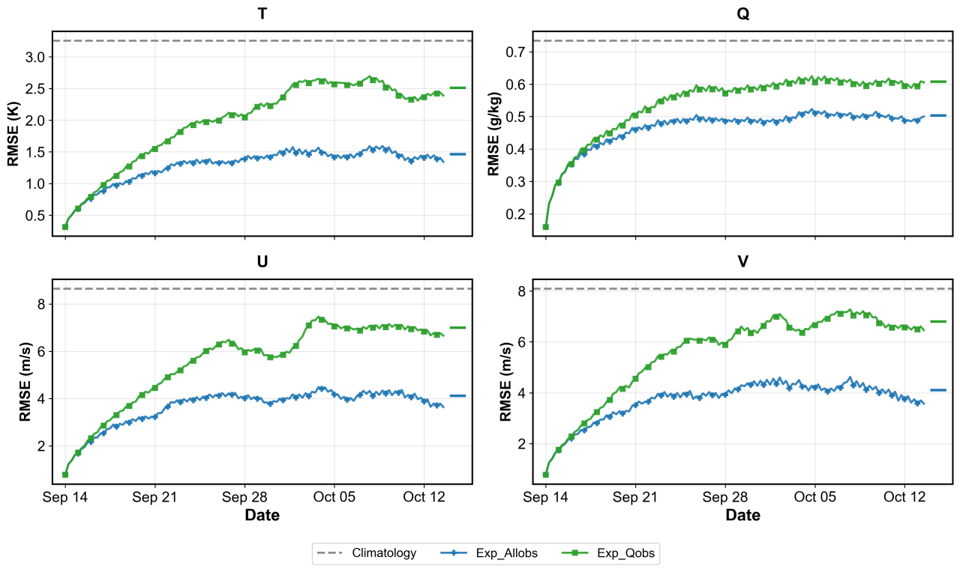
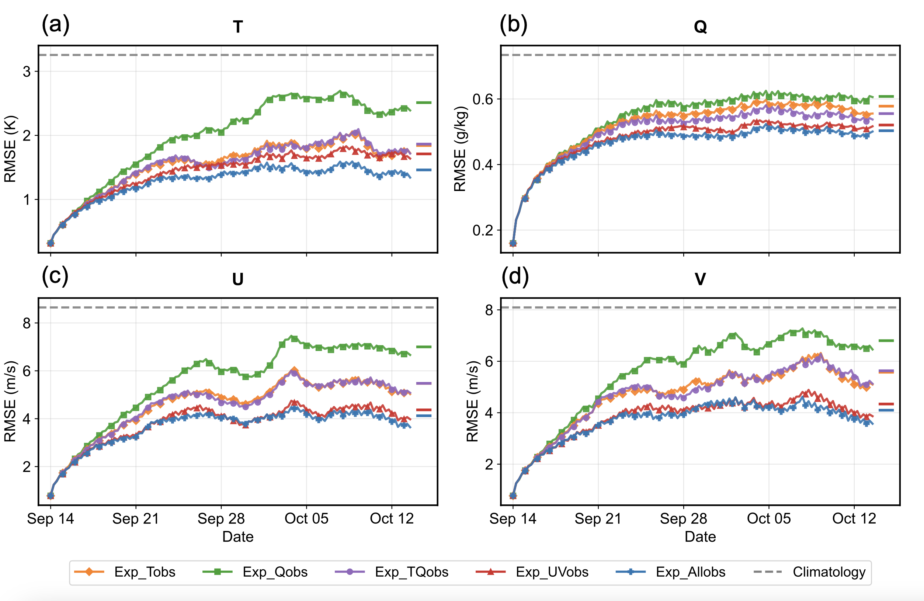
Ensemble-based DA with AI models
Assimilating Q observations (Exp_Qobs) can constrain 6-h RMS errors of state variables (T, Q, U and V), but with larger errors than assimilating all observations (Exp_Allobs)

Slide 15
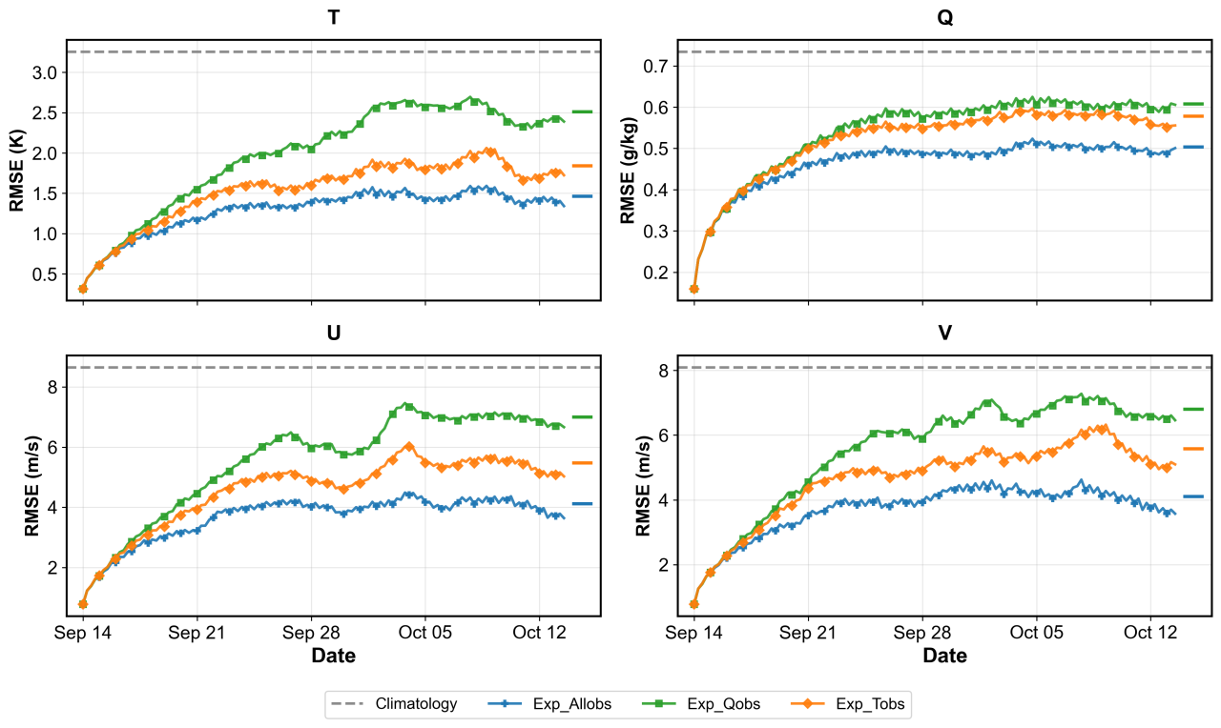
Ensemble-based DA with AI models
Assimilating T observations (Exp_Tobs) has smaller errors than Exp_Qobs, especially for T, U and V, which indicates that temperature has larger length scales than specific humidity

Slide 16
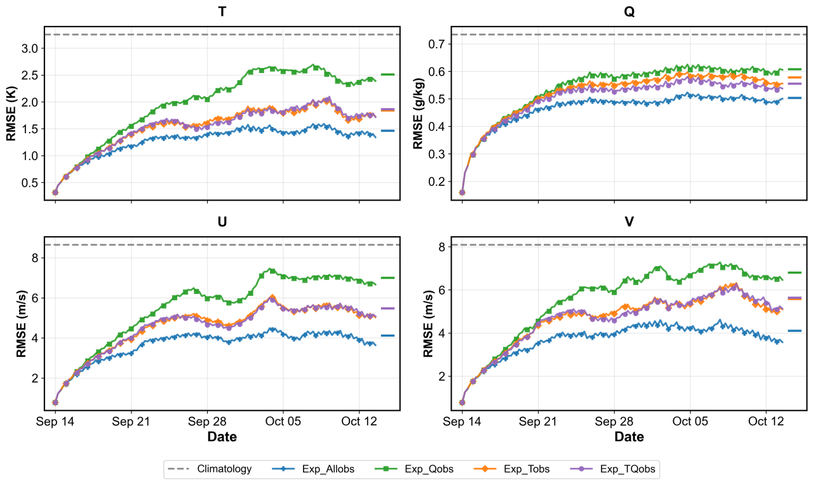
Ensemble-based DA with AI models
Compared to Exp_Tobs, Exp_TQobs has similar errors of T, U and V, but smaller Q errors
Assimilating T observations that leads to large-scale corrections is beneficial for Q, even with direct observations resulting in small-scale corrections

Slide 17
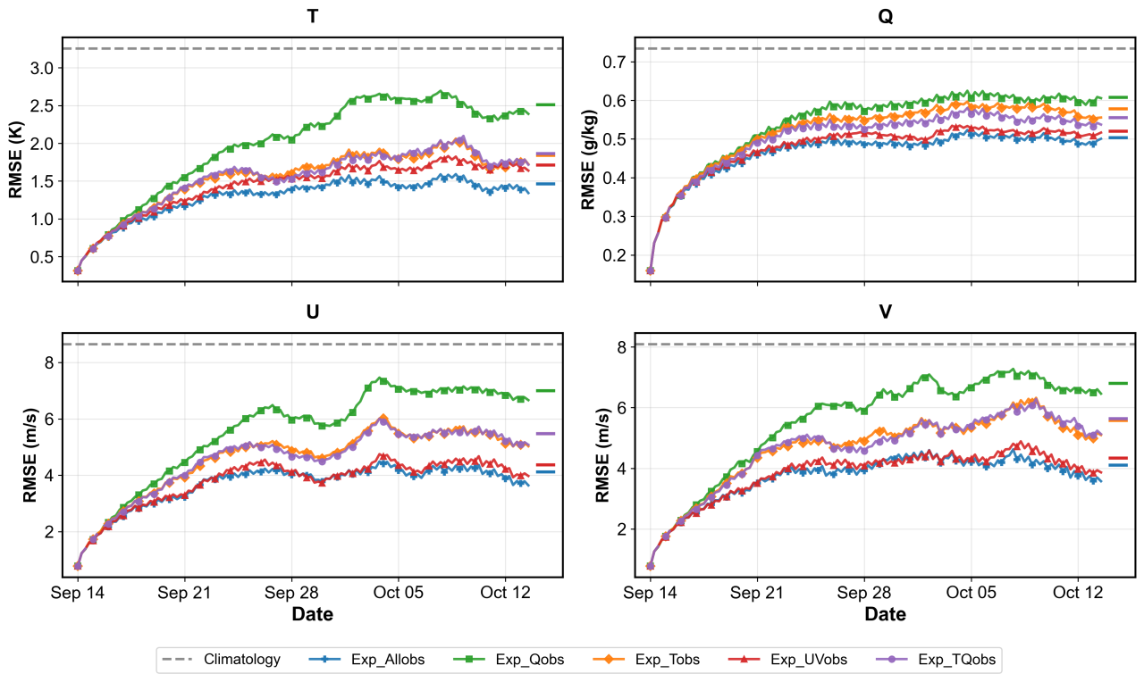
Ensemble-based DA with AI models
Compared to Exp_Tobs, Exp_Qobs, and Exp_TQobs, assimilating U and V observations (Exp_UVobs) leads to much more reduced errors of U and V, as well as T and Q

Slide 18
Ensemble-based DA with AI models
Consistent results are obtained from the power spectrum of error kinetic energy and temperature error

Slide 19
Ensemble-based DA with AI models
Compared to Slivinski et al. (2025), a stably cycling DA is achieved owing to:
the effective observation constrains from radiosonde profiles
the additive inflation to maintain sufficient ensemble spread

Slide 20
Ensemble-based DA with AI models
A successful cycling DA using Pangu-Weather with assimilating only sounding observations is also obtained
However, Exp_UVobs cannot effectively constrain T and Q, as using FengWu

Slide 21
Ensemble-based DA with AI models
Assimilating wind observations with Pangu-Weather can limit the 6-h error growth of state variables at small scales, but not for large scales, especially for temperature
Pangu-Weather
Due to different intrinsic error characteristics of AI weather models, influences of observation types on cycling DA with AI weather models are model-dependent

Slide 22
Ensemble-based DA with AI models
Ensemble-based DA with AI weather models
Online paleoclimate DA with DL-based surrogate models

Slide 23
Online PDA with DL-based surrogate models
A deep learning-based network (NET) is built to map the model state at t-1 to that at t, aiming to represent nonlinear processes
A convolutional decoder-encoder architecture (Scher 2018)
Sun et al. (2025 JAMES)

Slide 24
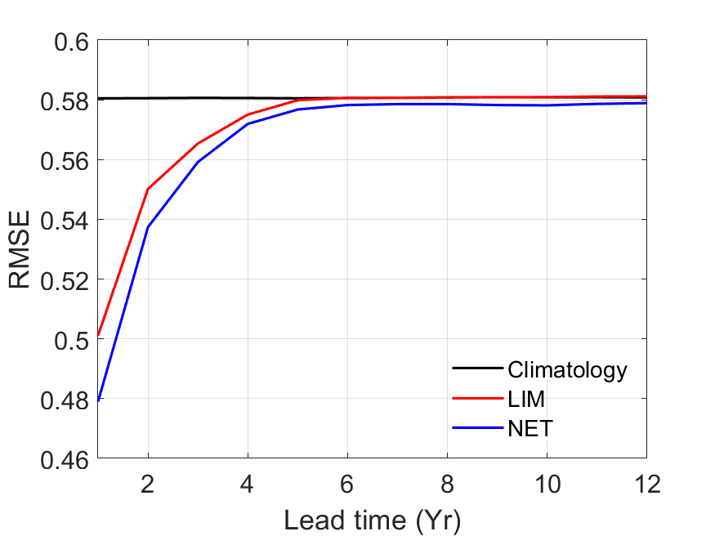
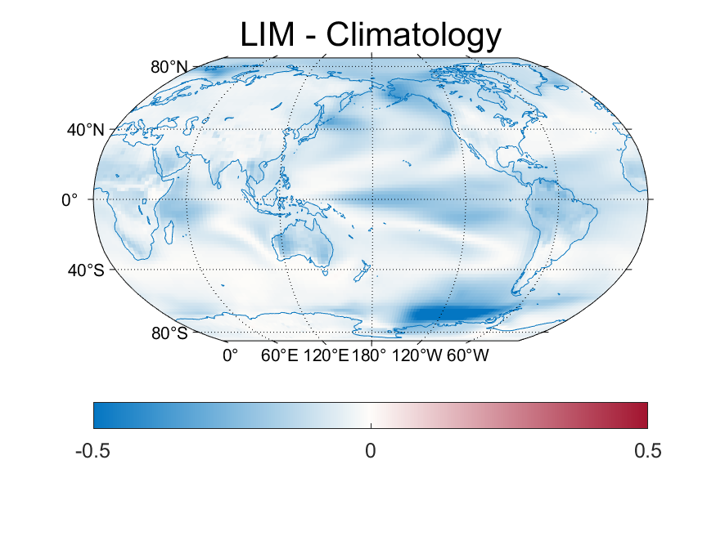
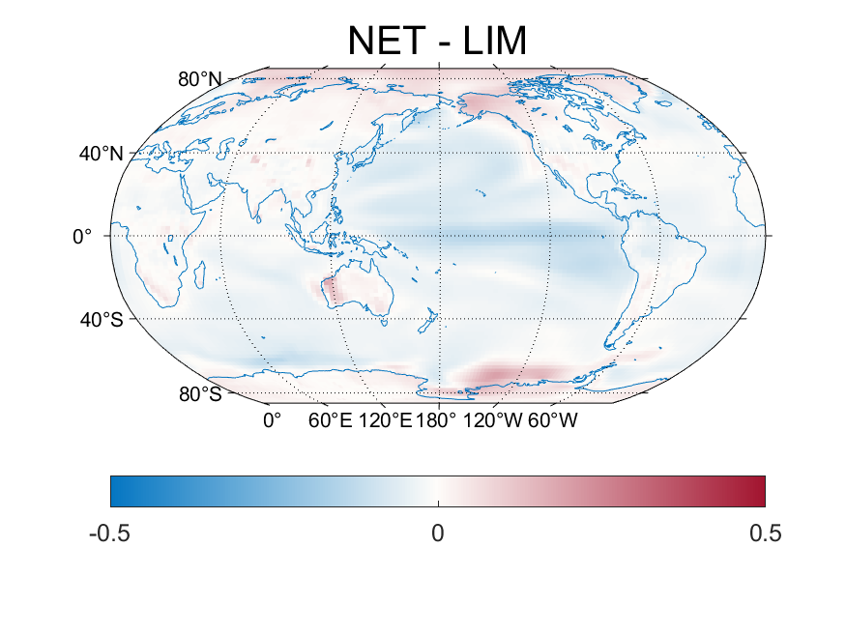
Online PDA with DL-based surrogate models
Compared to the climatologic priors used by offline PDA, LIM has improved predictive skills for 5 years
NET further improves the predictive skills than LIM, especially over the ocean
Notes:
except for the degradations near the poles

Slide 25
Online PDA with DL-based surrogate models
An online PDA with the integrated hybrid ensemble Kalman filter (IHEnKF; Lei et al. 2021)
Integrated Hybrid EnKF
(IHEnKF)
Analog blending inflation

Slide 26
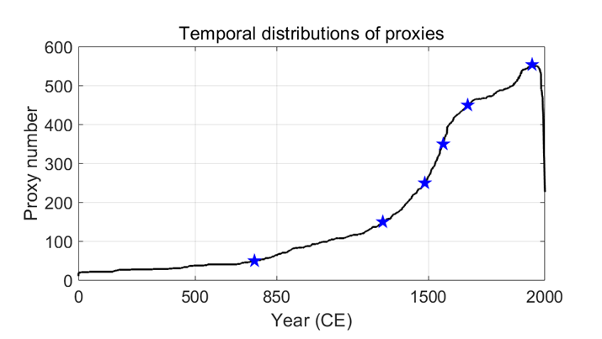
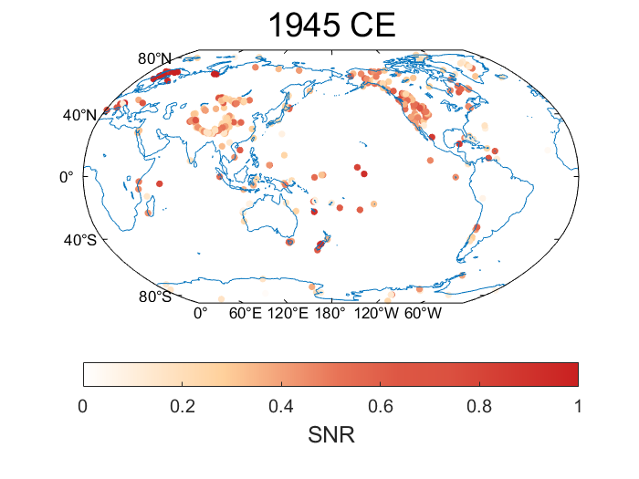
Online PDA with DL-based surrogate models
Proxies from the PAGES 2k Consortium (Emile-Geay et al. 2017) with the real proxy network / various pseudoproxy networks are assimilated
The PSM is constructed by a linear univariate model for each kind of proxy

Slide 27
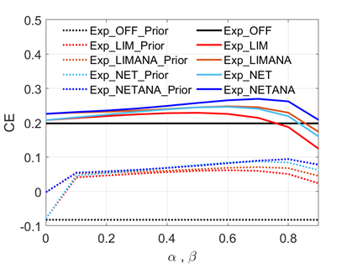
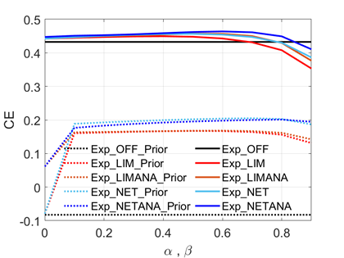
Online PDA with DL-based surrogate models
150 proxies
554 proxies
For both sparse and dense proxy records, experiments LIM and NET have larger CEs of priors and posteriors than experiment OFF, which is mainly contributed by the online model cycling with surrogate models

Slide 28
Online PDA with DL-based surrogate models
150 proxies
554 proxies
Experiments LIMANA and NETANA that use the analog blending, achieve larger CEs than experiments LIM and NET
The analog ensembles produce a more accurate prior ensemble mean and plays the role of static B with somewhat “flow-dependent” error structures

Slide 29
Online PDA with DL-based surrogate models
150 proxies
554 proxies
Experiment NET (NETANA) has larger CEs than experiment LIM (LIMANA), especially for the optimal hybrid / blending weight, because of the high-dimensional input and representation of nonlinear processes

Slide 30
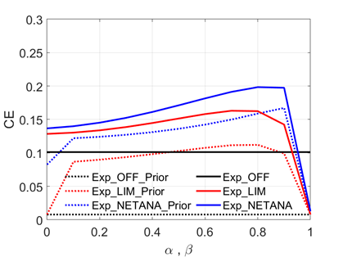
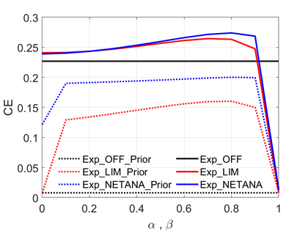
Online PDA with DL-based surrogate models
150 proxies
554 proxies
Experiments LIM and NETANA have larger CEs of priors and posteriors than experiment OFF, led by the gained forecast skills from the online cycling
Experiment NETANA produces larger CEs than LIM, which proves the improved predictive skills further gained from NET
Notes:
Experiment NETANA is superior to experiments LIM and OFF, with enlarged advantages given sparser proxies

Slide 31
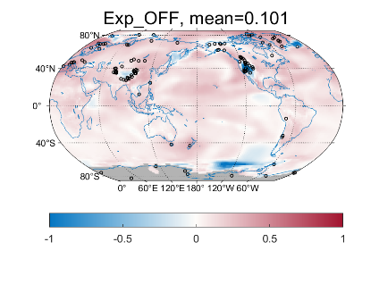
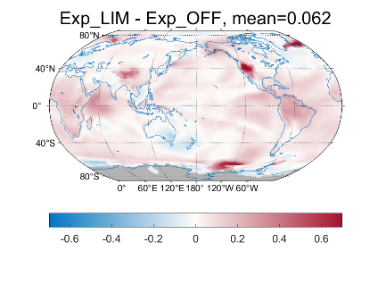
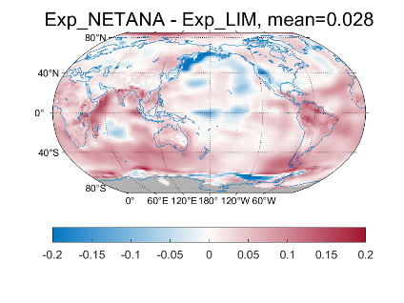
Online PDA with DL-based surrogate models
Experiment LIM is superior to experiment OFF, especially over the ocean
Compared to LIM, experiment NETANA further enhances the reconstruction skill, especially over the middle latitude ocean and some continental regions
Notes:
The advantages of Exp_NETANA over Exp_LIM and Exp_OFF are mainly led by the nonlinear predictive skills provided by the NET and more informative ensembles by the analog blending. The differences among Exp_OFF, Exp_LIM and Exp_NETANA are enlarged with sparser proxy data.

Slide 32
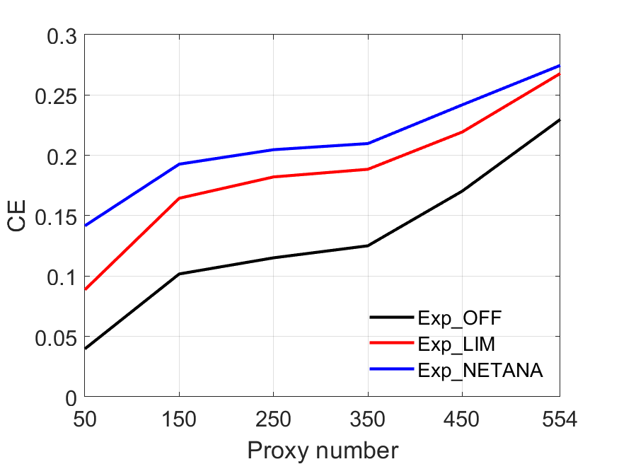
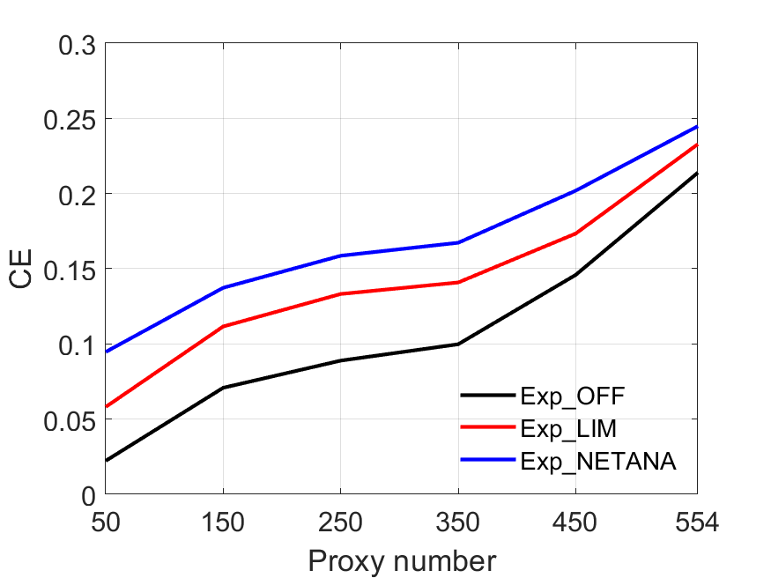
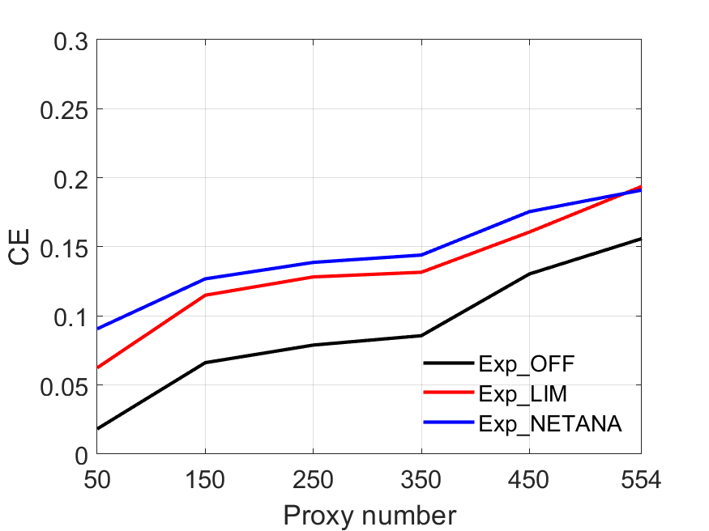
Online PDA with DL-based surrogate models
BE
GISTEMP
20CR
Experiment LIM outperforms experiment OFF, and experiment NETANA further improves the reconstruction compared to LIM
The differences among the experiments become more prominent, as the number of assimilated proxy data decreases

Slide 33
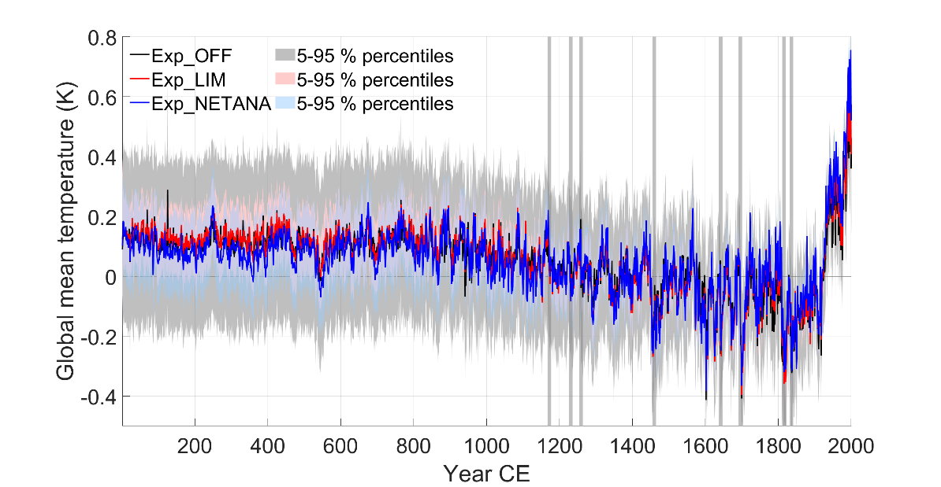
Online PDA with DL-based surrogate models
Exp_NETANA shows larger temperature variability compared to Exp_OFF and Exp_LIM, which mainly comes from improved predictive skill of the NET and the analog ensembles selected based on the proxy data

Slide 34
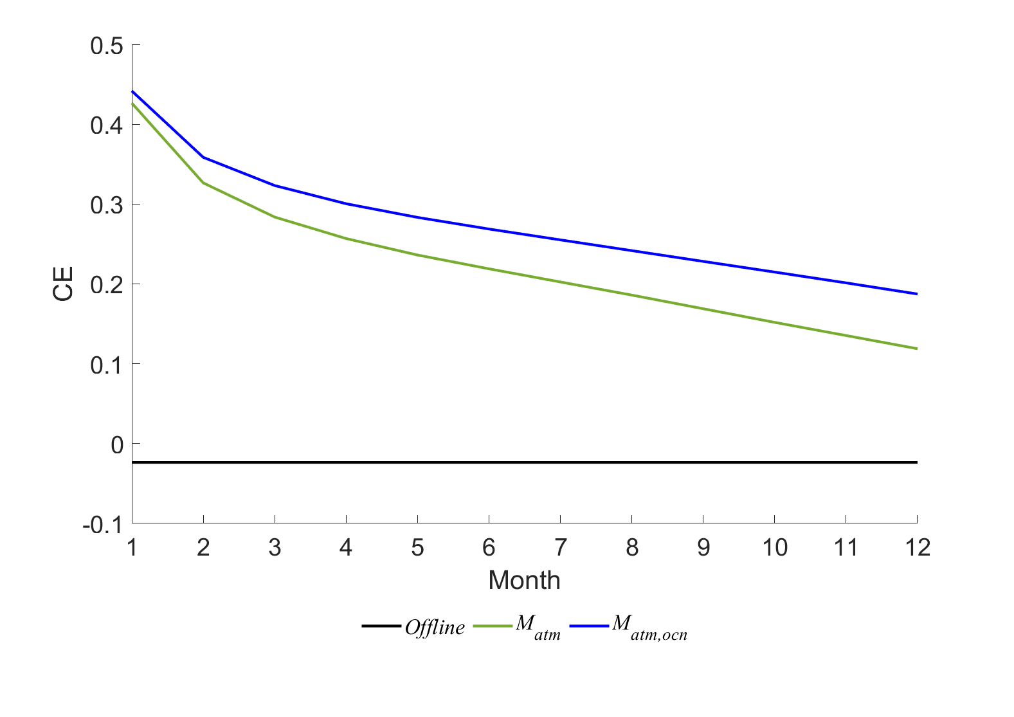
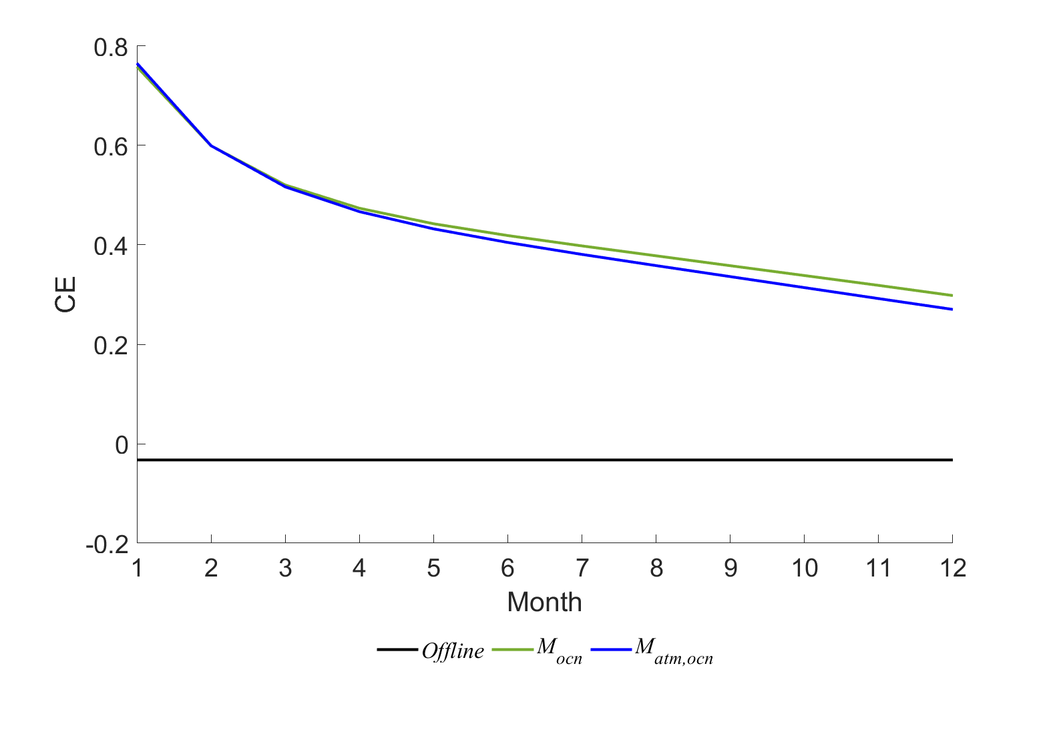
Weakly- and strongly-coupled PDA
Surface air temperature (SAT)
Sea surface temperature (SST)
Lei et al. (2026 JAMES)
Standalone models (M_{atm} and M_{ocn}) and coupled model (M_{atm,ocn}) are trained with monthly resolution and 1-year lead time
By coupling M_{ocn} to M_{atm}, forecast skills of SAT are improved, which is contributed by longer time scales and memory of ICs of SST than SAT

Slide 35
Weakly- and strongly-coupled PDA
Surface air temperature (SAT)
Sea surface temperature (SST)
But forecast skills of SST are slightly degraded when M_{atm} is coupled to M_{ocn}, since SAT has shorter time scales than SST and it acts as high-frequency noises to SST

Slide 36
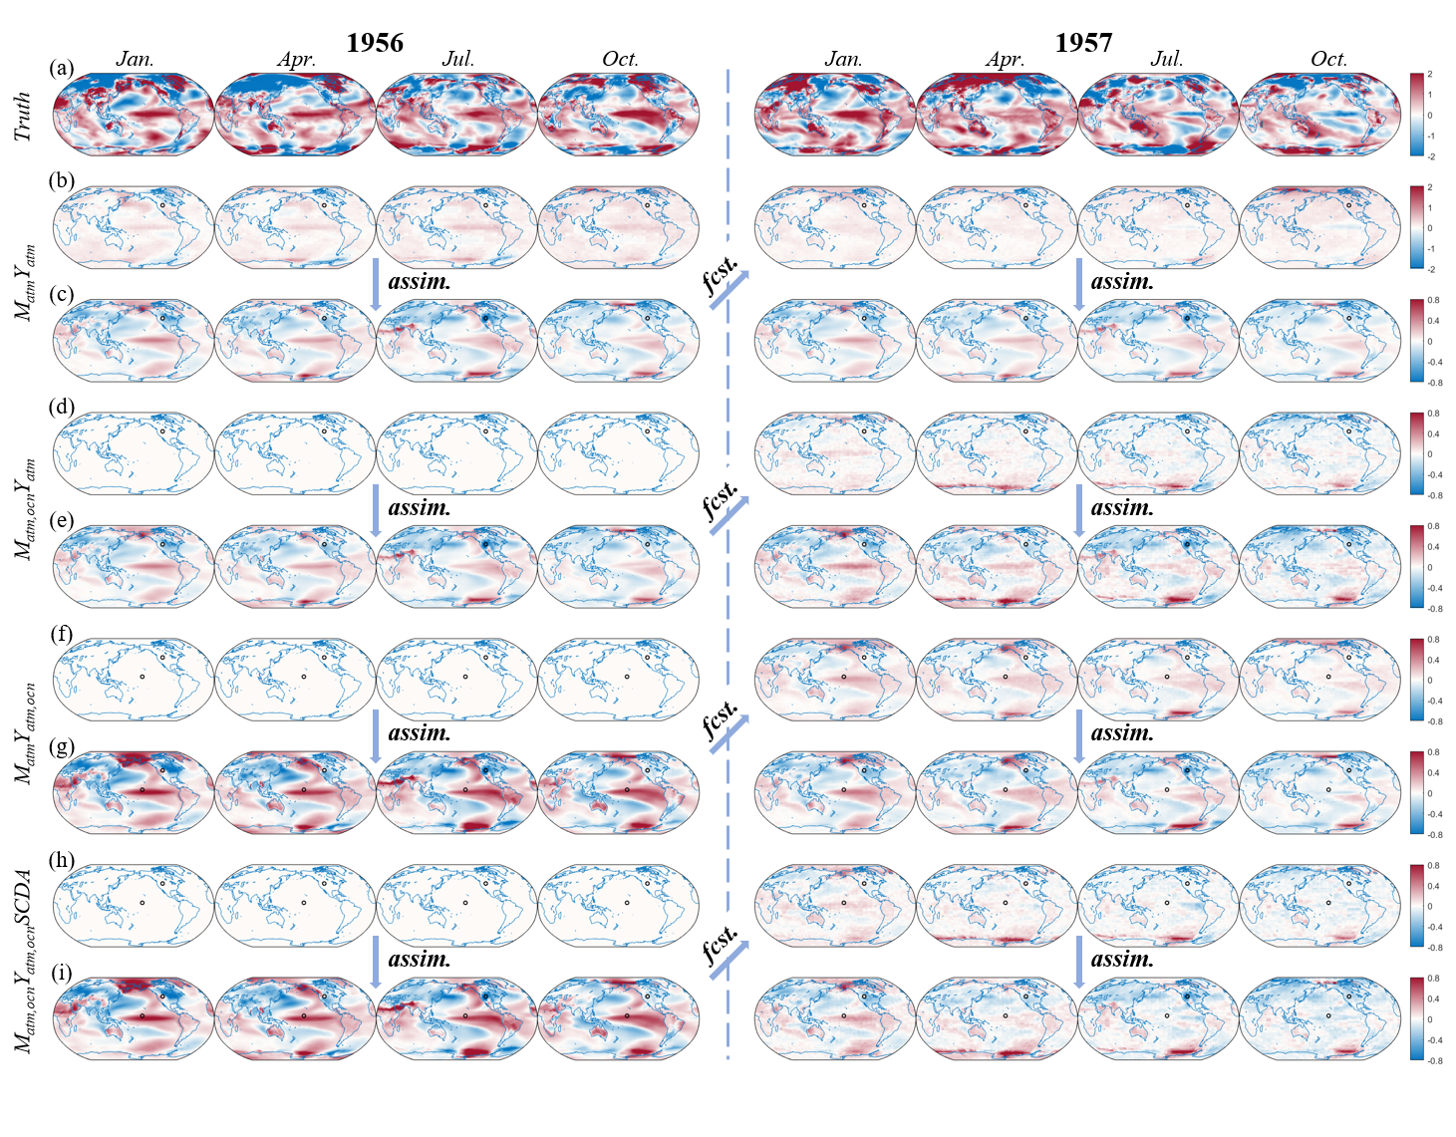
Weakly- and strongly-coupled PDA
Single-observation experiment of 1956-1957 period for SAT

Slide 37
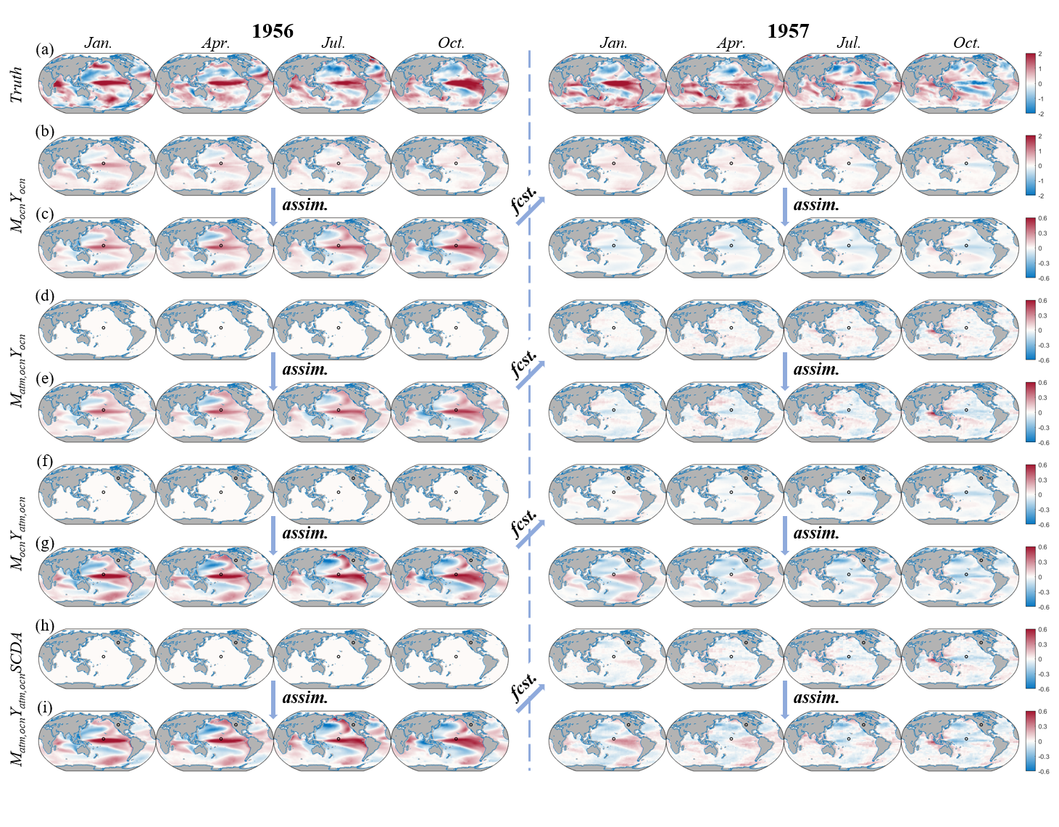
Weakly- and strongly-coupled PDA
Single-observation experiment of 1956-1957 period for SST

Slide 38
Weakly- and strongly-coupled PDA
Surface air temperature (SAT)
Sea surface temperature (SST)
Coupling an oceanic component to atmospheric model is beneficial for SAT predictions, but the opposite for SST by coupling an atmospheric component
This is mainly due to different time scales, as high frequent noises introduced by coupling an atmospheric component to oceanic model

Slide 39
Weakly- and strongly-coupled PDA
Surface air temperature (SAT)
Sea surface temperature (SST)
Compared to the coupled model, cross-component update from cross-component proxy has larger positive impacts on SAT and SST analyses
Simultaneously assimilating atmospheric and oceanic proxy with a coupled model yields the most accurate SAT and SST reconstructions
Notes:
Assimilation of atmospheric / oceanic proxy in the associated component model is beneficial for the reconstruction of SAT / SST
, so the advantages of SCDA for PDA are demonstrated

Slide 40
Discussions and conclusions
The ability of state-of-the-art AI weather models within the framework of cycling DA is demonstrated, achieving a successful and stable cycling DA with assimilation of real-time sounding observations
An online PDA with a DL-based surrogate model and an integrated hybrid EnKF is proposed and further developed for weakly- and strongly-coupled PDA, which leads to improved paleoclimate reconstruction.
A hybrid dynamical and AI framework for weather forecasts and paleoclimate reconstruction

Slide 41
Thanks!

