Slide 1


Posterior Sampling in Variational Data Assimilation via Flow-matching
EnKF Workshop 2026
15-18 June, 2026, Rosendal, Norway
Shashank Kumar Roy, Paul de Nailly, Ronan Fablet
Lab-STICC, IMT Atlantique

Slide 2
The Challenge:
Can we use Flow-matching to turn a Variational Data Assimilation into a posterior sampler?

Slide 3
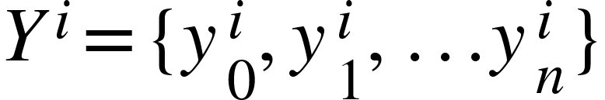
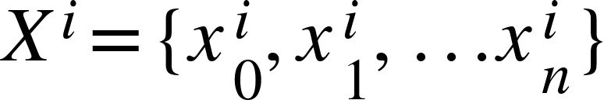

Background: 4DVar Data Assimilation
Var Data Assimilation: Minimize the cost function to reduce misfit with observations and consistent with the physical models to determine the
optimal state reconstruction.
Observations
& states
: Dynamical model
Weak 4DVar Cost

Slide 4
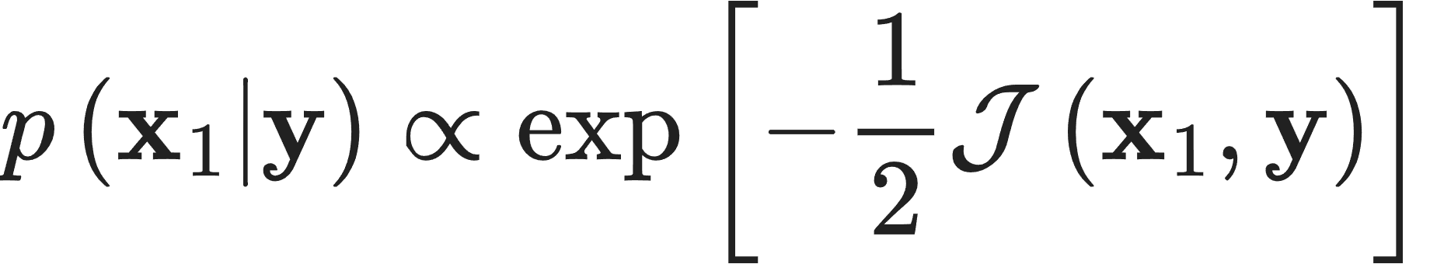
The Bayesian Perspective
The 4D-Var cost function is the negative log-posterior density given the observations:
The minimiser is a the MAP estimator
BFGS(or LBFGS)/ Gradient Descent (works with more number of steps).

Slide 5






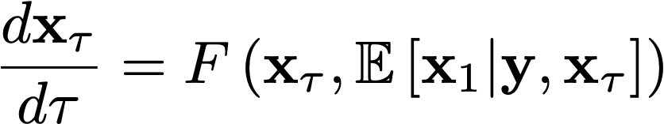

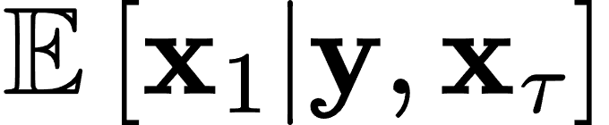
Flow matching path from a Gaussian space to the targeted physical space
State
Observations
All we need is an estimator:
Lipman et al., 2023; Albergo et al., 2025
Notes:
Now we introduce the estimator which 4dvar can give us.

Slide 6
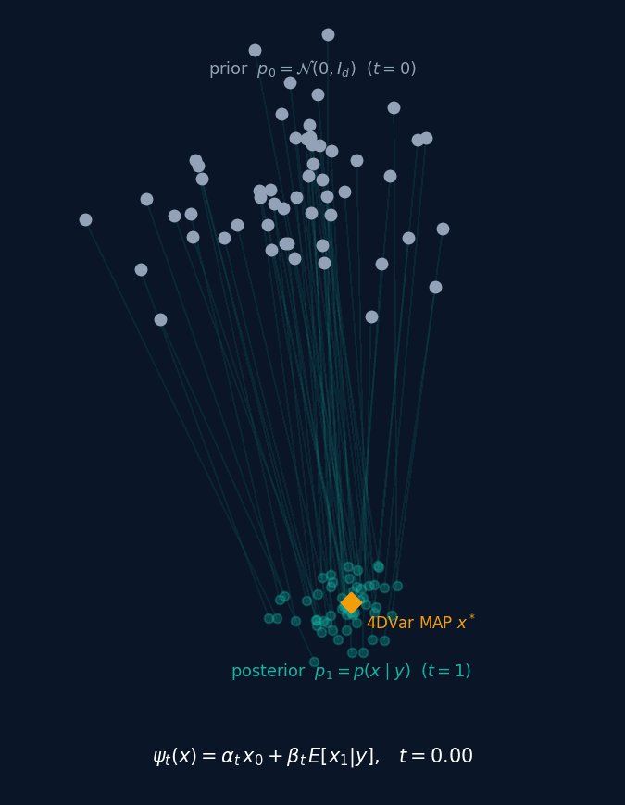
Flow-matching trains a network
to learn this estimator !!
Can DA algorithms be used
as the estimator?
We have no training data but a da solver with the observations can give us an estimate.
We choose variational data assimilation in (weak-4dvar form).

Slide 7
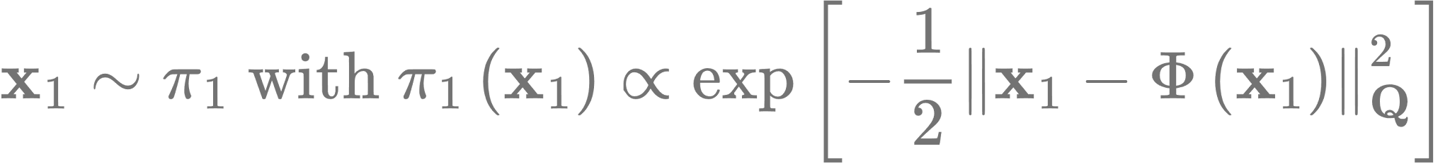
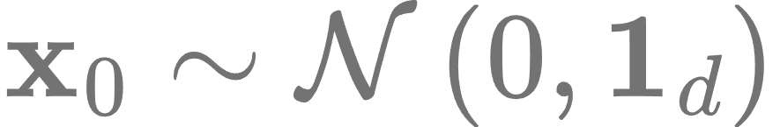
Bridging 4DVar and Flow-matching
-
The cost function depends on flow-matching time!

Slide 8
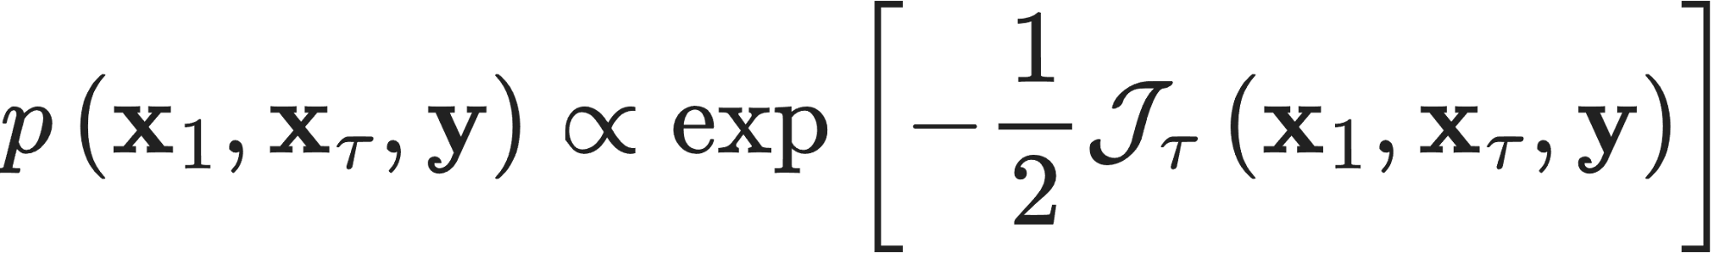
Bridging 4DVar and Flow-matching
-

Slide 9

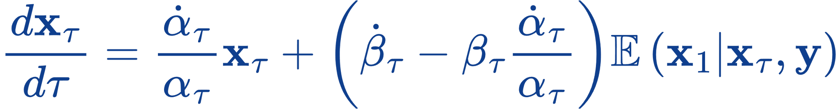


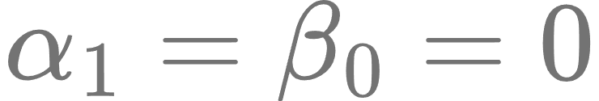
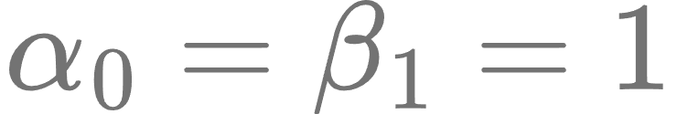
Corresponding Flow-matching ODE
With Boundary conditions on &

Slide 10

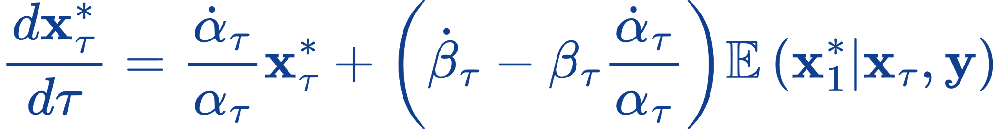

We can also sample only Anomalies!

Slide 11
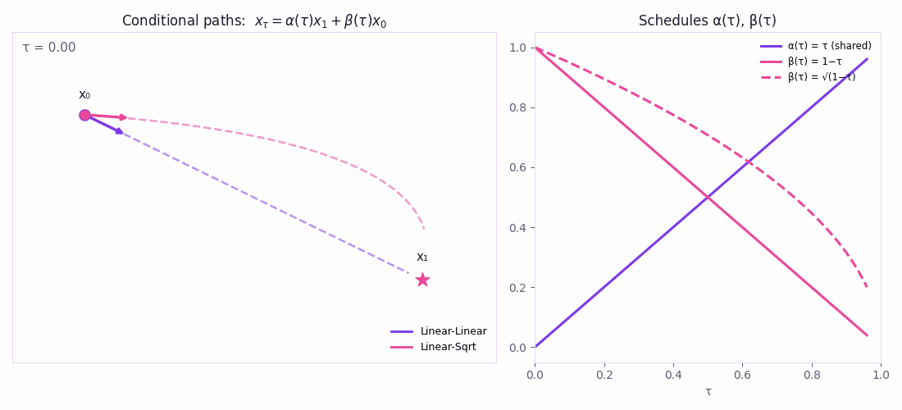

Slide 12
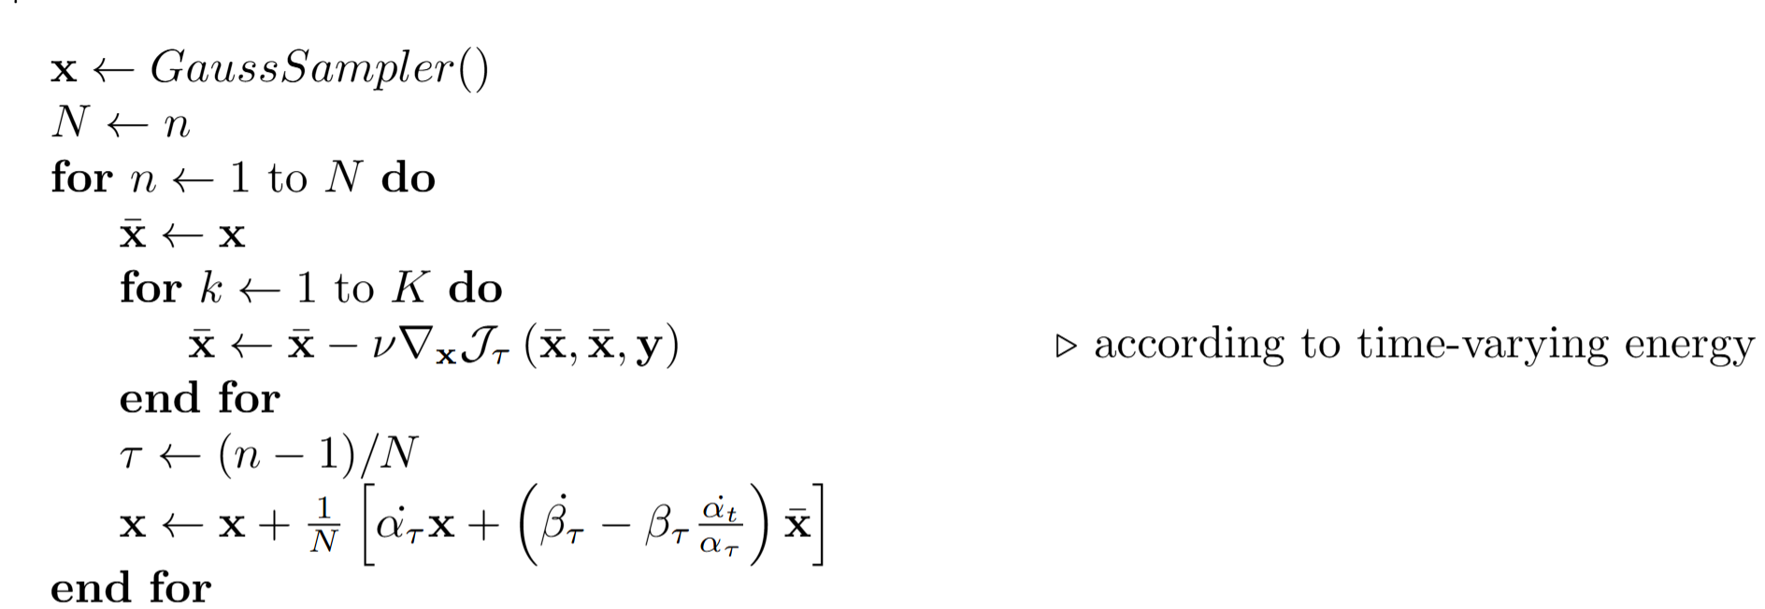
Algorithm: 4DVar-FM

Slide 13
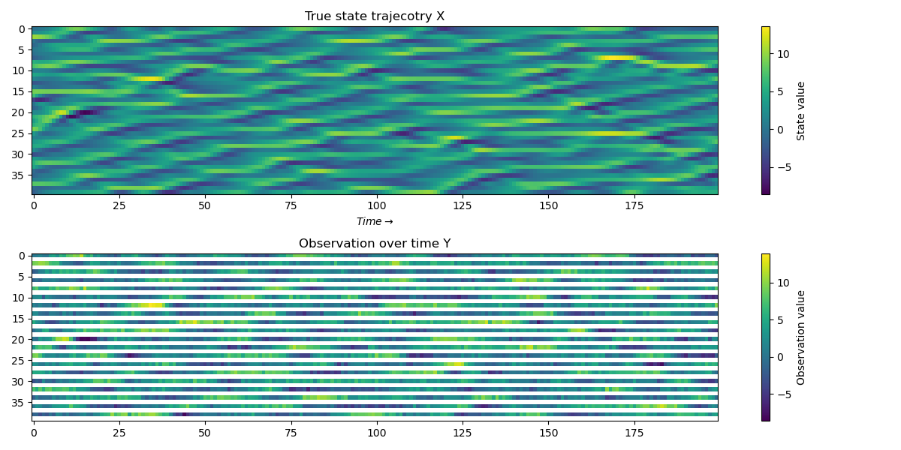
Lorenz-96 case study
DAPPER testbed: https://github.com/nansencenter/DAPPER
L96 system with 40 coupled variables (interpreted as latitudes).
Observations are noisy & partial, (every alternate component observed).

Slide 14
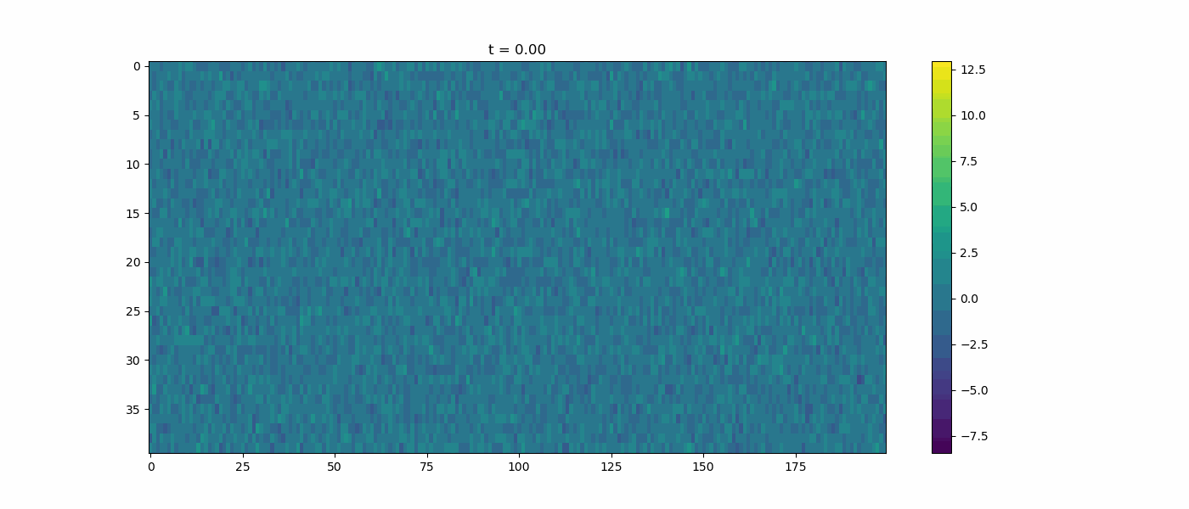
Illustrative example of the generation

Slide 15
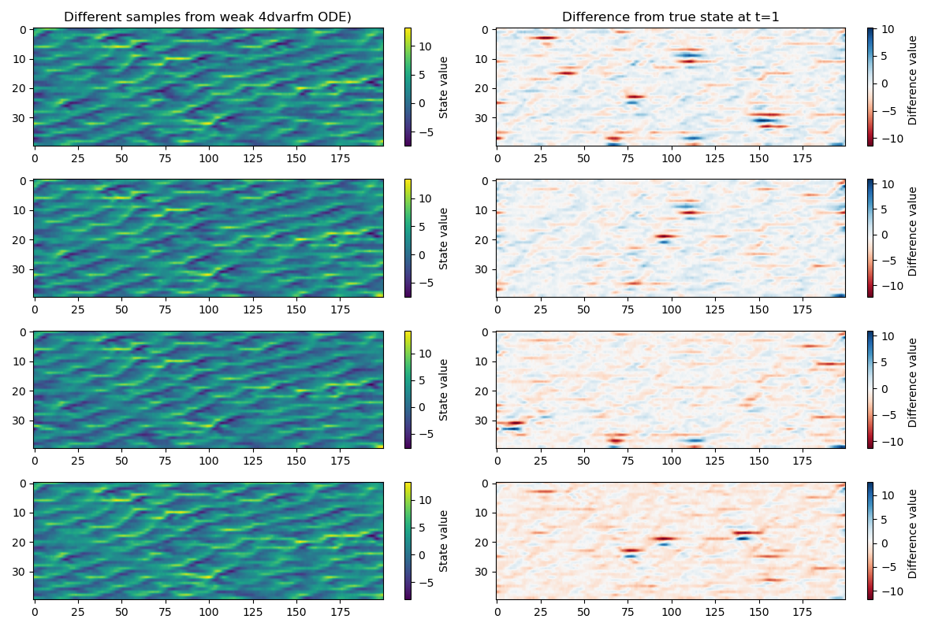
Sampling the posterior (different I.C.)

Slide 16
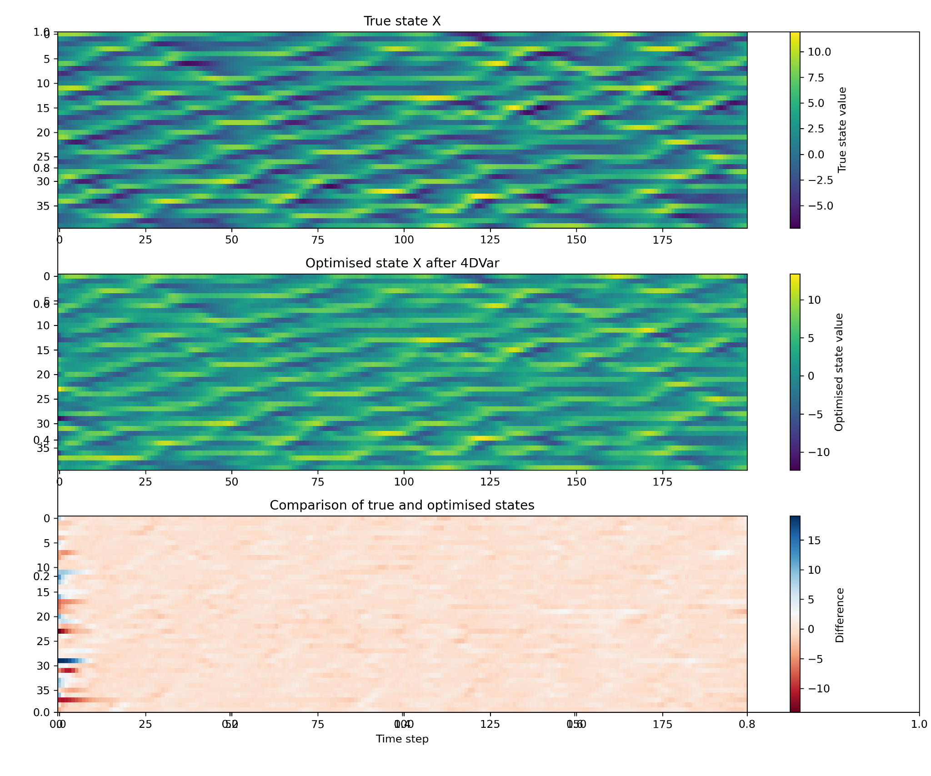

Slide 17
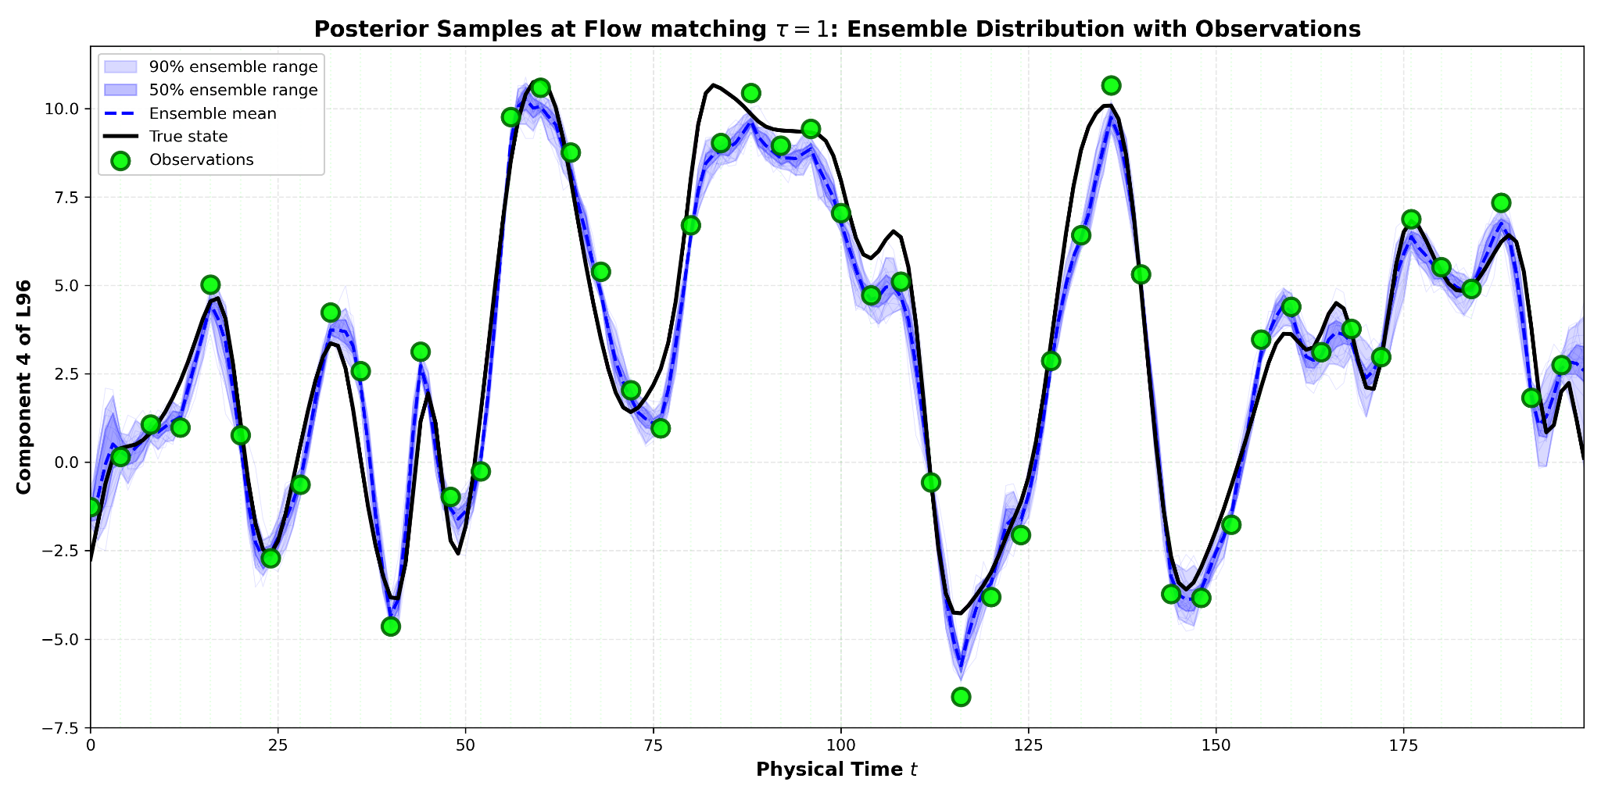

Slide 18
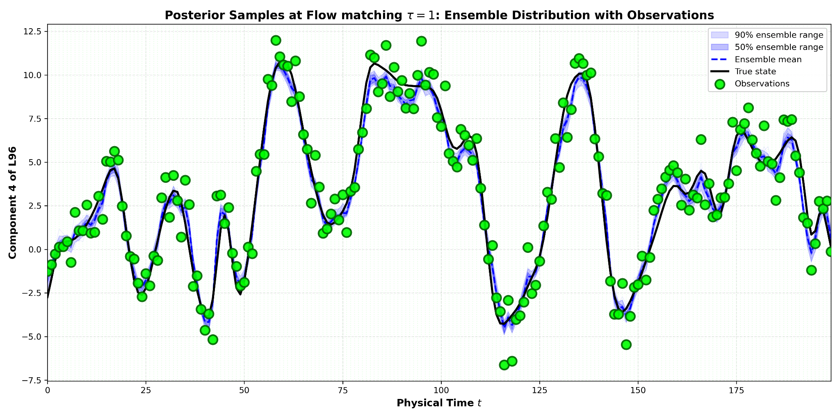

Slide 19


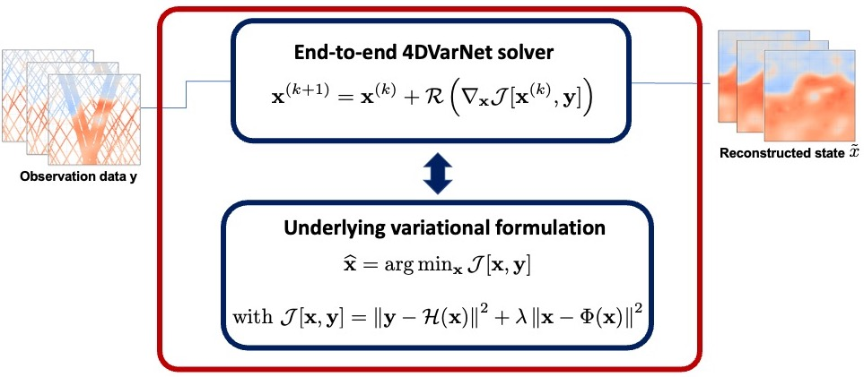


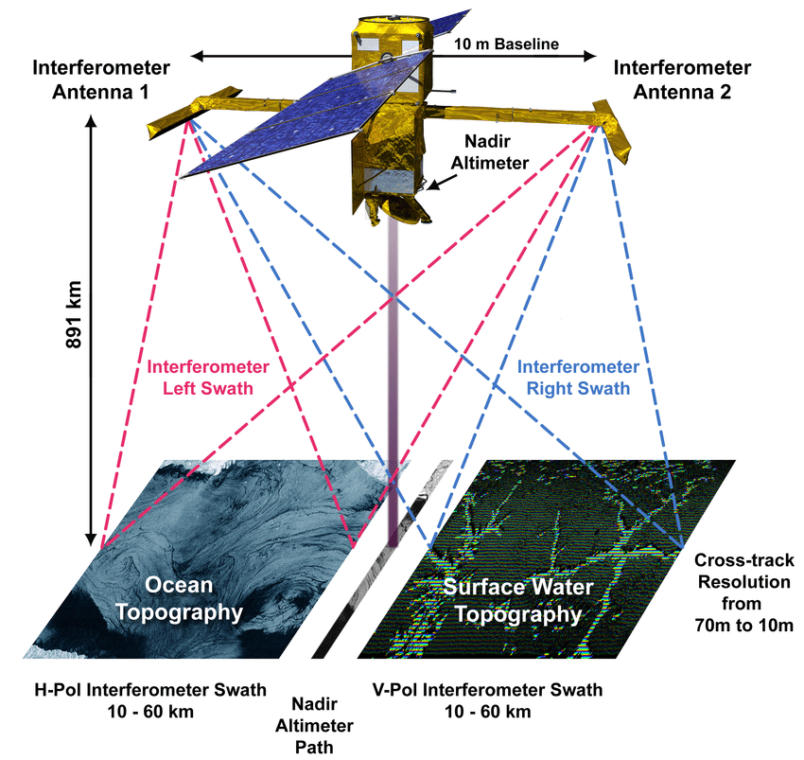
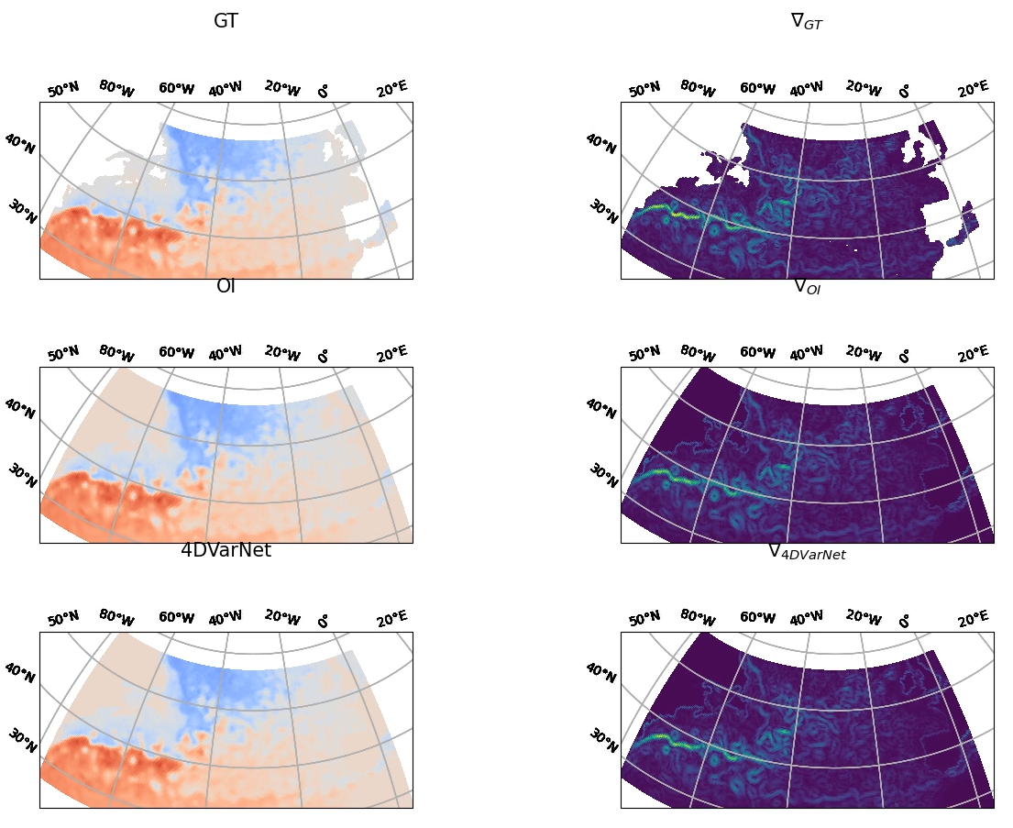
From 4DVar-FM to 4DVarNet-FM [Fablet et al., 2021]
From a Variational DA formulation
End-to-end neural DA scheme
Method
Trainable variational model
Trainable gradient-based solver
Region-scale mapping
Proposed approach: Bridging DA and Flow Matching
Scalable neural-based DA model.
Flow-matching for sampling multiple outputs.
Current demonstrations
Notes:
So first, a quick reminder of the 4DVarNet framework.
It can be seen as an end-to-end neural DA backboned on a variational formulation. The key idea is to make the whole variational DA pipeline fully differentiable, and jointly learn the variational cost function — prior included — and the gradient-based solver used for the optimization. So instead of prescribing the model and the inversion scheme, both are learned from data.
Now, looking at current demonstrations, the main questions are really about scalability.
How can we extend 4DVarNets to global-scale and fully 3D ocean data assimilation?
And how do we properly account for uncertainty in this framework?
To address these challenges, the proposed direction is to bridge data assimilation with generative approaches - in particular flow matching, opening the way toward probabilistic and scalable formulations

Slide 20
Conclusions & Future work
A method to systematically sample states around a given true state- an ensemble.
4DVarNet : a neural data assimilation model based on 4DVar.
Towards parameter calibration with joint estimation for states and parameters.
Understanding the impact of 4DVar solvers vs the ODE solvers in flow-matching samplers.

Slide 21
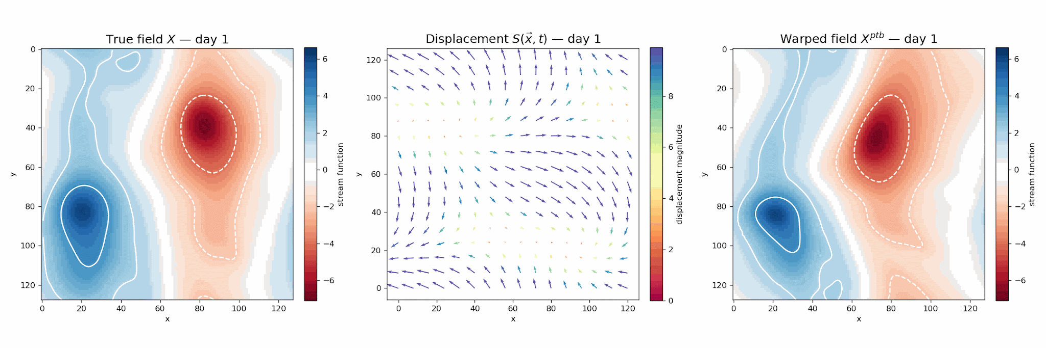
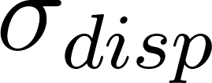
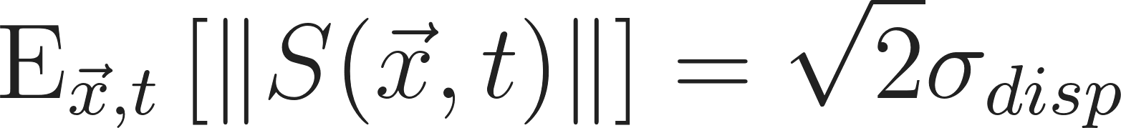


….a way to model location uncertainty (we can talk at poster time)
: the std. of the random displacements
: the spatial & temporal correlation lengths
21

Slide 22
References
Fablet, R.; Chapron, B.; Drumetz, L.; Mmin, E.; Pannekoucke, O.; Rousseau, F. Learning Variational Data Assimilation Models and Solvers. Journal of Advances in Modeling Earth Systems n/a (n/a), e2021MS002572.
Fablet, R.; Beauchamp, M.; Drumetz, L.; Rousseau, F. Joint Interpolation and Representation Learning for Irregularly Sampled Satellite-Derived Geophysical Fields. Frontiers in Applied Mathematics and Statistics 2021, 7.
Yannick Tremolet, Accounting for an imperfect model in 4D-Var https://doi.org/10.1256/qj.05.224
Thank You for your time
and Attention!

