Slide 1


New features in NEDAS v1.2.0 and applications in geophysical data assimilation
Yue (Michael) Ying
NERSC
EnKF Workshop 2026, Rosendal, Norway

Slide 2
Outline
Part 1: How I built NEDAS, some development history
Part 2: Using the software, some examples
Part 3: Why I built it, motivation and future works
1/24

Slide 3
Development history
Models at NERSC
HYCOM-CICE (TP4, TP5)
neXtSIM (Lagrange, dG)
NorESM
NEDAS was an initiative to unify the DA practice at NERSC.
Python DA core: ETKF/EAKF
Bash control script
Offline DA only
Added more DA methods
Python control script
Both online/offline
Refactor of assim_tools
Introduced core and base classes
I joined NERSC
init
v1.0-beta
v1.1.0
v1.2.0
2020
2022
2024
2025
2026
2/24

Slide 4
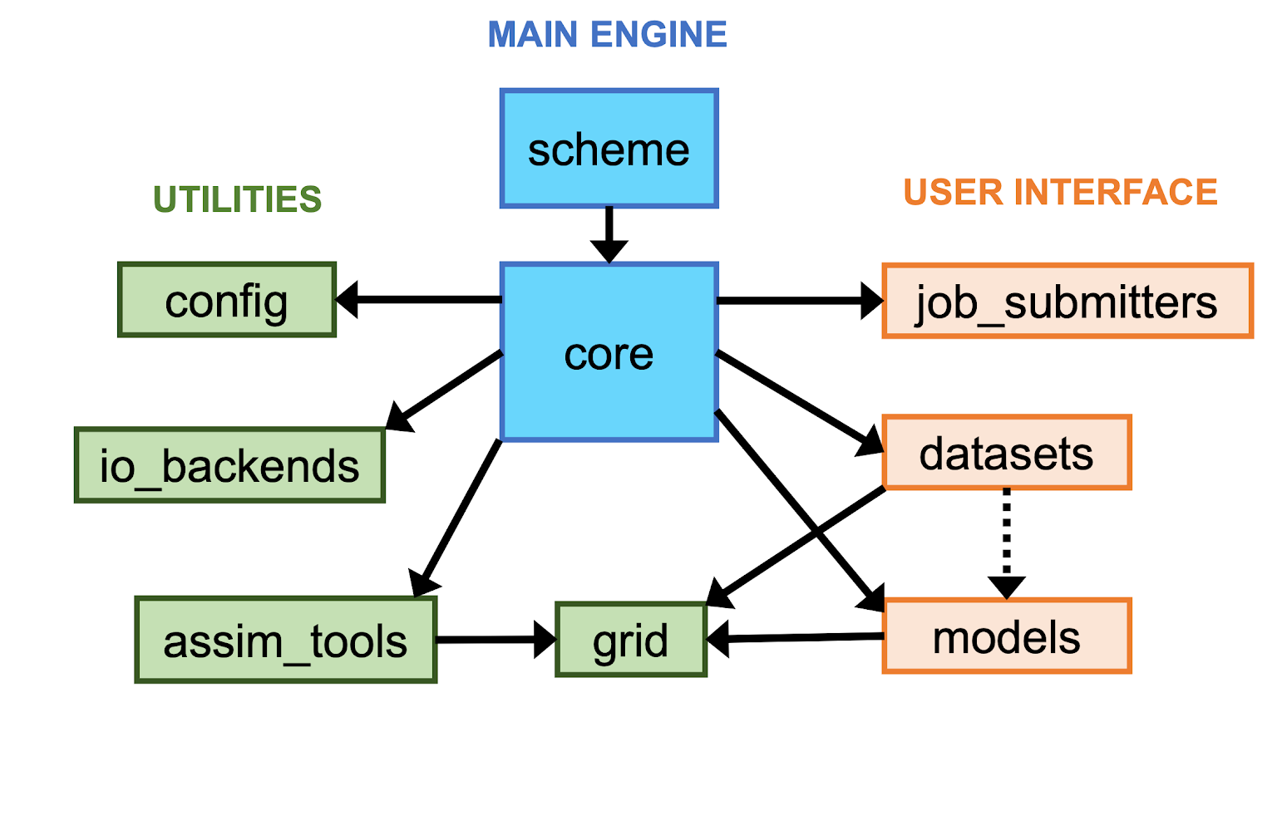
Architecture
deals with running external programs on various computer platforms
deals with observations processing and forward operators
deals with model restart file read/write and running forecasts
contains DA algorithmic components:
Assimilator / Updator
Localization / Inflation / Perturbation / Misc. Transforms
3/24

Slide 5










DA algorithmic components
Misc. transform of prior state/obs
such as scale decomposition, anamorphosis…
Assimilator:
EnKF (different variants)
other non-Gaussian filters (such as QCEF)
observation
Localization
“observation prior”
Assimilator
misc. transform
Inflation
Covariance
Updator:
Inverse transform
or other enhancement
prior state
Updator
posterior state
Perturbation
state-space
increment
4/24

Slide 6
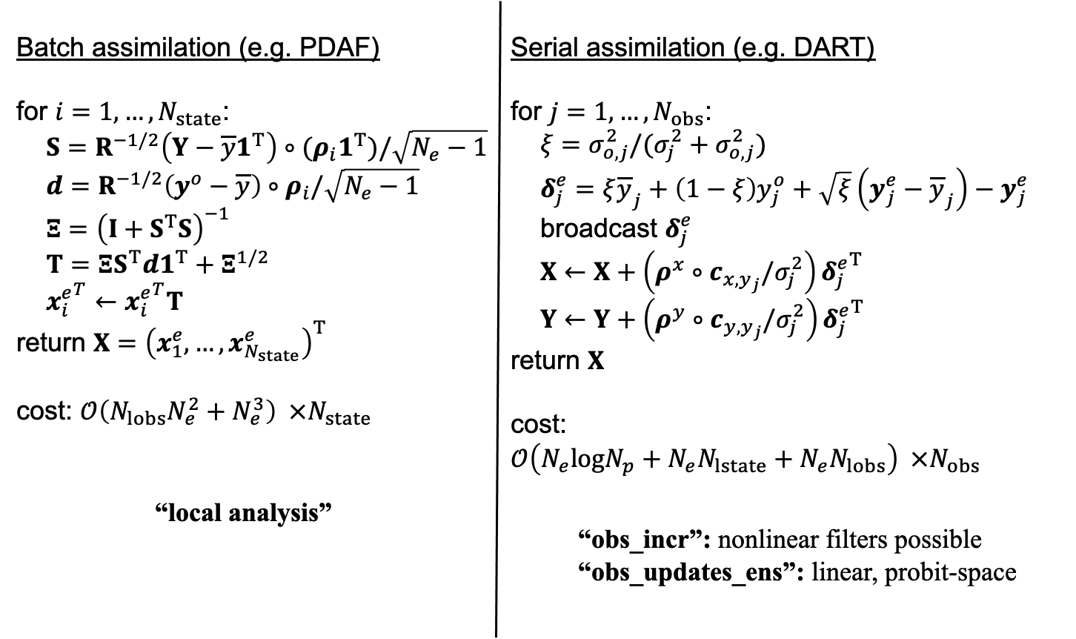
Parallelization
5/24

Slide 7
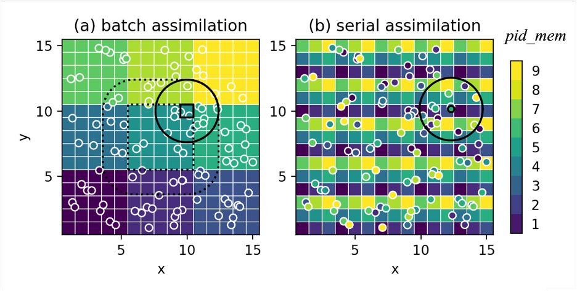
Parallelization
6/24

Slide 8
Outline
Part 1: How I built NEDAS, some development history
Part 2: Using the software, some examples
Part 3: Why I built it, motivation and future works
7/24

Slide 9
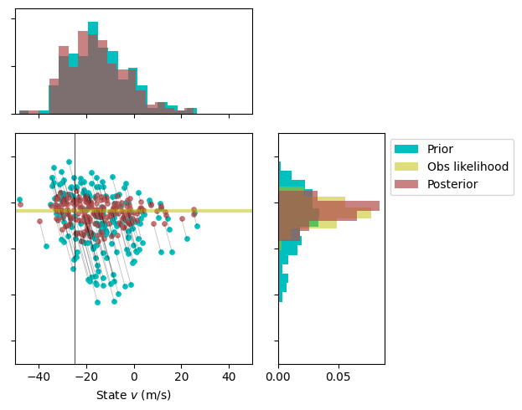
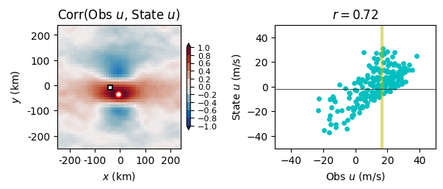
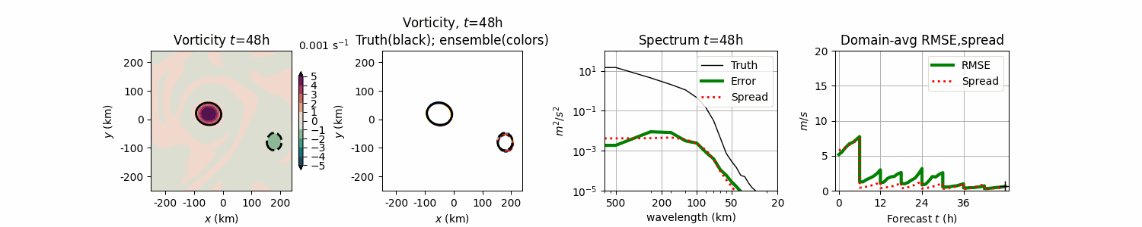
Vort2d model step-by-step tutorial
github.com/myying/NEDAS_tutorials
8/24

Slide 10
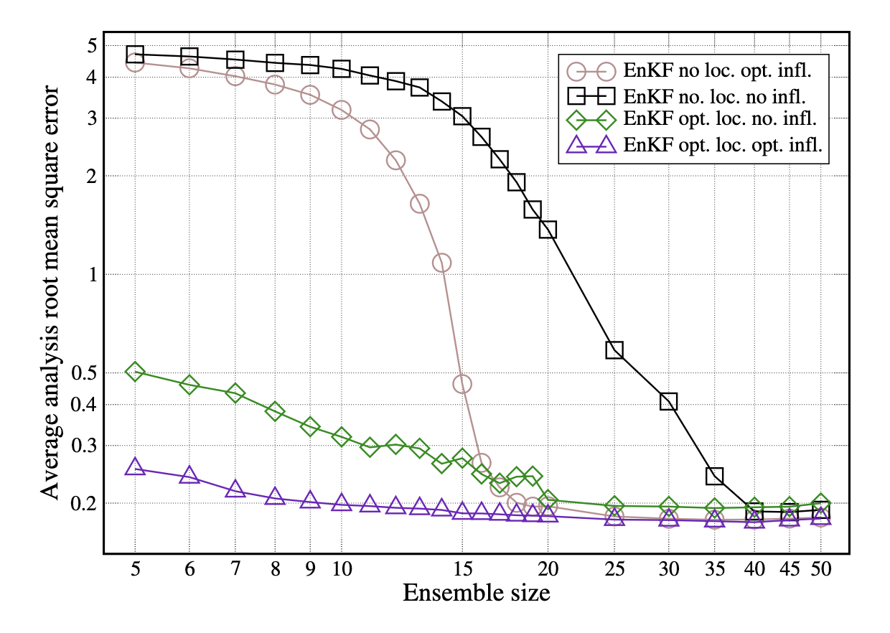
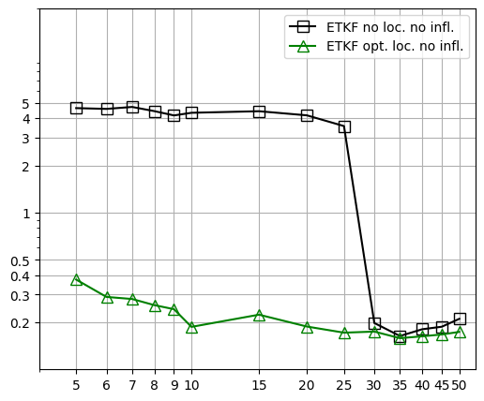
Lorenz96 benchmark
NEDAS results
Figure 5.7 from Marc Bocquet’s Lecture Notes
Ensemble size
Also, from DAPPER’s basic_3.py
9/24

Slide 11
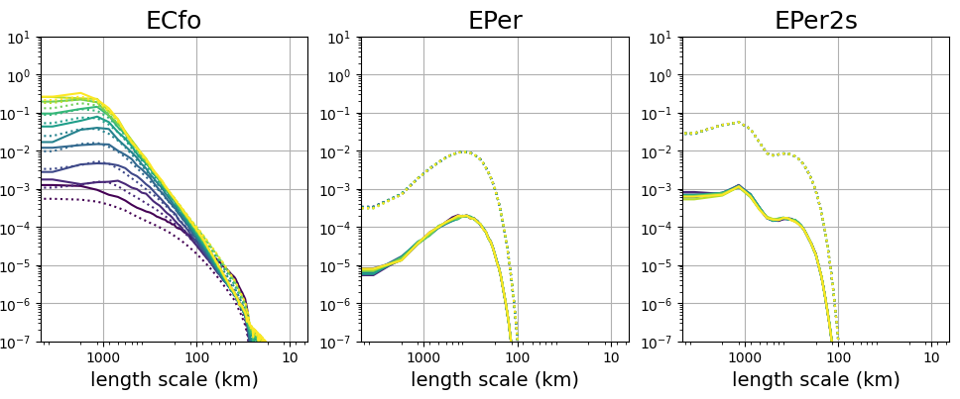
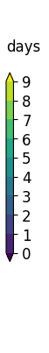
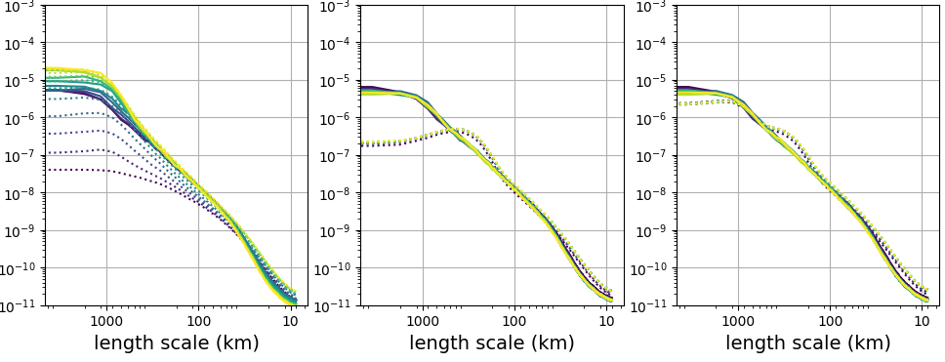
TOPAZ: calibration of ensemble spread
Solid: error
Dotted: ensemble spread
ECfo: ECMWF forecasts
EPer: TOPAZ ensemble perturbation scheme
EPer2s: 2-scale perturbation
Surface wind
Sea ice velocity
10/24

Slide 12
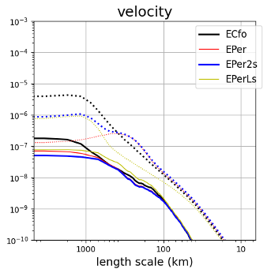
TOPAZ: calibration of ensemble spread
Sea ice drift
Error (solid) & spread (dotted) after DA:
The 2-scale perturbation better represents uncertainties across scales, resulting in a better fit to the available observations.
On-going work: test the impact on cycling DA and forecast skills
11/24

Slide 13
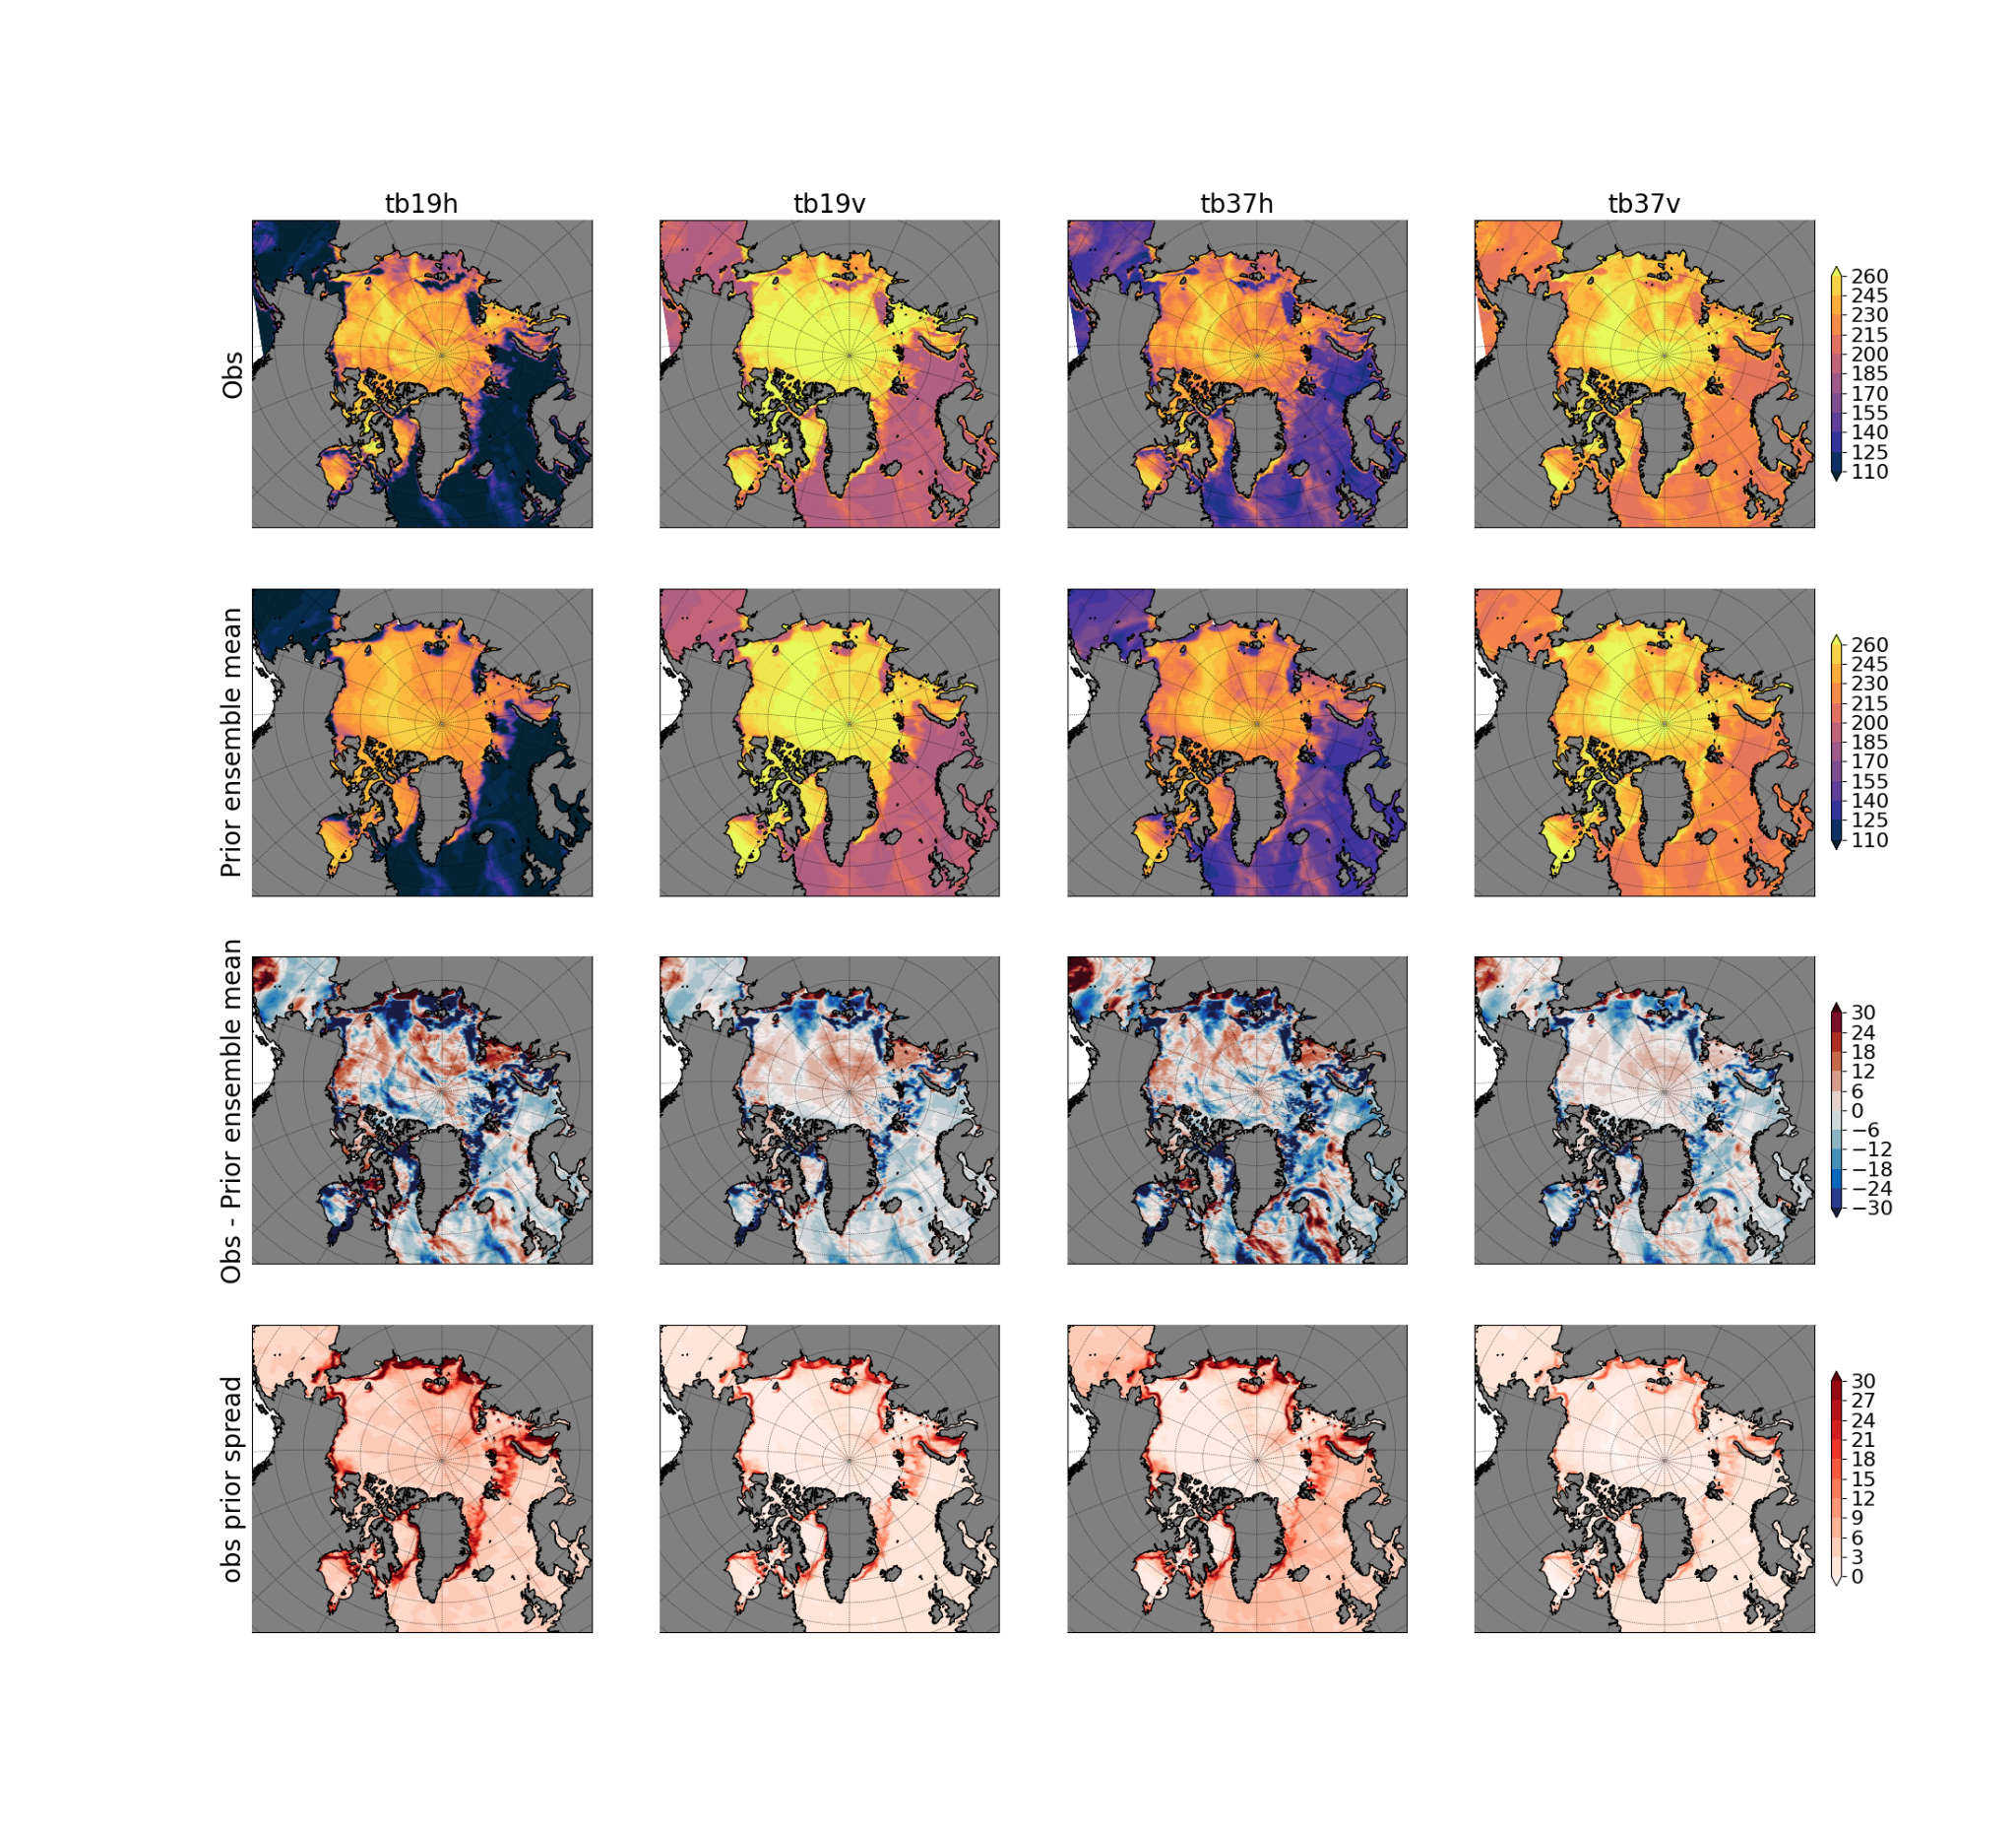
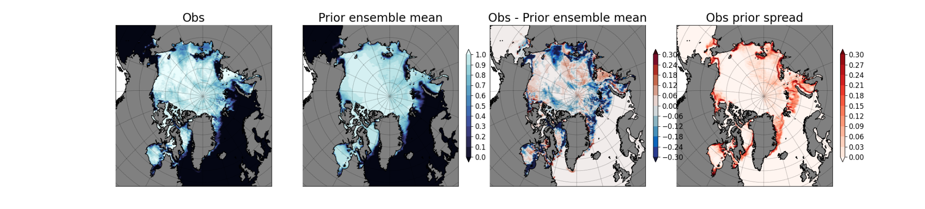
TOPAZ: direct assimilation of Tb
AMSR2 Tb
H = I
Assimilation
AMSR2 SIC
Retrieval
Direct assimilation?
H = RTM
12/24

Slide 14
TOPAZ: direct assimilation of Tb
Observation forward operator: a simplified surface RTM
(Met Norway, Lavergne et al. 2019, github.com/marinadmo/rtm_da)
13/24

Slide 15
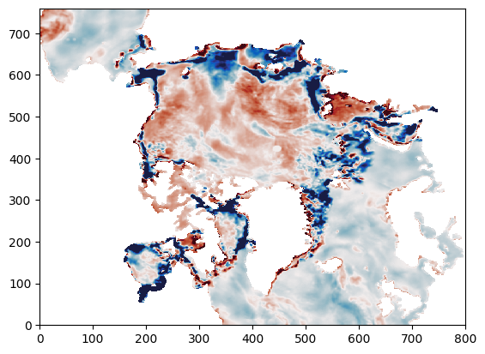


TOPAZ: direct assimilation of Tb
Innovations in Tb19H
Innovations in Tb19V
Analysis increment in SIC
DEnKF
innovation in SIC using retrieval from AMSR2
14/24

Slide 16
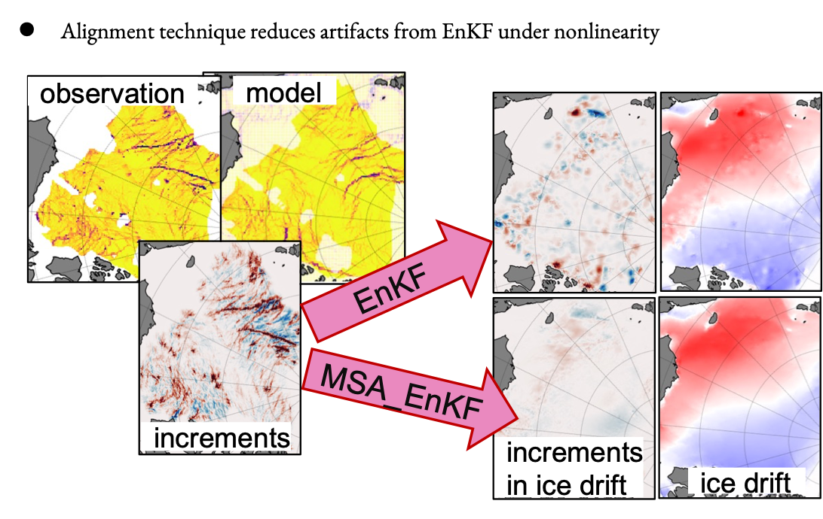
neXtSIM: update linear features with alignment
u
u
15/24

Slide 17
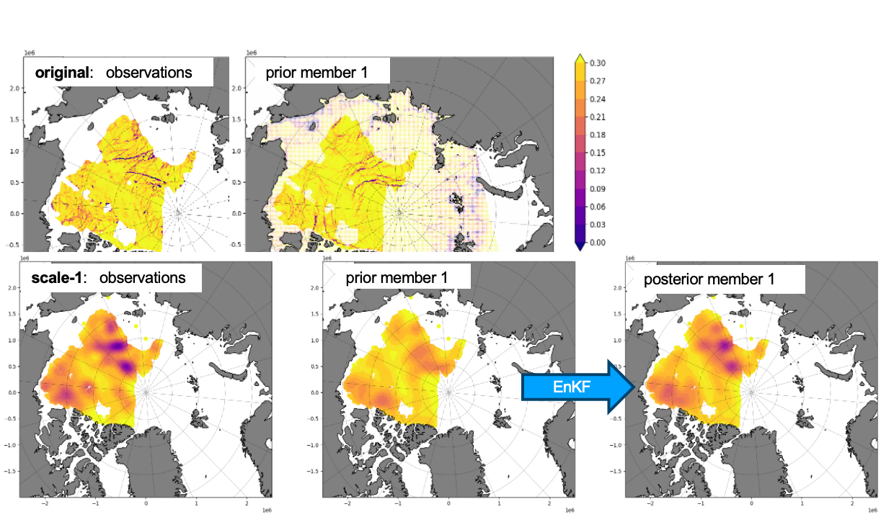
neXtSIM: update linear features with alignment
16/24

Slide 18



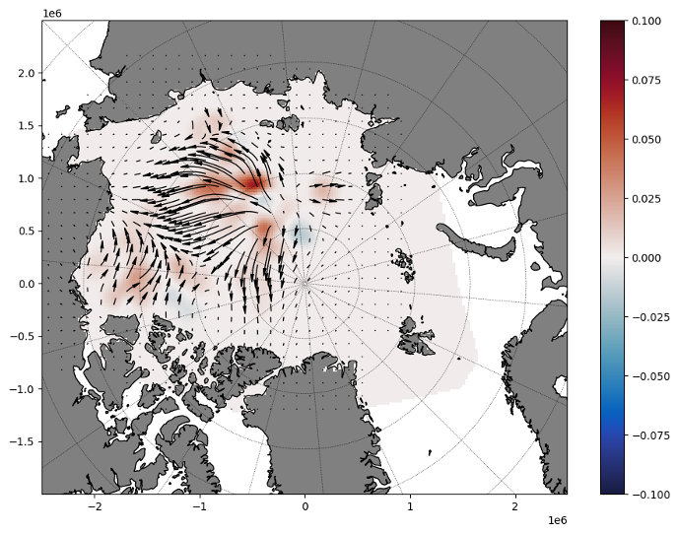
neXtSIM: update linear features with alignment
The “valina” AdditiveUpdator
AlignmentUpdator
“optical flow” in a Multiscale Alignment approach (Ying 2019)
17/24

Slide 19
Outline
Part 1: How I built NEDAS, some development history
Part 2: Using the software, some examples
Part 3: Why I built it, motivation and future works
18/24

Slide 20
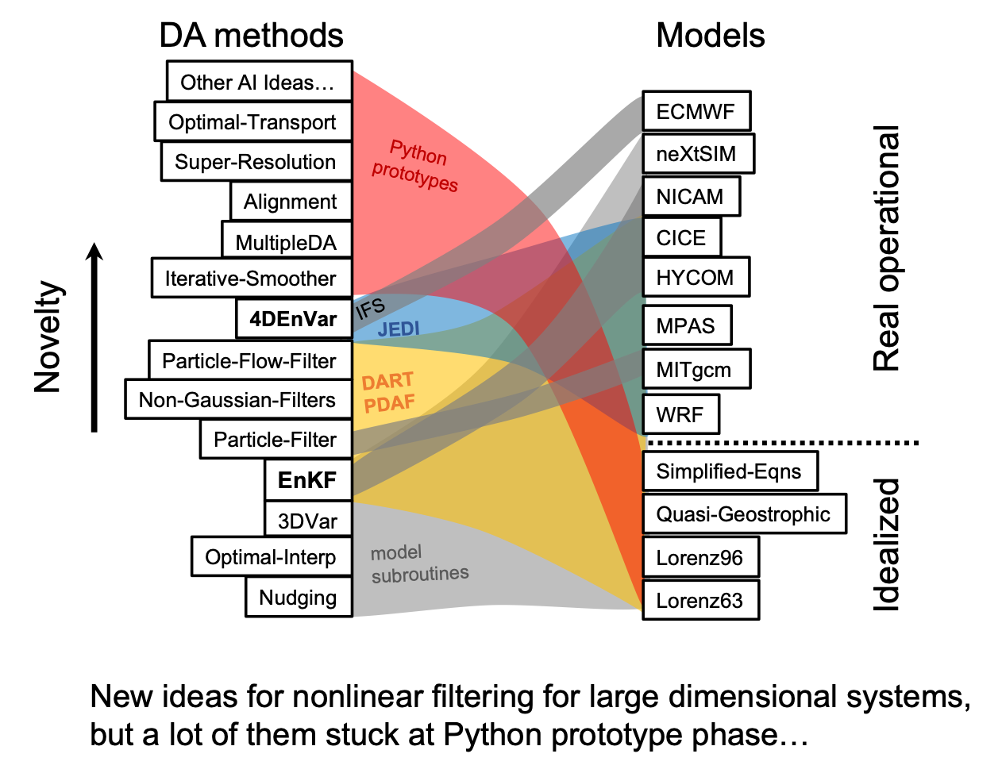
Why I built NEDAS
NEDAS is modular and light-weight: an easier way to implement new method for large models
…new innovations of DA involving not just the core algorithm
…leverage Python ecosystem for AI integration
19/24

Slide 21
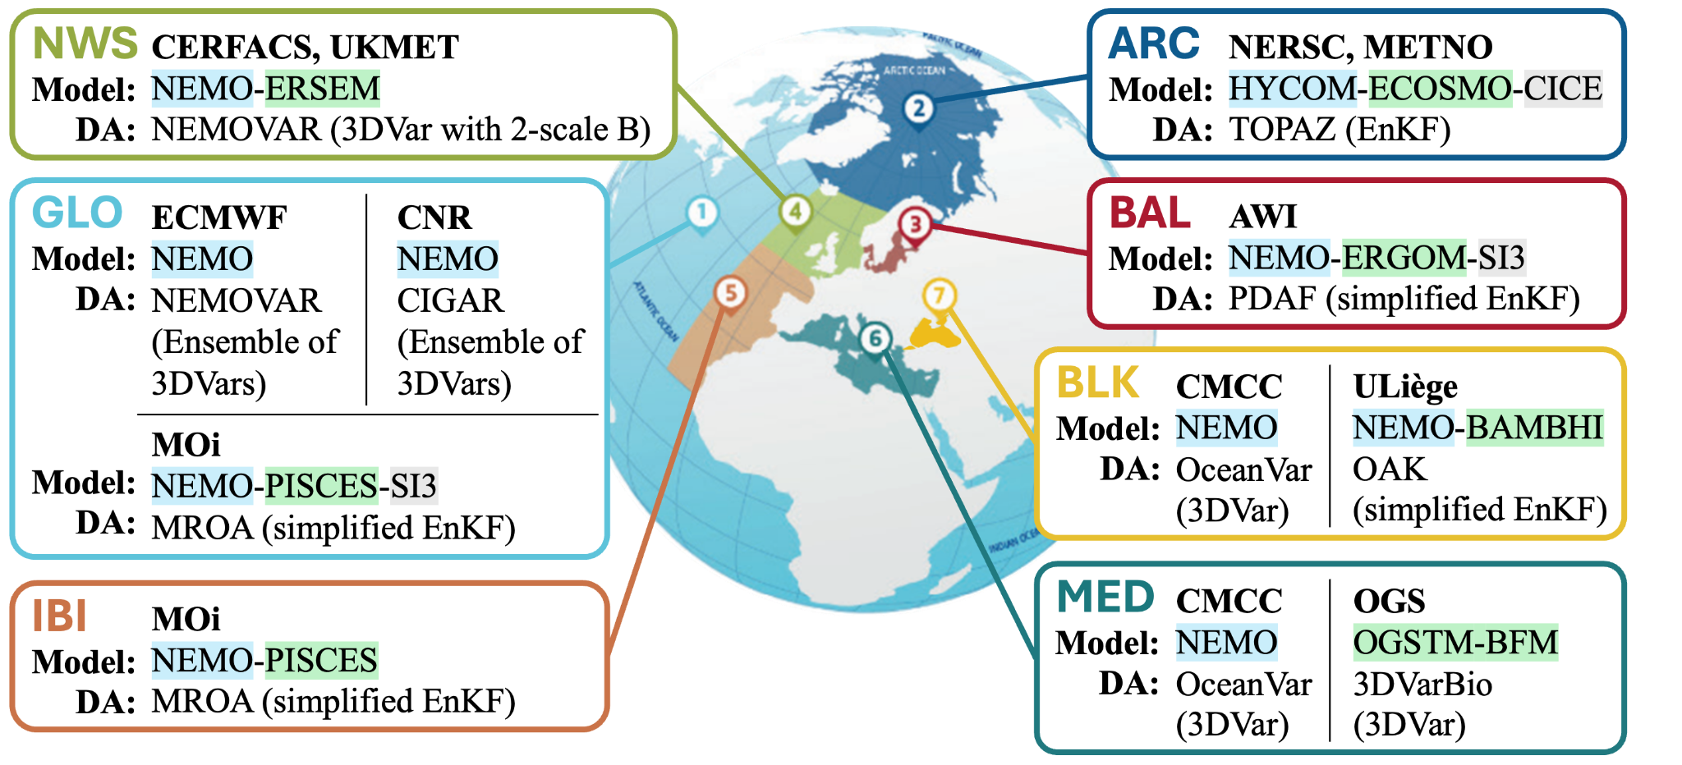
Operational DA in Copernicus Marine
20/24

Slide 22

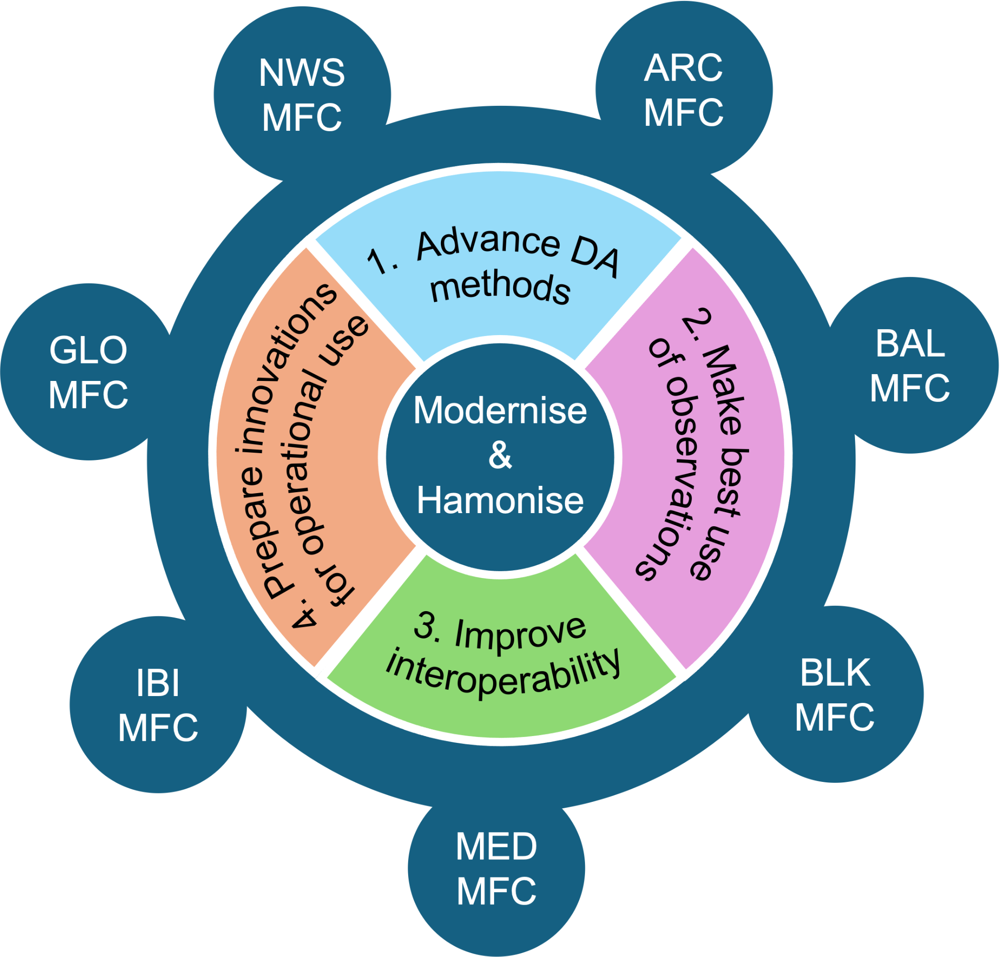
A new project!
EU Horizon
Coordinated by NERSC
11 partners
Starts September 2026
21/24

Slide 23
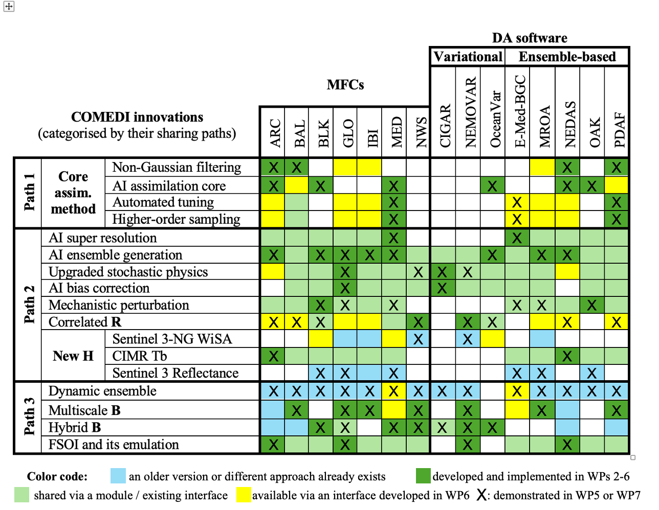
COMEDI: improving interoperability
22/24

Slide 24
DA algorithmic components - AI integration
Misc. transform of prior state/obs
such as scale decomposition, anamorphosis…
Assimilator:
EnKF (different variants)
other non-Gaussian filters (such as QCEF)
Updator:
Inverse transform
or other enhancement
observation
AI enhancements:
Super-resolution
Bias correction
Alignment
AI assimilation core?
Localization
“observation prior”
Assimilator
misc. transform
Inflation
Covariance
AI operators
prior state
Updator
posterior state
Perturbation
state-space
increment
AI ensemble generation
AI emulators
23/24

Slide 25
Take home message
NEDAS v1.2.0 has a cleaner architecture design and more DA methods implemented.
It’s been used in several geophysical models to test different aspects of DA systems.
Future work: to implement more DA innovations, including the use of AI, and compare methods in operational context.
NEDAS is open source: github.com/nansencenter/NEDAS
New: github.com/myying/NEDAS_tutorials
Thank you!
For contact: yue.ying@nersc.no
24/24

